Slide 1
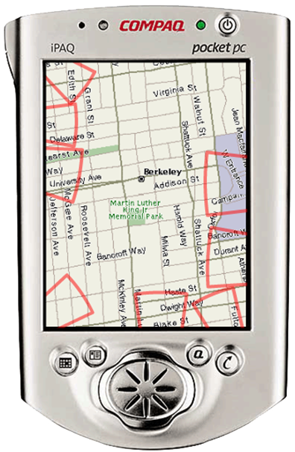
Sean Gustafson
master of science
thesis defense
Dec 15 / 2008
Visualizing
Off-Screen Locations on
Small Mobile Displays

Slide 2
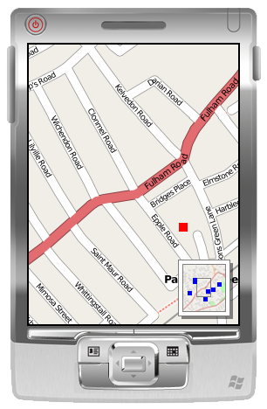
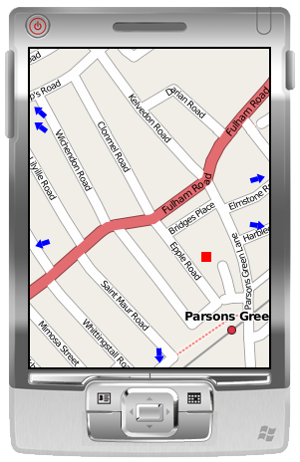
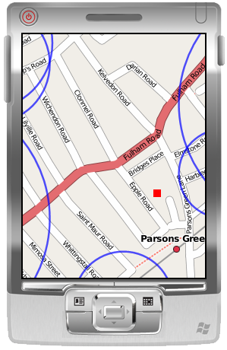
off-screen viz
overview
arrows
halo
f

Slide 3
rel
ated
work

Slide 4
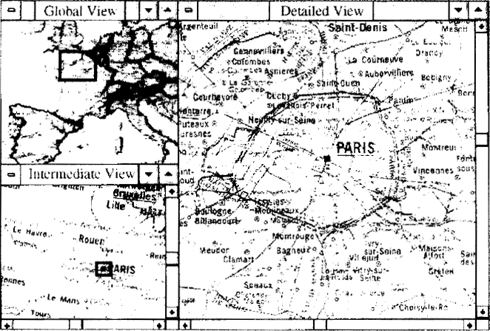
overviews
[Plaisant 95 and many others]

Slide 5
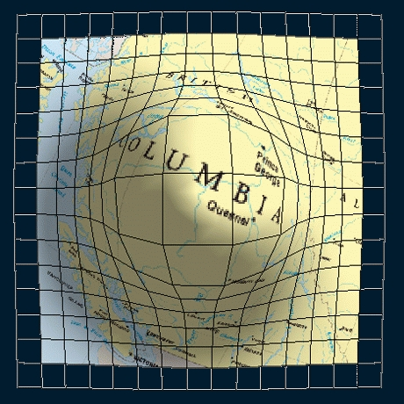
fisheye views
fisheye views
[Carpendale 01]

Slide 6
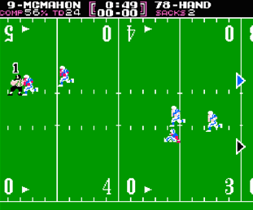
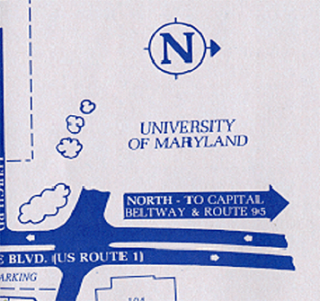
simple arrows
[Tecmo Bowl 87]

Slide 7
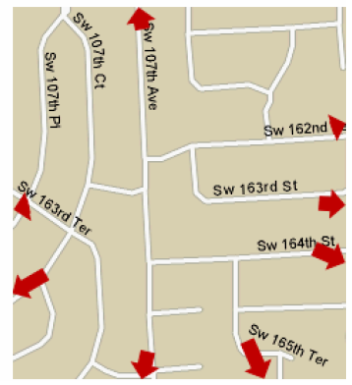
scaled and stretched arrows
[Burigat 06]

Slide 8
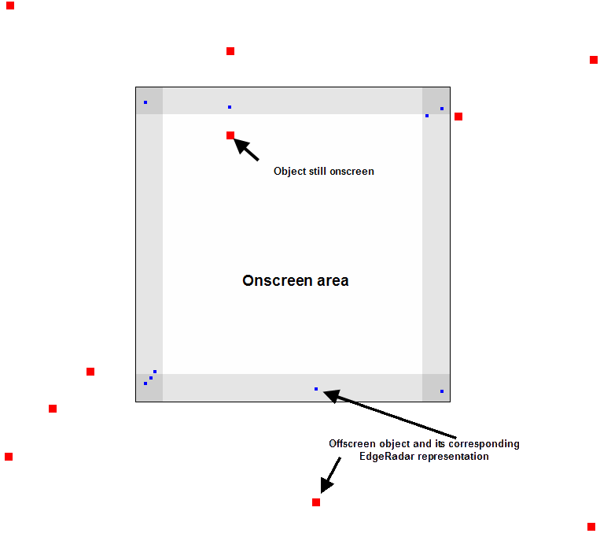
edgeradar
[Gustafson 07]

Slide 9
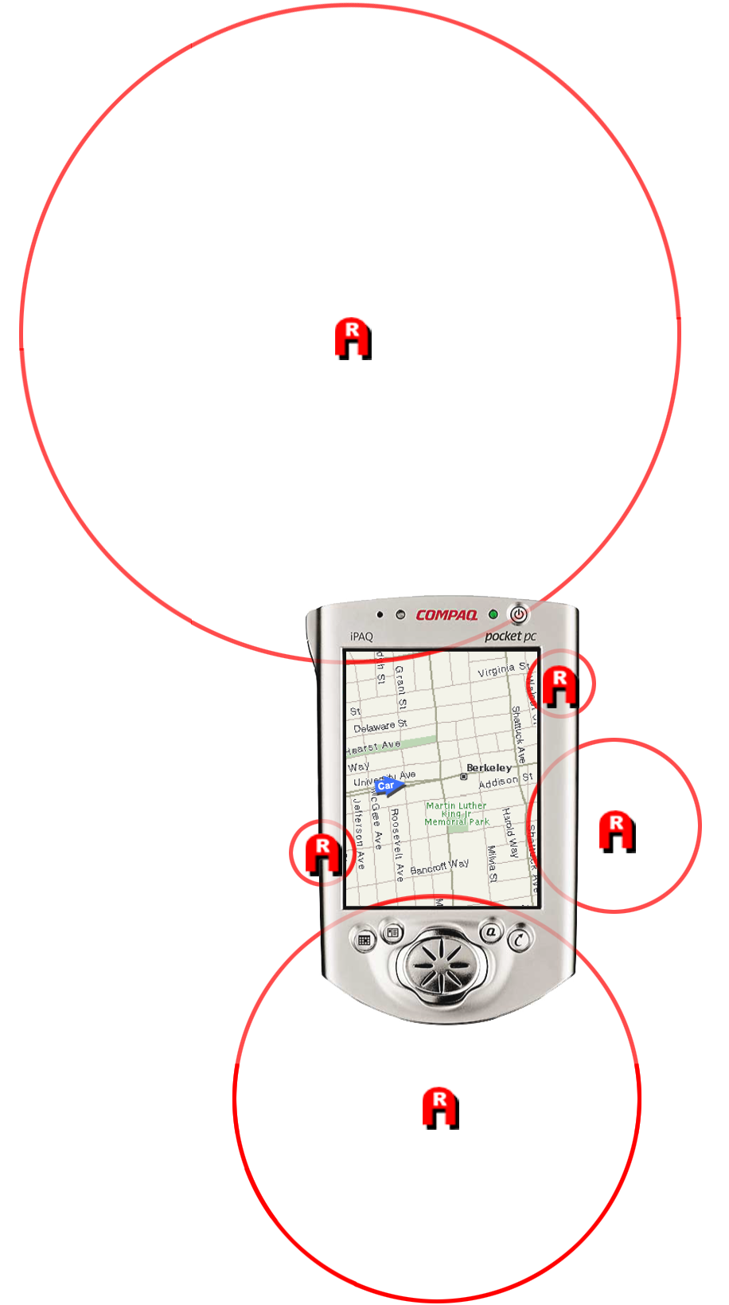
halo
[Baudisch 03]

Slide 10
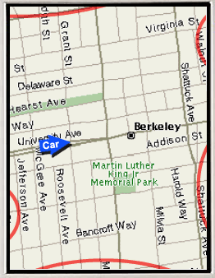
halo
[Baudisch 03]

Slide 11
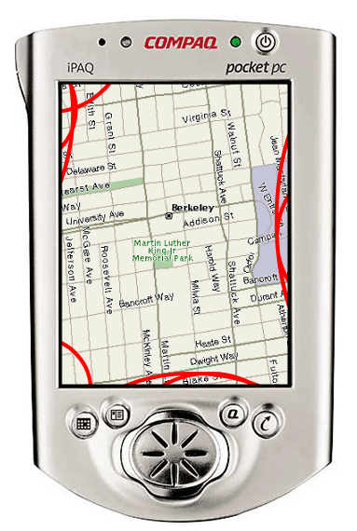
the problem: clutter

Slide 12
the problem: clutter
Notes:
Worst of all, arcs can be misinterpreted. As with these two arc, at a glance the overlapping sections ambiguously represent two different sets of targets.

Slide 13

(also not great: corners)
side
corner

Slide 14




initial approaches
clustering
ovals
Baudisch & Rosenholtz
Irani et al.
cut lines
color
separate
visually

Slide 15
th
e
wedge

Slide 16
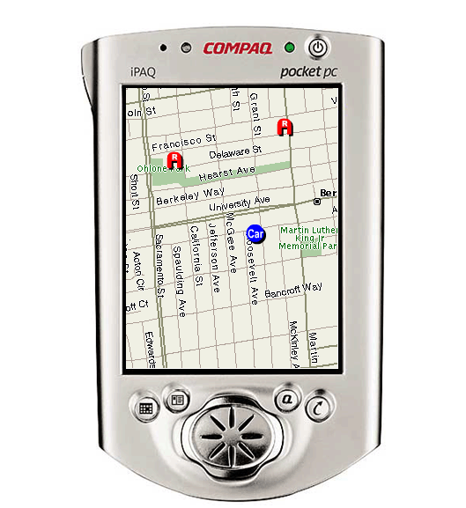
wedge
base
base
base
base
leg
leg
target

Slide 17
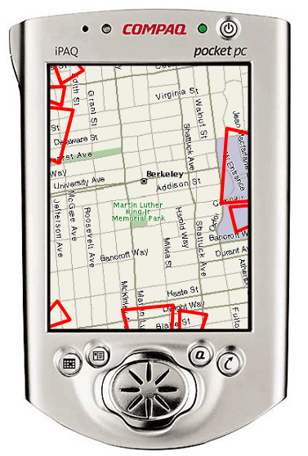
halo
wedge

Slide 18
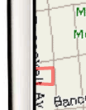
3 degrees of freedom
intrusion
base length
rotation

Slide 19
avoiding overlap
intrusion
rotation
base length

Slide 20
lay
out
algorithm

Slide 21
avoidance algorithm

Slide 22
avoidance algorithm

Slide 23
avoidance algorithm

Slide 24
avoidance algorithm

Slide 25
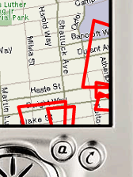
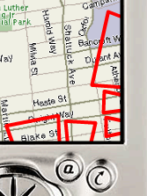
avoidance algorithm

Slide 26
leaves 2 degrees
intrusion ~ distance
base-width ~ distance

Slide 27
u
ser
study

Slide 28
two interface conditions
  halo and wedge

Slide 29
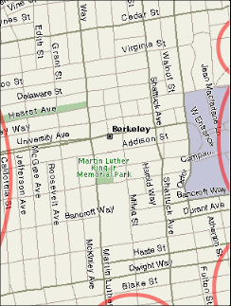
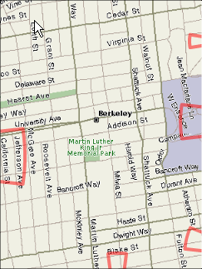
task 1: locate
same as original halo paper
halo
wedge

Slide 30
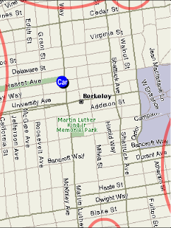
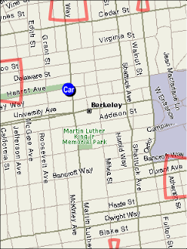
task 2: closest
same as original halo paper
halo
wedge

Slide 31
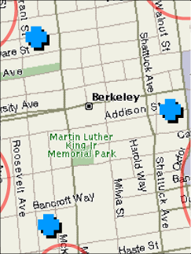
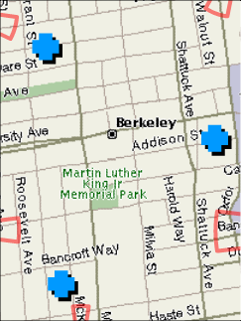
task 3: avoid
same as original halo paper
halo
wedge

Slide 32
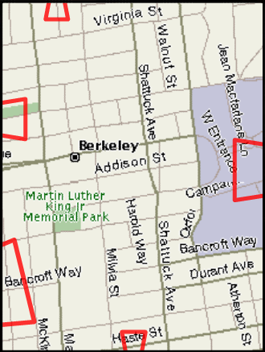
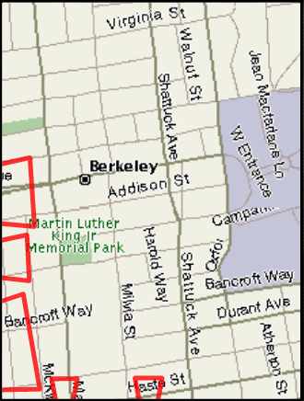
IV: density
sparse
dense

Slide 33
IV: corner
side
corner

Slide 34
36 participants

Slide 35
hypotheses
1. wedge is more accurate
larger improvement in dense condition
larger improvement in corners
(no hypothesis about task time)

Slide 36
results

Slide 37
participants were significantly more accurate when using the wedge

Slide 38
error in pixels
Side
80
Halo
Wedge
60
Error (pixels)
40
20
0
Dense
Sparse
locate task

Slide 39
error in pixels
Side
Corner
80
Halo
Wedge
60
Error (pixels)
40
20
0
Dense
Sparse
Dense
Sparse
locate task

Slide 40
other results
no interesting results from the other tasks or from completion time.

Slide 41
other results
preferences
 | Wedge | Halo | No Preference
Locate | 25 | 10 | 1
Avoid | 21 | 13 | 2
Closest | 18 | 14 | 4

Slide 42
hypotheses
✓
1. wedge is more accurate
larger improvement in dense condition
larger improvement in corners
✓
✓

Slide 43
mod
eling
pointing

Slide 45
beam

Slide 46
beam

Slide 47
beam
beam

Slide 48
beam
orbital
beam

Slide 49
intrusion

Slide 50
intrusion

Slide 51
aperture

Slide 52
aperture

Slide 53
rotation

Slide 54
rotation

Slide 55
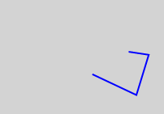
data collection
experiment to gather accuracy data

Slide 56
data collection
experiment to gather accuracy data
legLength1
distance
baseLength
legLength2

Slide 57
results
60
0
50
-60
60
0
100
-60
60
Distance
Breadth Error
0
200
-60
60
0
300
-60
-100
0
100
200
300
Depth Error

Slide 58
results
60
length
width
0
bias
-60
-100
0
100
200
300
Depth Error

Slide 59
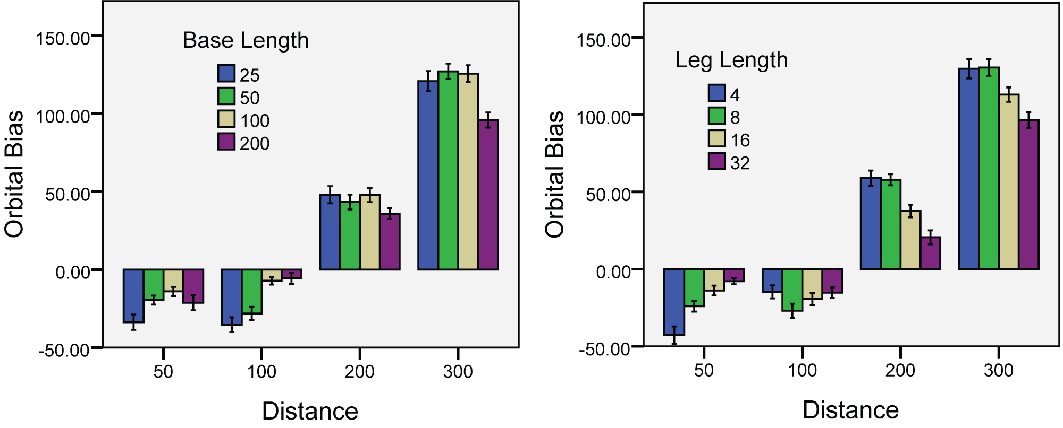
results - bias

Slide 60
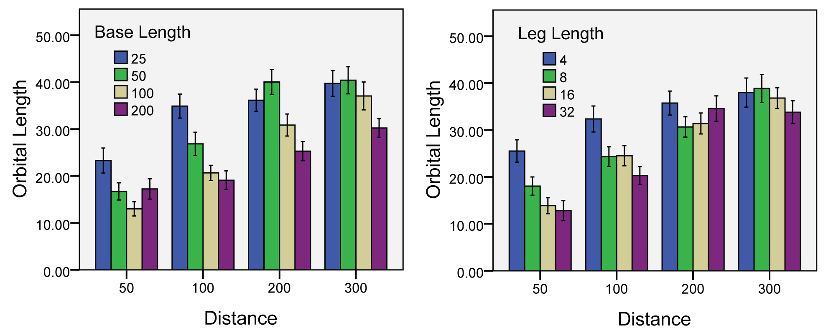
results - length

Slide 61
minimizing errors
choose smallest base and leg length that still maintains small orbital and low bias
base length of at least 50px, 100px for longer distances
a large leg length (above 8px) does not result in smaller orbital
avoid heavily rotating wedges

Slide 62
conclusion

Slide 63
contributions
summary of existing techniques and criteria for evaluating them
introduction of Wedge
introduction of the concept of degrees of freedom and dynamic layout
evaluation of Wedge
preliminary model

Slide 64
thanks

Slide 66
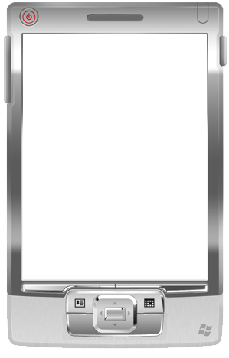
IV: density
1
2
sparse
3
4
dense

Slide 68

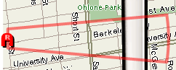
correcting errors

Slide 69
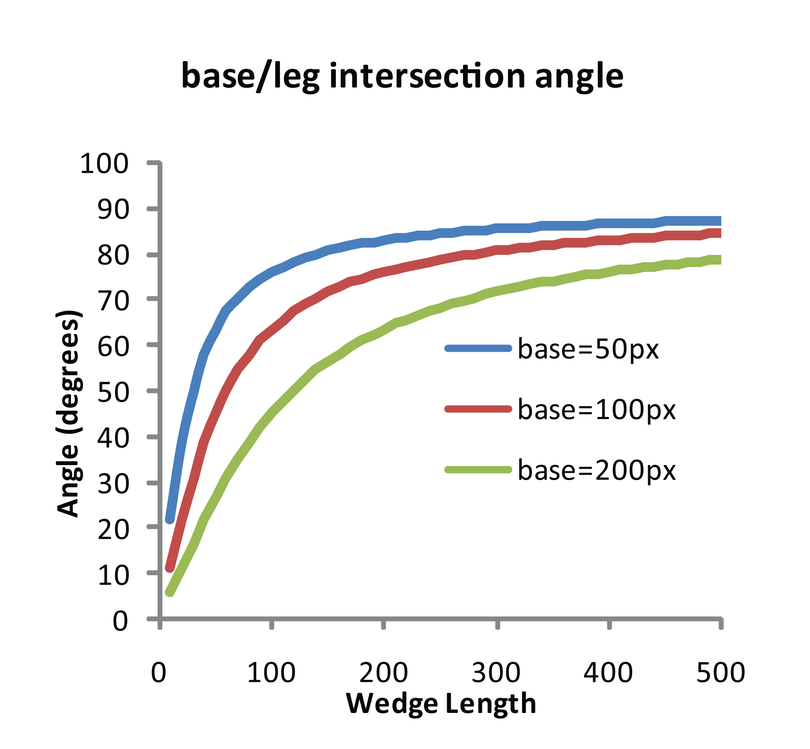
correcting errors

Slide 71
wedge=
uni
fied
pointing

Slide 72
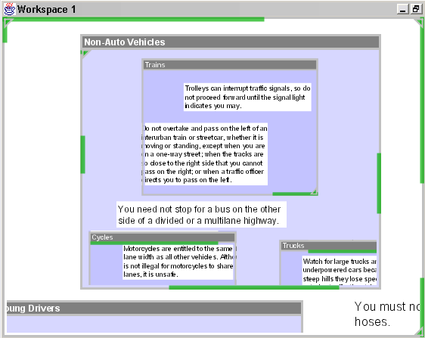
intrusion → 0
citylights

Slide 73
aperture → 0
stretched arrows

Slide 74
?
halo

Slide 75
distance information in corner
distance information along arc
round bases

Slide 76
aperture → 360
halo

Slide 78
full results
Corner
Side
Corner
Side
80
Halo
3000
Halo
Wedge
Wedge
60
2000
Error (pixels)
Time (ms)
40
20
1000
0
0
Dense
Sparse
Dense
Sparse
Dense
Sparse
Dense
Sparse
locate task

Slide 79
full results
Corner
Side
Corner
Side
50
Halo
Halo
Wedge
5000
Wedge
40
4000
30
Error Rate %
3000
Time (ms)
20
2000
10
1000
0
0
Dense
Sparse
Dense
Sparse
Dense
Sparse
Dense
Sparse
avoid task

Slide 80
full results
Corner
Side
Corner
Side
Halo
Halo
60
Wedge
Wedge
6000
40
Time (ms)
4000
Error Rate %
20
2000
0
0
Dense
Sparse
Dense
Sparse
Dense
Sparse
Dense
Sparse
closest task

