Slide 1
Soliciting Reader Contributions to Software Tutorials
M. Sc. Thesis:
Patrick Dubois
Supervisor: Dr. Andrea Bunt
January 30th, 2017

Slide 2
Notes:
Tutorials in text-and-image format, e.g. not video
incomplete, errors or omissions
targeted to different skill levels or software or software versions

Slide 3
Notes:
One way to address these challenges is through comments

Slide 4
Notes:
Thanks are not useless
This thesis, we describe an approach to getting these user contributions
We look at how the design of the interface impacts how/what users contribute

Slide 5
Contributions
Model for community enhancements
Multi-session evaluation
Design considerations

Slide 6
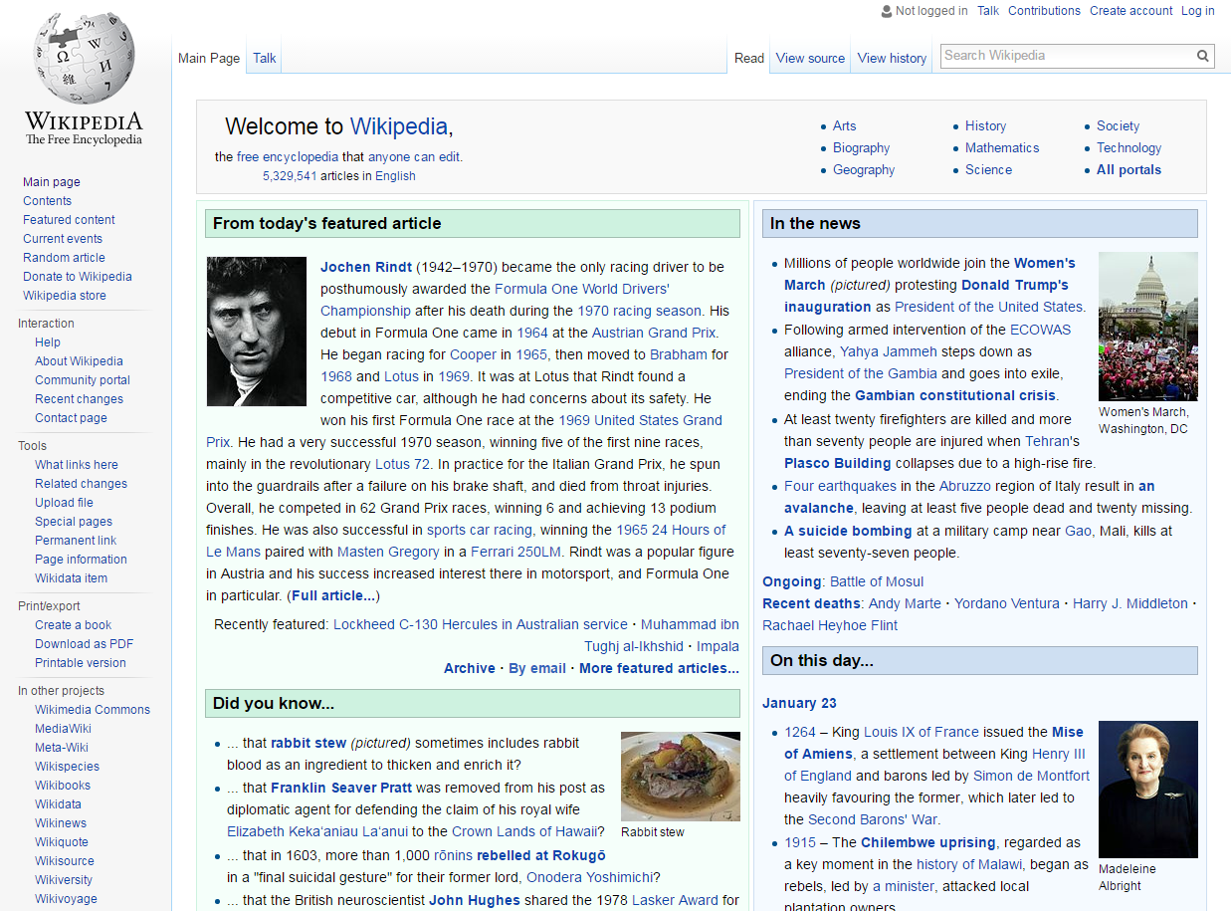
Notes:
Authors
But not a complete source, want different perspectives.

Slide 7
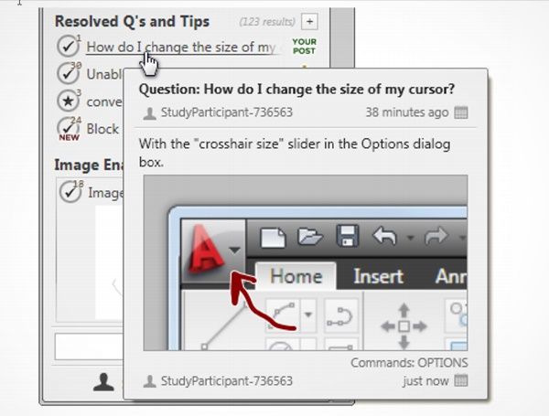
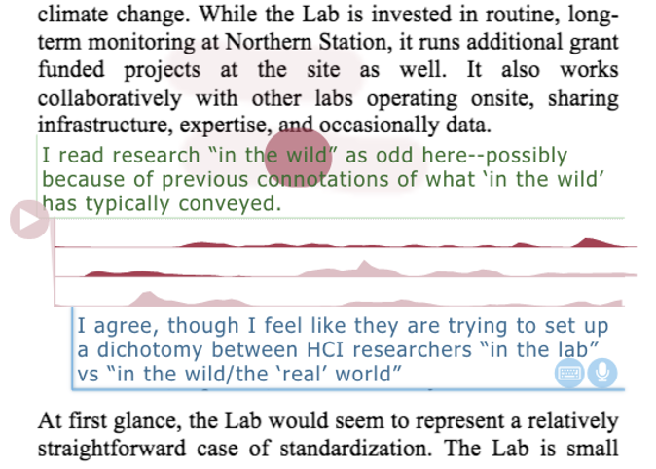
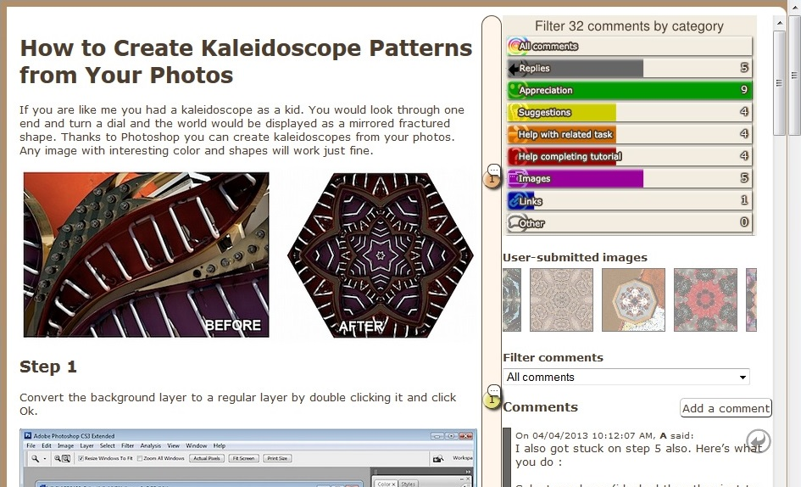
Matejka et al. (2011)
Yoon et al. (2016)
Bunt et al. (2014)
Notes:
TaggedComments
RichReview++
IP-QAT

Slide 8
Questions
How can contributions be integrated into tutorials?
How does the interface impact frequency and content of submissions?
Notes:
How can community contributions be integrated into software tutorials in such a way as to respect tutorial authors’ reasons for posting initial tutorials?
How does the manner in which the interface solicits contributions impact the frequency and content of submissions?

Slide 9
Notes:
Notes within tutorial, after a step

Slide 10
Tell me more!
What is this?
Corrections
Questions
Other
Notes:
Previous research found categories reflecting existing commenting behaviour
Created categories to encourage more useful notes

Slide 12
Antorial
Notes instead of comments
Guides contributions via categories
Scopes notes to tutorial steps
Promotes the importance of notes

Slide 13
Multi-Session Evaluation

Slide 14
Participants & Tasks
13 (+1 dropped) expert Photoshop users
Improve tutorials using notes
Tutorials might be used as course material
Notes:
1 dropped, 4 female

Slide 15
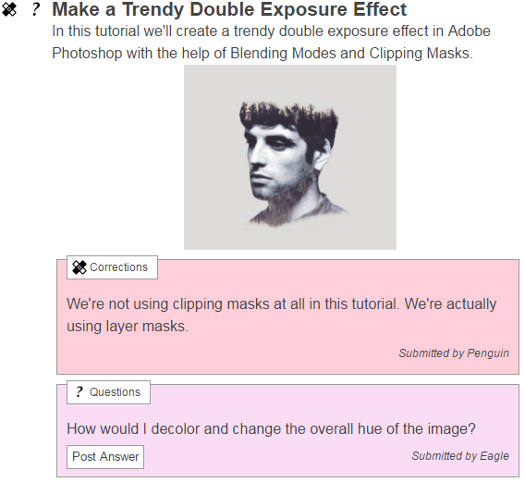
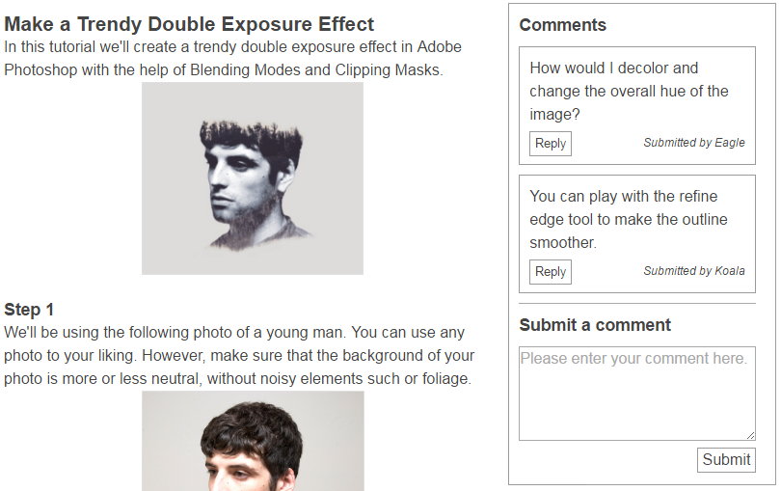
Antorial
Baseline
Notes:
Similar efficiency

Slide 16
Procedure
Meet participant
Antorial
Set 1
Questionnaire
Baseline
Set 2
Questionnaire
Semi-structured interview
Set 2
Set 1
Baseline
Set 1
Antorial
Set 2
Set 2
Set 1
Notes:
Counterbalanced
Within-subjects

Slide 17
Pre-seeded Notes
Is there a tool that might make selecting the flowers more efficient?
You can play with the refine edge tool to make the outline smoother.
Notes:
1 question
2 Tell me more/What is this
Can’t see others’ notes

Slide 18
Evaluation Results
Notes:
Submitted notes
Questionnaires
Interviews were transcribed
In interest of time, only discuss those of interest

Slide 19
Mean number of notes per participant
Mean number of words per note
p < 0.05
*Error bars represent standard error
Notes:
RM-ANOVA: statistically significant difference
Total: 319, 192 (Antorial) 127 (Baseline)
“step 1:”

Slide 20
Notes:
Correcting workflow (27-5)
Correcting wording or grammar (4-13)

Slide 21
Target Audience
Majority of notes targeted tutorial author
Content always more elaborate when targeting readers
Notes:
CHI-squared test
Most notes were not categorized correctly
Reader, tutorial author, general. Mostly to author.
Word or sentence, single step, multiple steps, tutorial, additional step. Mostly single step.
Critique, supplemental. Mostly supplemental. If reader, all supplemental.

Slide 22
Overall Preference
5 preferred Antorial
5 preferred the baseline
3 were neutral
Notes:
Transcribed interviews
Grouped into themes (?)

Slide 23
Antorial Facilitates Specificity
[Antorial] is more specific than [the baseline] […] The [baseline] is just for regular stuff, [Antorial] is much more specific. (P1)
Notes:
Participants –felt– more specific with Antorial
Don’t need to mention step number

Slide 24
Categories Guide Contributions
[The] icon guided me to make my comments. […] I would go here and say ‘maybe I need to look for something I don't understand, or something to correct. (P3)
Notes:
Second design goal: guiding contributors towards posting beneficial notes
Suggest what kind of notes would help

Slide 25
Categories can be Restrictive
I knew what my comment was but I really had a hard time figuring out what the category should be. (P11)
Notes:
Can’t find a good category, or too much thought
Preferred freeform
Overall, need refinement, still open to see how much they actually help

Slide 26
Drawbacks of Hidden Notes
More discussion with [the baseline]. It feels more like the commenting section - it feels like you'd have more discussion with the other artists than on [Antorial]. (P9)
Notes:
Encouraged discussion
See what’s there
Community felt more interactive, get help quickly

Slide 27
Benefits of Hidden Notes
I didn't want to annoy other people and post a lot. So I combined all the things I had to say step by step into one tutorial, by the end of it. (P11)
Notes:
Concerned with taking over conversation, group comments in longer notes
Particular participant posted many more notes with Antorial (22 to 5), but with Antorial, was more descriptive

Slide 28
Design Considerations
Categories can guide contributions, if done well
Layout impacts behaviour
Emphasize learners as audience

Slide 29
Limitations and Future Work
Few, expert participants
Study procedure may have limited contributions
Generalizing to other formats and domains
Notes:
1: Few, all experts
2: Improve tutorial, no communicating
3: Other formats (video), other software, other domains

Slide 30
Contributions
Model for community enhancements
Multi-session evaluation
Design considerations
Notes:
Expand on these!

Slide 31
Thanks!
Notes:
Thank committee

