Slide 1
Robot Pets for Everyone:
The Untapped Potential for Domestic Social Robots
Rahatul Amin Ananto
anantor@myumanitoba.ca
University of Manitoba

Slide 2
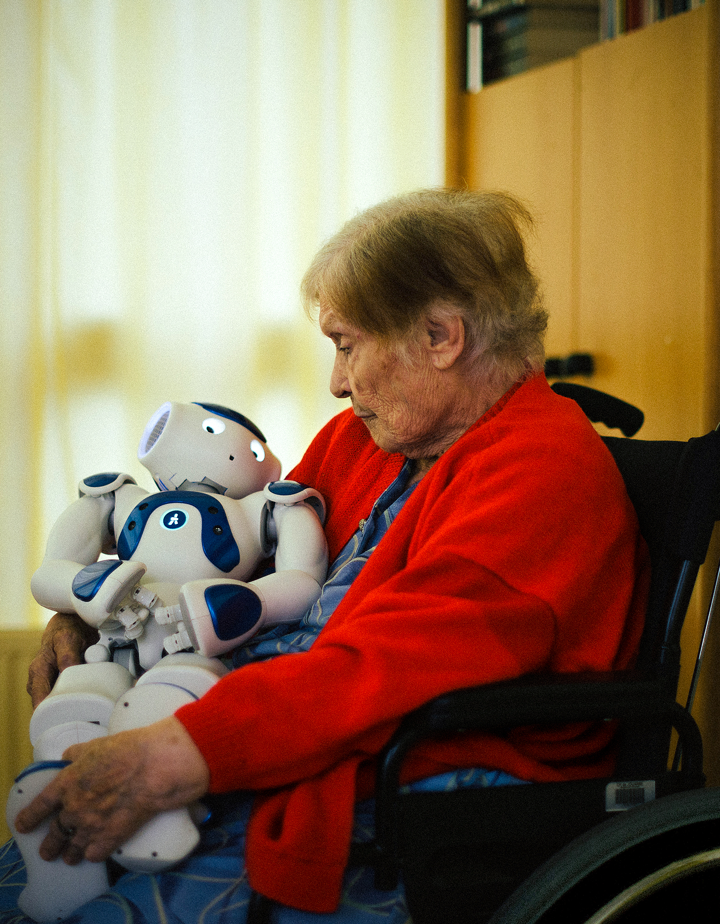
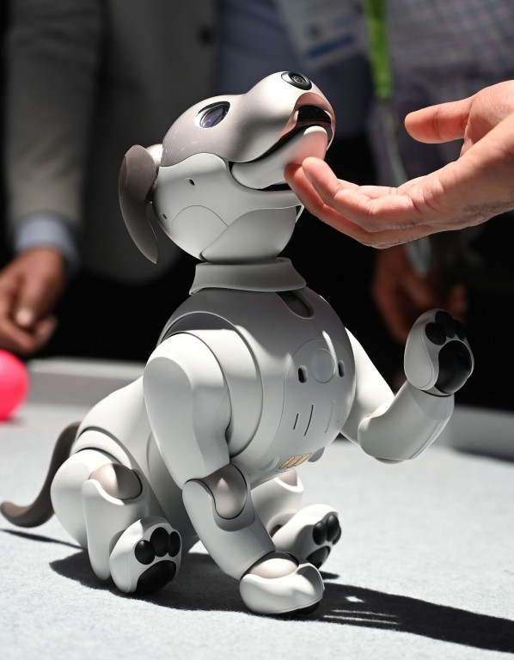

1 2 3
social robots interact like living things
social robots had successes in care homes and clinical practices
not a lot of people adopt social robots into their homes
https://www.nytimes.com/interactive/2018/11/23/technology/robot-nurse-zora.html 2. https://www.scmp.com/week-asia/society/article/3004622/are-companion-robots-cure-asias-emerging-loneliness-epidemic
3. https://www.japantrendshop.com/paro-robot-seal-healing-pet-p-144.html

Slide 3
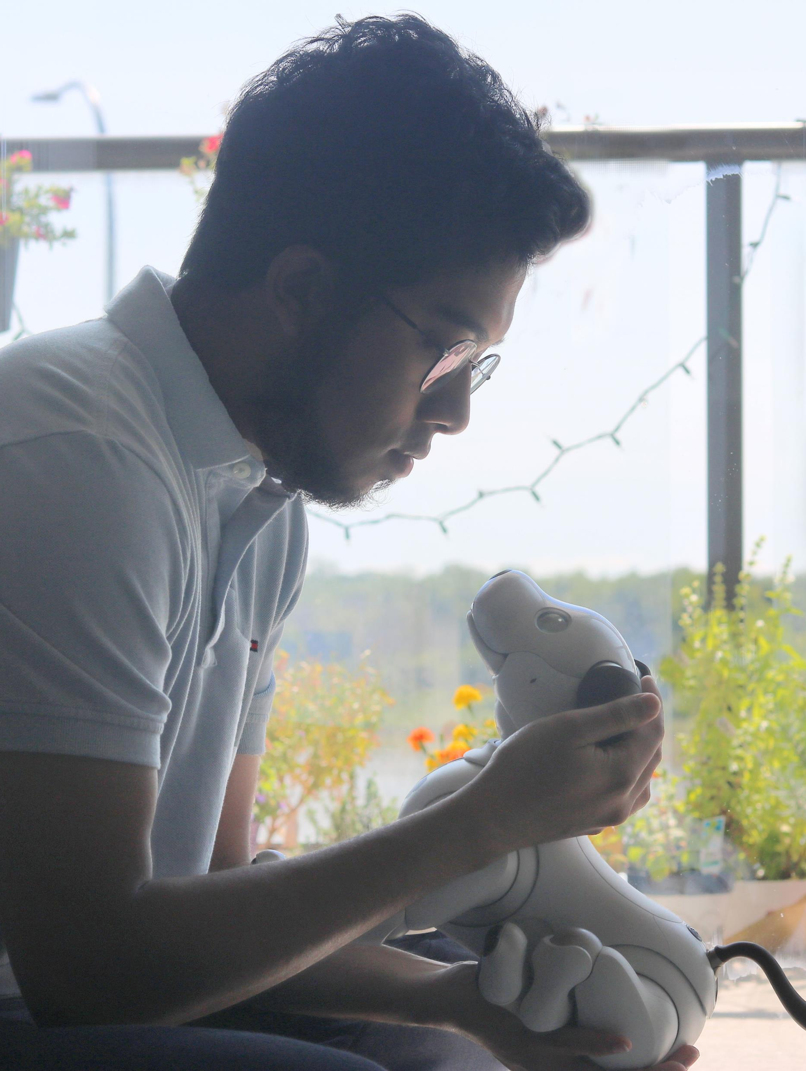
Why don’t we have successful domestic robots
most work on clinical or in lab studies
  relies heavily on Wizard-of-Oz
  does not reflect real-world use
existing social robots may not be suitable for homes
need more research

Slide 4
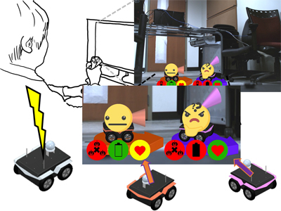
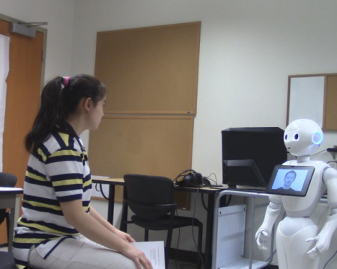
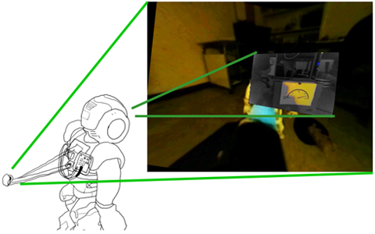
Agenda to Develop Improved Domestic Robots
Involving users early-on and throughout (e.g., User-Centered Design)
Human-robot communication
doi.org/10.1007/s12369-020-00670-9
Human-robot interaction
doi.org/10.1145/3284432.3284447
Robot-teleoperation
doi.org/10.1109/ROMAN.2017.8172419

Slide 5
Agenda to Develop Improved Domestic Robots
Participatory Design
Short-term Usability Study
Long-term Acceptance Study

Slide 6
Conclusion
understanding the issues is important
more research work is needed
may help developers create better domestic robots

Slide 7

Thank You
Rahatul Amin Ananto
anantor@myumanitoba.ca
University of Manitoba

