Slide 1
Design and Implementation of a Novel Conversational Companion Robot For Older Adults
M.Sc. Thesis Defense
Adriana Lorena González De la Garza
Advisor: James E. Young
March 1st, 2022

Slide 2
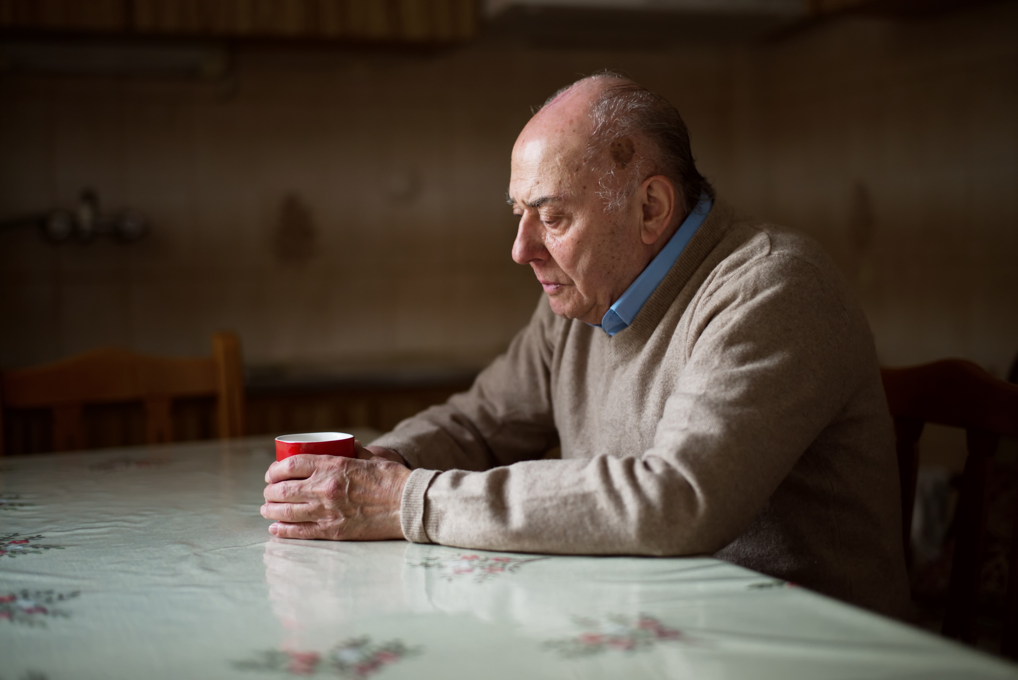
BACKGROUND
Older population is increasing
As social circles decrease, older adults face loneliness
Image from: https://today.uconn.edu/2020/11/older-adults-pandemic-loneliness/#

Slide 3
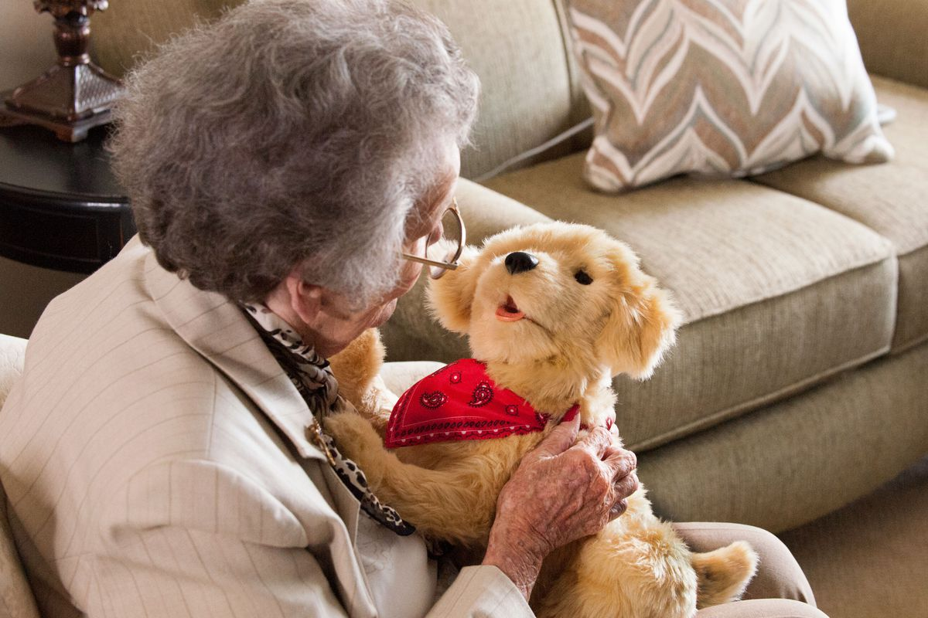
BACKGROUND
Social robots
Animal-like robots
Humanoids and healthy older adults
Image from: https://www.vox.com/2016/10/11/13149824/robot-dog-elderly-companion-cat-pets-paro-seal-hasbro

Slide 4
HUMANOIDS
More complex interactions
Leverage conversation
Working with robots is hard
Simple robot for self-reflection

Slide 5
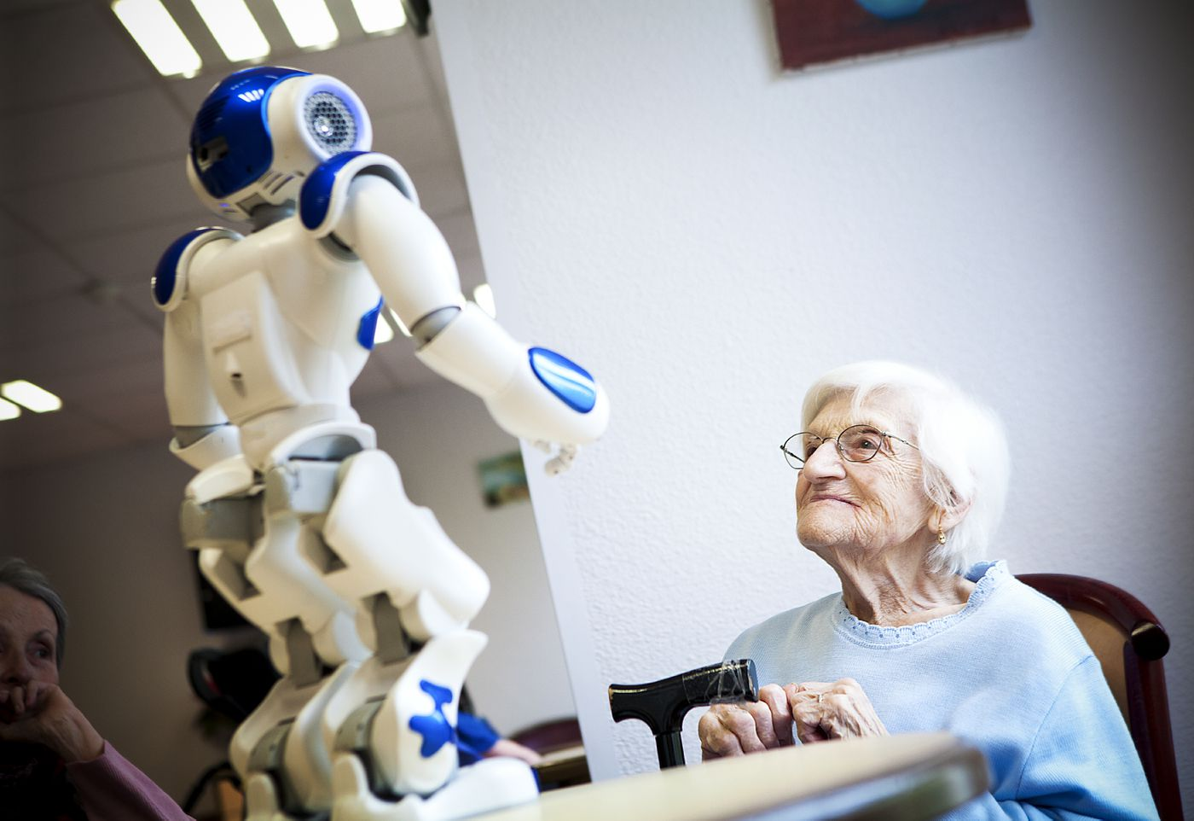
OUR IDEA
Simple conversational companion robot
Healthy older adults in their natural environment
Understand feasibility
Image from: https://www.vox.com/future-perfect/2020/9/9/21418390/robots-pandemic-loneliness-isolation-elderly-seniors

Slide 6
RESEARCH QUESTIONS
Technical feasibility– is it plausible to design and deploy a conversational robot for self reflection that is fully unsupervised and autonomous?
Domestic integration feasibility– would people accept a conversational robot into their homes: their social and physical spaces and routines?
Self-reflection feasibility– are people able to use a conversational robot to engage in self reflection with the potential for meaningful interaction?

Slide 7
RESEARCH QUESTIONS
Technical feasibility
Domestic integration feasibility
Self-reflection feasibility

Slide 8
TECHNICAL FEASIBILITY
Autonomous robot for self-reflection
Guiding goals
Brainstorm feasible interactions

Slide 9
INTERACTION DESIGN GUIDING GOALS
Interaction simplicity
Implementation simplicity
Social engagement
Expectation management
Safety and privacy

Slide 10
CHOSEN BEHAVIOR
Reflective listening with prods

Slide 11
CHOSEN BEHAVIOR
Meeting our goals
Interaction simplicity
Implementation simplicity
Social engagement
Expectation management
Safety and privacy

Slide 12
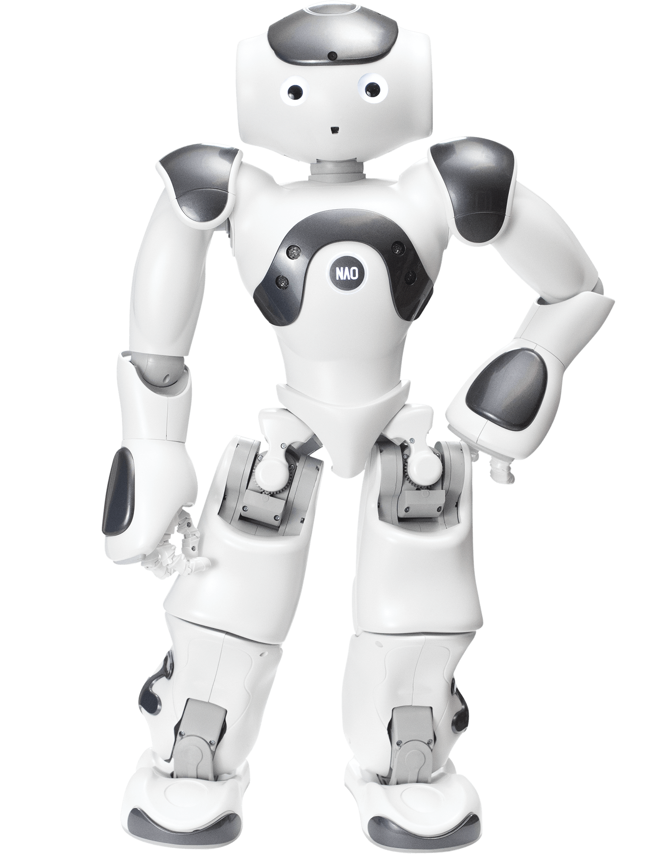
IMPLEMENTATION
Unsupervised robot for self-reflection
NAO robot
Algorithm to detect conversation stops
Technical feasibility

Slide 13
RESEARCH QUESTIONS
Technical feasibility
Domestic integration feasibility
Self-reflection feasibility

Slide 14
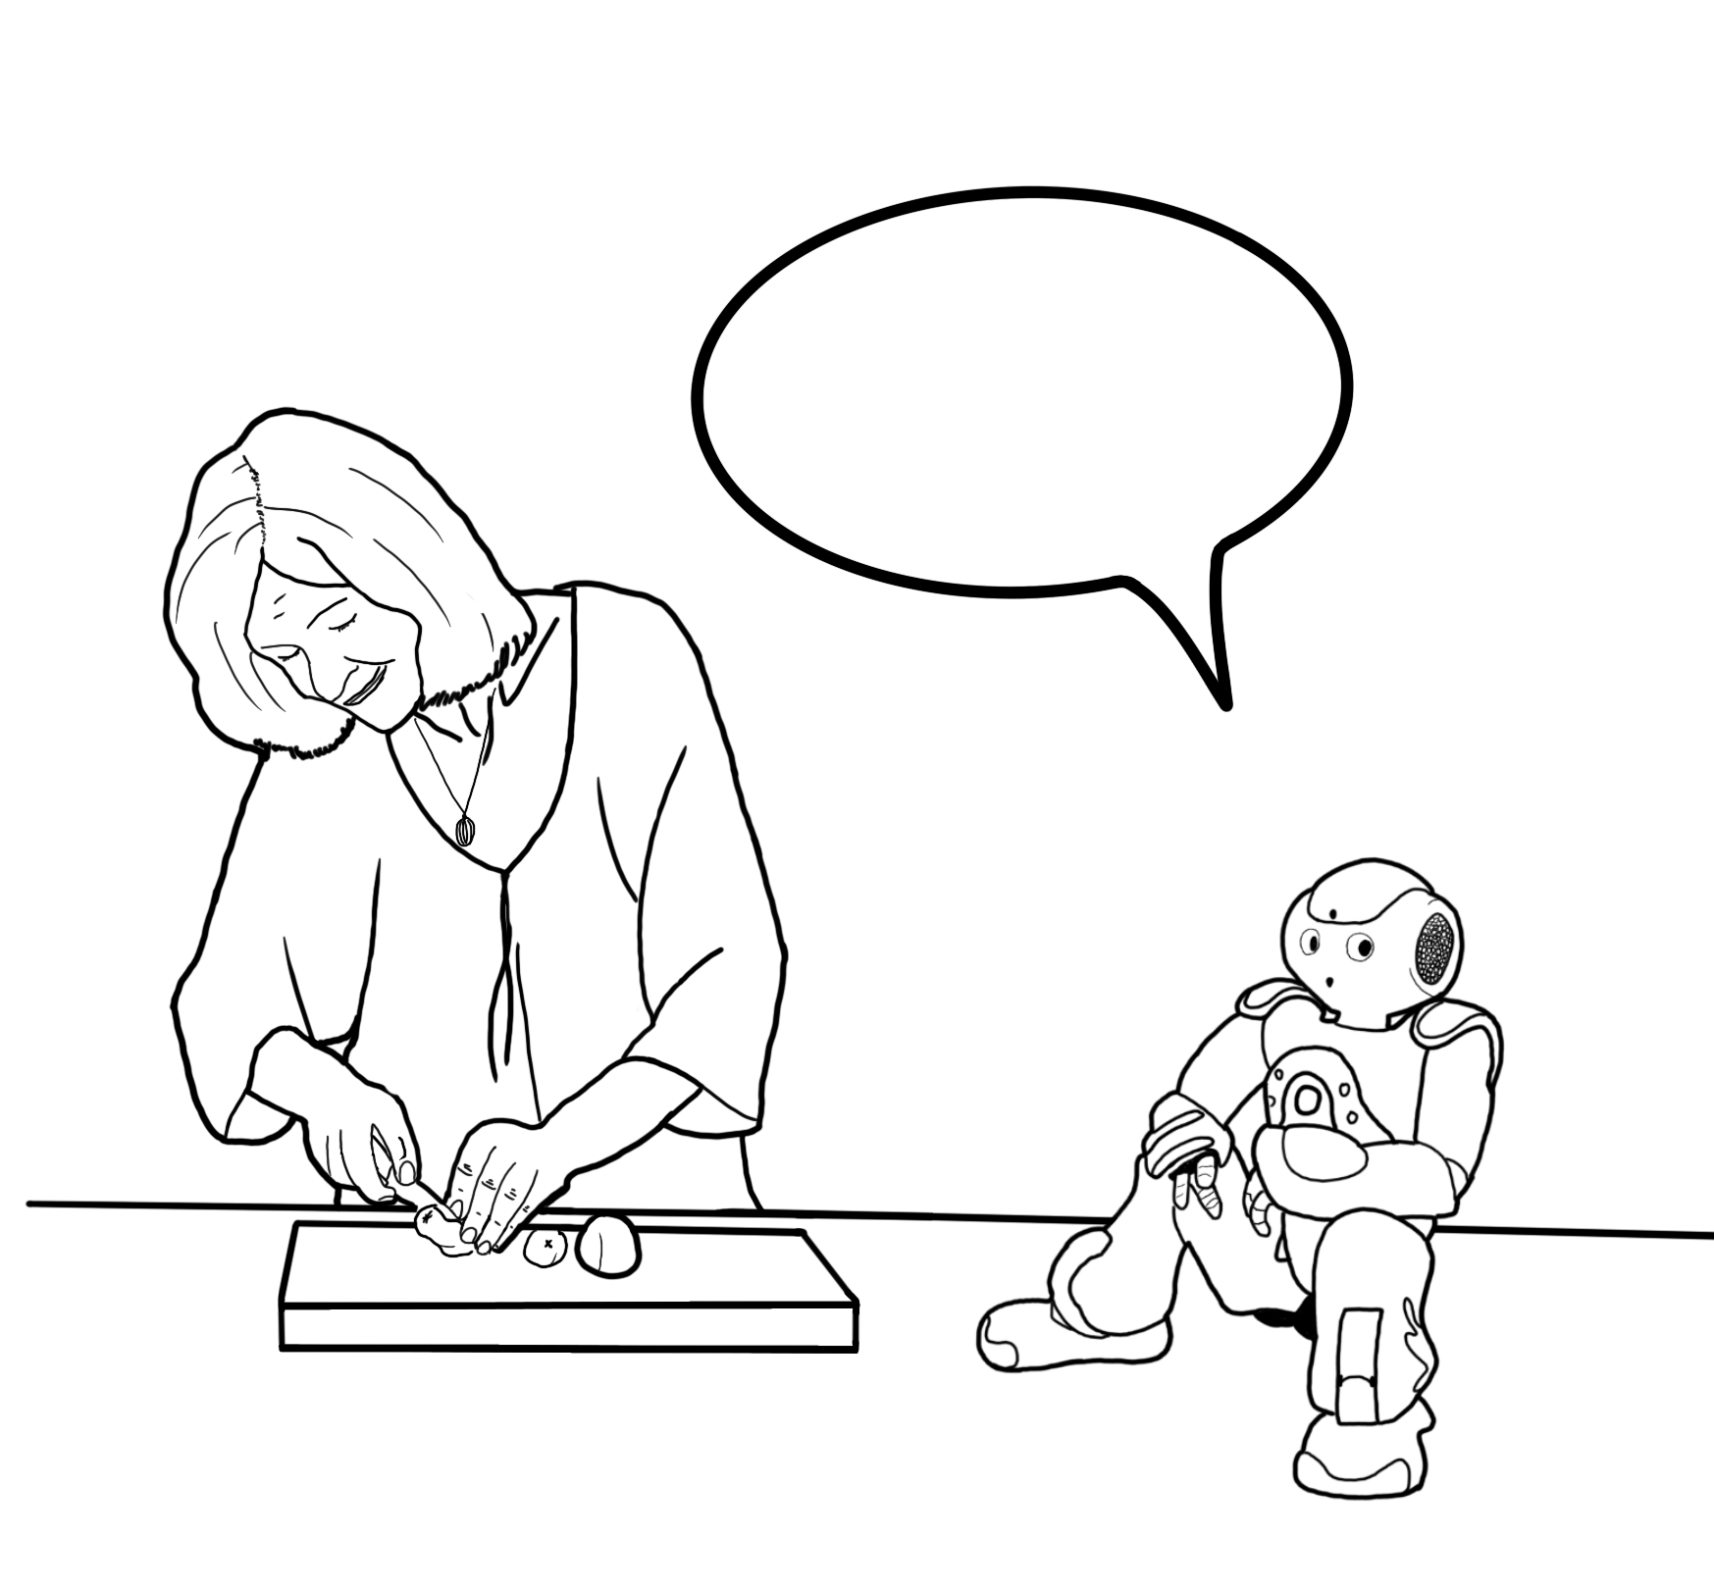
STUDY
Three-day study
Healthy older adults living alone
14 participants (> 65)
Use the robot whenever they wanted

Slide 15
MEASURES
Logged the interactions
Initial and exit interviews
Standardized questionnaires

Slide 16
STUDY GOALS
Effectiveness and usefulness
Perception of the behavior
Long term use

Slide 17
STUDY GOALS
Effectiveness and usefulness
Perception of the behavior
Thoughts on long-term use

Slide 18
RESULTS
Robot and behavior feasibility
Usefulness of conversational robot
Interaction and physical design
Overall suggestions and thoughts

Slide 19
EFECTIVENESS
Ease of use
“[I have to] wait for the beep but otherwise it’s pretty simple” – P1, intake
“I found it very easy to use, I wasn't apprehensive about using it […] because of the limited first knowledge I needed” – P5, exit

Slide 20
EFFECTIVENESS
Expectation management
“If I had higher expectations, it probably would have affected me, but I didn't have any expectations after your explanation on the first day” – P9, exit

Slide 21
EFFECTIVENESS
Robot at home
“It was not intrusive at all. I mean, it just sat there on the table until I want to have a session and then it was out of the way again” – P9, exit

Slide 22
USEFULNESS
Social catalyst
“They (family) were interested in something like this being developed. … there is a need for this out there” – P12, exit
“My grandchildren were very fascinated too, […] I FaceTimed them about and showed them how the robot was acting” – P1, exit

Slide 23
USEFULNESS
Self-reflection
9/14 were encouraged by the robot for reflection
“The prompt takes you out of your head. You're listening to yourself talk, that's kind of interesting” – P3, exit
“At the very beginning […] I was not very forthcoming […]but the more that we chatted, the more forthcoming I became” – P12, exit
“Clearly having the robot there pushed me to think about these things and behave in a way that I wouldn't have ordinarily” – P6, exit

Slide 24
USEFULNESS - CONVERSATION
Potential to help with loneliness
“It's good company. My daughter says I'm antisocial. I like to be alone, but I turn the robot on. I don't feel so lonely” – P11, exit
“For somebody that’s homebound […], it might be worthwhile to have this. […] It's not going to solve any problems, but sometimes just talking about it makes a world of difference” – P9, exit

Slide 25
PERCEPTION
Questions and simplicity
“I would like to be able to sit down and say talk about family, and questions would come up on it. […] Still generic but in topics” – P12, exit
“The robot is great, it’s unjudgmental, but also unfeeling, and so, you'd want something that you could feel was actually, really, following up” -P7, exit

Slide 26
PERCEPTION
Movements and anthropomorphism
“Its movements were interesting, the gestures it would make were appropriate. The way it asked the question it was inviting” – P1, exit
“It is very lifelike in the way its hands and legs move” – P5, exit

Slide 27
DISCUSSION
Study goals
Behavior's effectiveness
Perception of behavior and design
Thoughts on long-term use

Slide 28
CONCLUSION
Technical feasibility
Domestic integration feasibility
Self-reflection feasibility

Slide 29
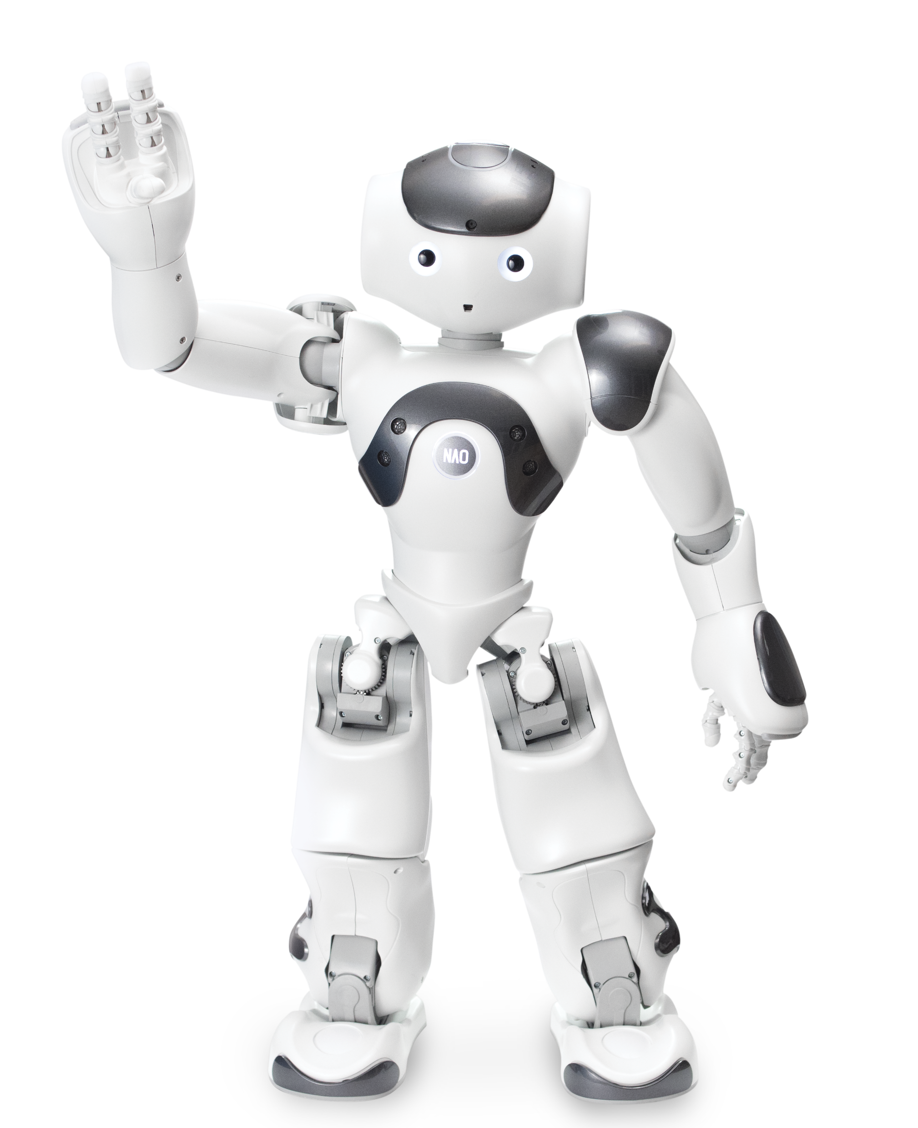
FUTURE WORK
Improve robotic behavior
Test long-term deployment of robot

Slide 30
CONTRIBUTIONS
Conversational behavior design
Simple deployable offline robot
Effectiveness and performance of behavior
Proof of concept for future long-term deployment

Slide 31
Design and Implementation of a Novel Conversational Companion Robot For Older Adults
MSc Thesis Defense
Adriana Lorena González De la Garza
Advisor: James E. Young
March 1st, 2022

Slide 33
Participants
14 people 65+
participants between 66 and 88 years old, only 2 were male (mean=71.5, SD=6.74).
Rather than having a more diverse sample, we made this decision to be able to better reflect on usability and reactions for a specific demographic. As well, it opens the possibility of studying the effects on loneliness in older adults in future long-term studies after having feedback from the same age demographic on how to improve it.

Slide 34
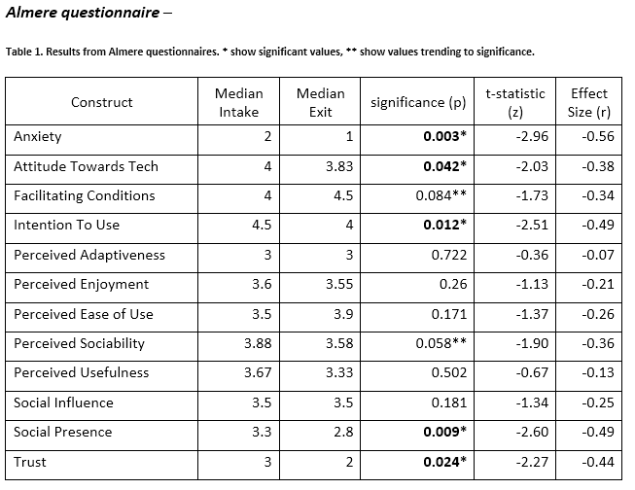
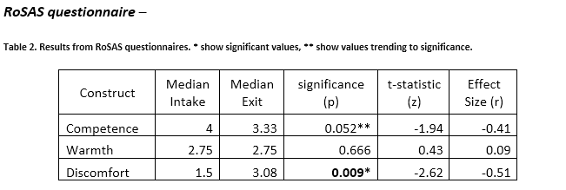

Slide 35
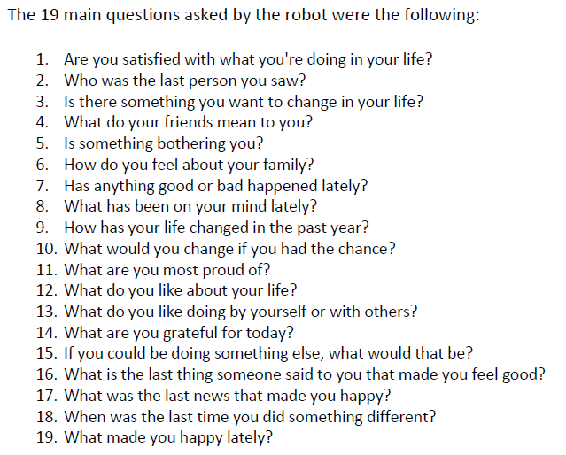

Slide 37
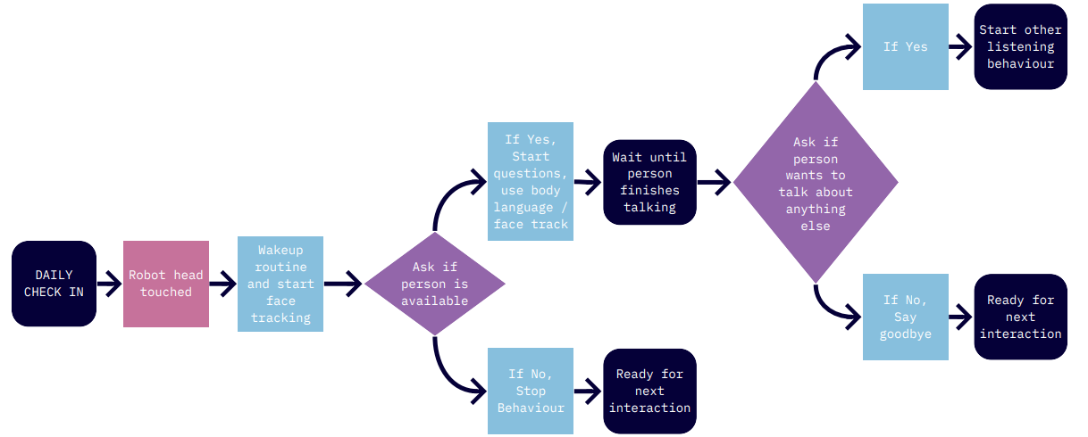
DESIGNS CREATED
Check ins

Slide 38
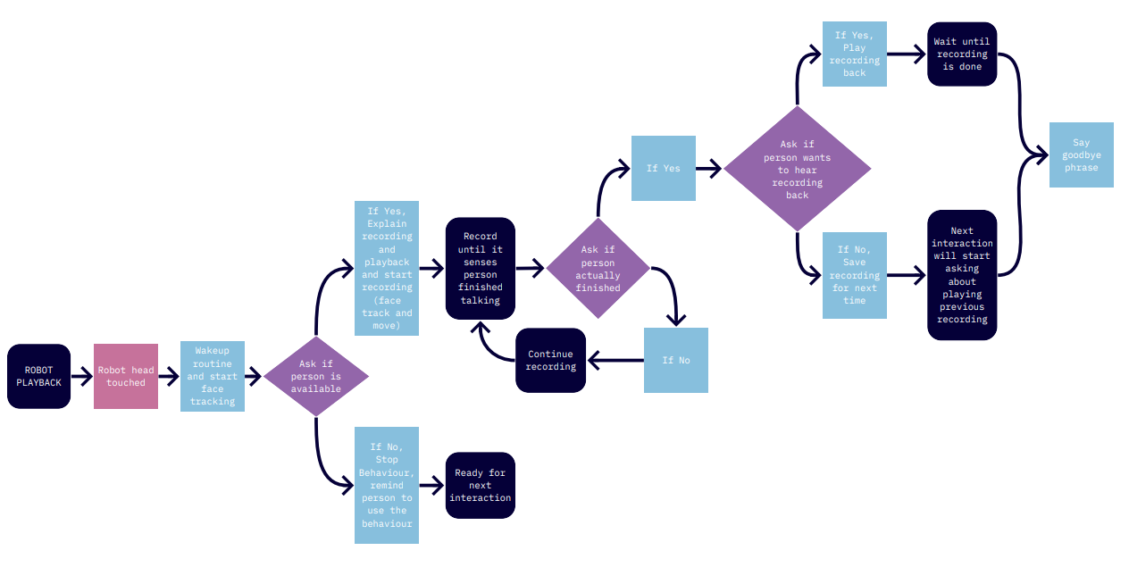
DESIGNS CREATED
Recording people and playback

Slide 39
DESIGNS CREATED
Reflective listening with prods

Slide 40
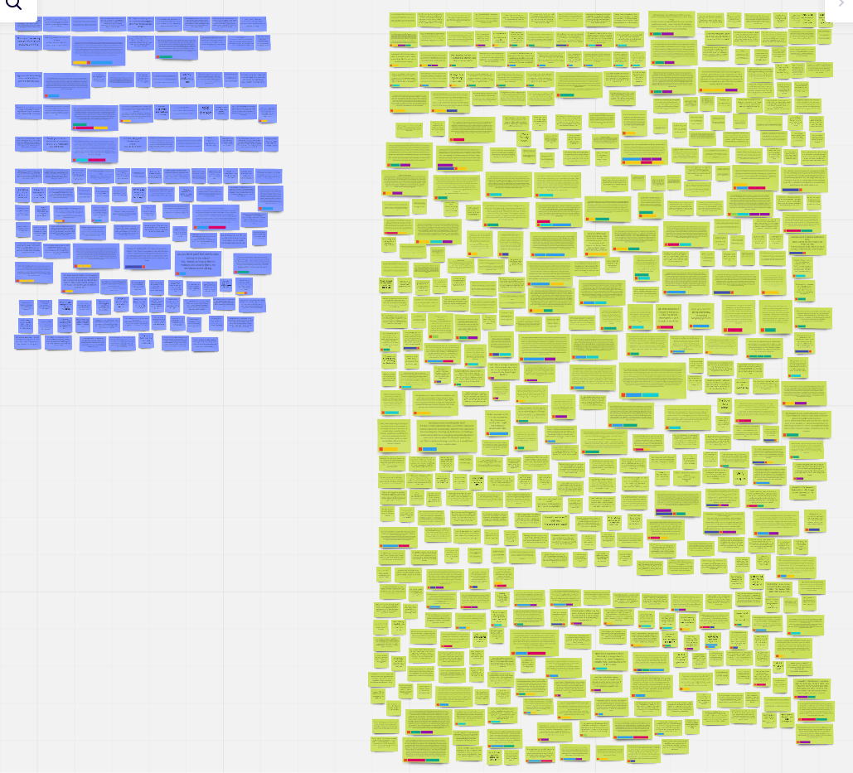
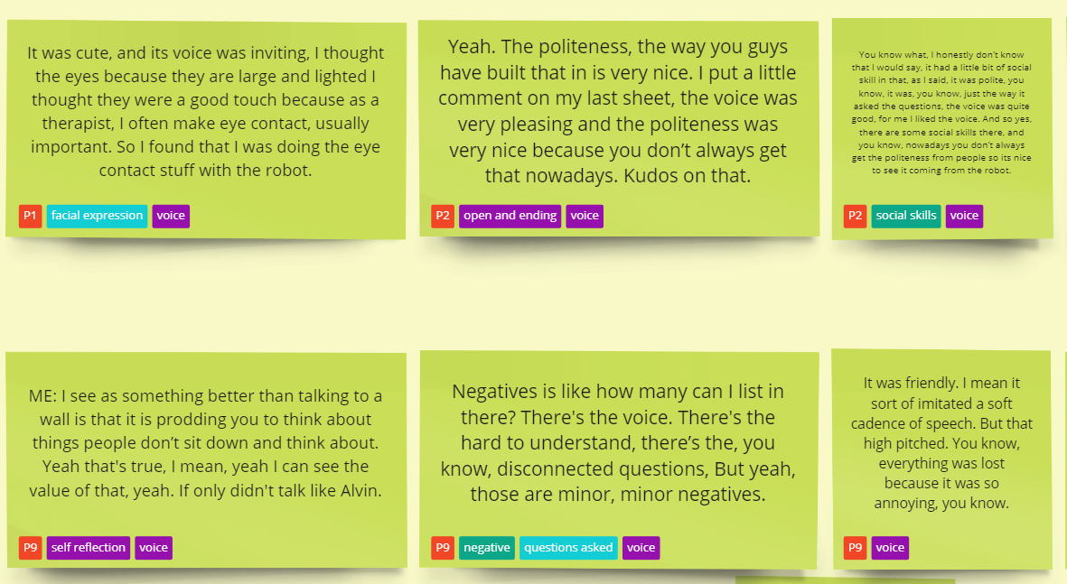

Slide 41
