Slide 1
Reflections on Online Child-Centric Participatory Design Approaches: Two Case Studies with Children and Early Adolescents
Ananta Chowdhury, Andrea Bunt University of Manitoba, Winnipeg, Manitoba, Canada

Slide 2
Participatory Design with Children
Elicits children’s perspectives
Helps understand age-specific requirements
Promotes child-oriented design thinking
Icon is from flaticon.com

Slide 3
Online Participatory Design
Challenges:
technical difficulties, video conferencing fatigue, appropriate logistics support
Opportunities:
removed geographical barriers, involved participants from different backgrounds
Icon is from flaticon.com

Slide 4
Our Contribution
Reflections on our experience from 2 case studies
Adaptations of the PD methods for the online setting
Participant involvement in online PD activities
Use of virtual tools
Our challenges and advantages
Icon is from flaticon.com

Slide 5
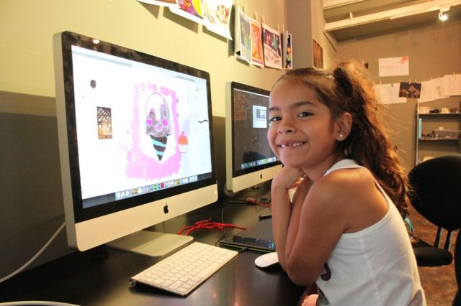
Case Study 1: Designing a Tutorial Authoring Tool for Digital Art with Children
Allowing children to create drawing tutorials
Sharing digital art with others along with the drawing process
Benefitting other art enthusiastic children
https://braveintheattempt.com/2018/03/01/digital-art-for-students-no-photoshop-required; https://www.photophoto.cn/pic/29474127.html

Slide 6
Case Study 1: Design Approach
8 Participants
Target Age Group: 6-11
In-person Study
16 Participants
Target Age Group: 7-11
Online Study
Icons are from flaticon.com

Slide 7
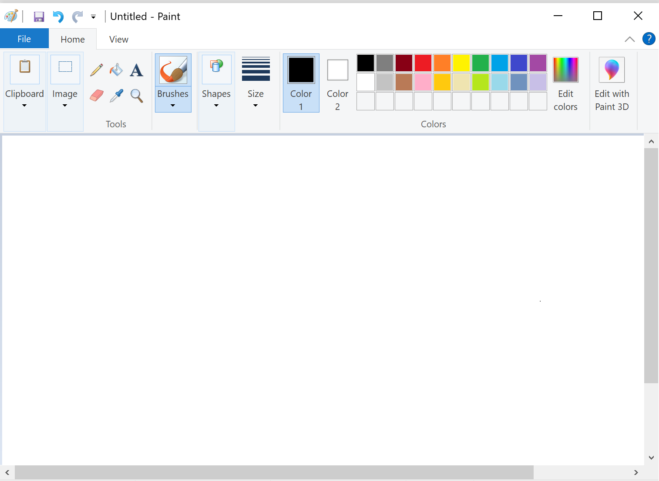
Case Study 1: In-person Study
Participants made a drawing on MSpaint
Drawing steps were captured
Printed out the steps instantly

Slide 8
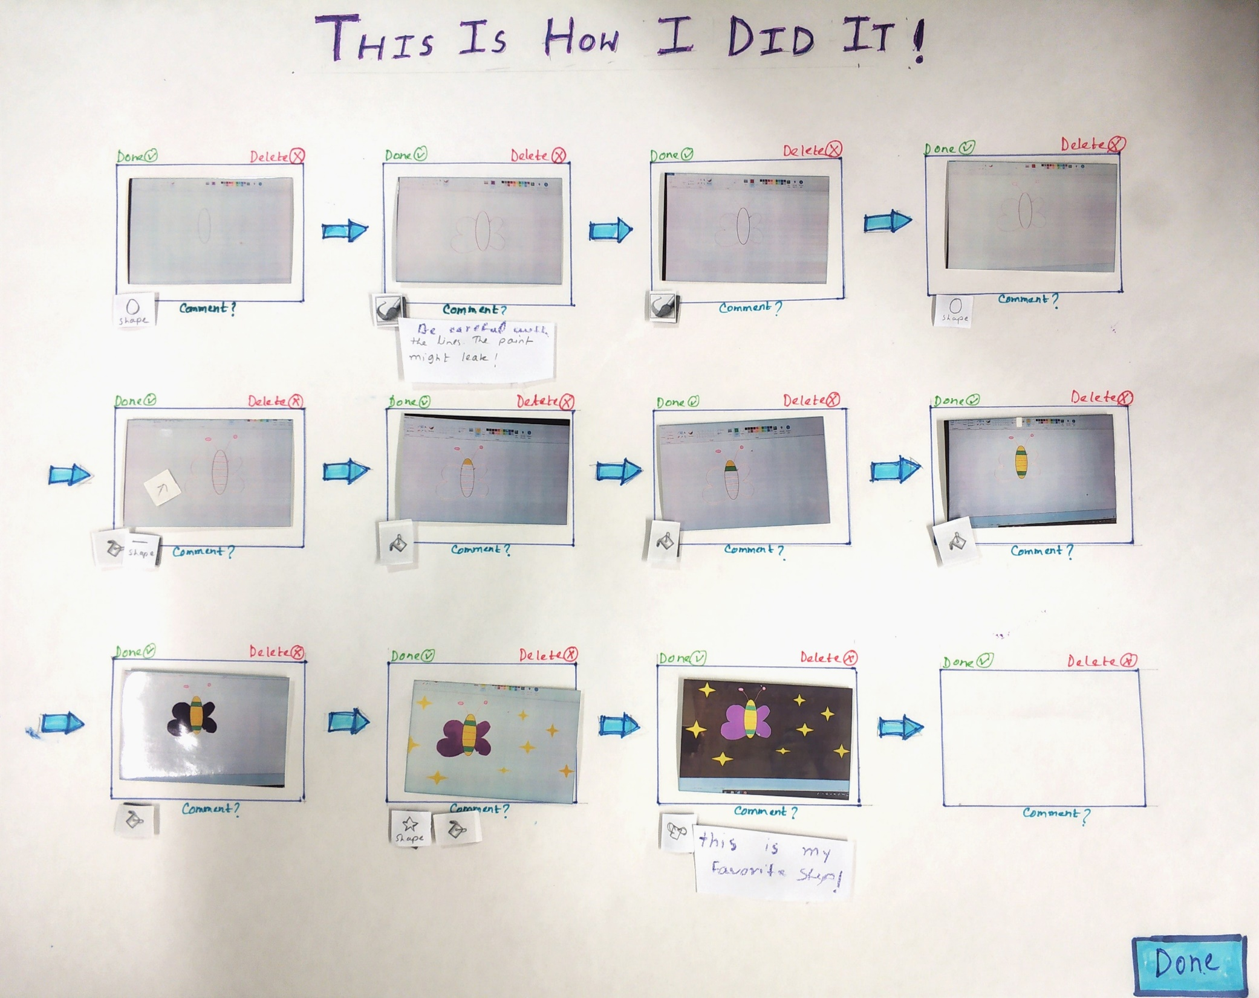

Slide 9
Case Study 1: Online Study
Semi-automated Wizard-of-Oz Prototype
Goal was to use it as a means of further inquiry
Icon is from flaticon.com

Slide 10
Case Study 1: Challenges in the Online Study
How to act as the Wizard?
- Using TeamViewer
Maintaining engagement
- mindful about study length
- conversational atmosphere
Icon is from flaticon.com

Slide 11
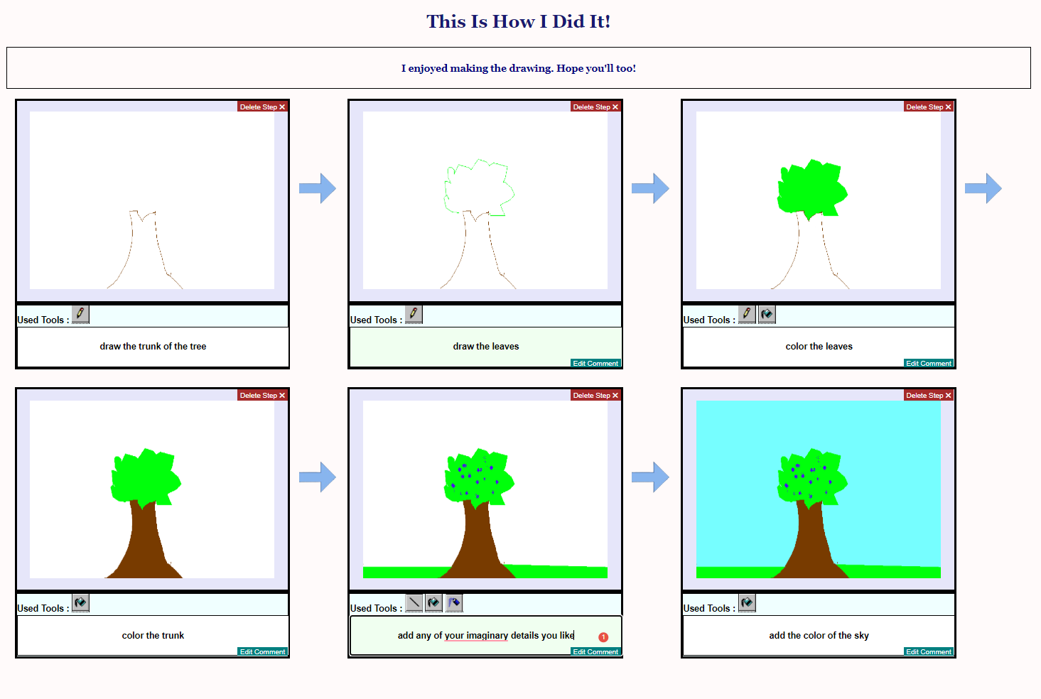

Slide 12
Case Study 2: Designing Tech-Based Interventions with Early Adolescents
Children’s perceptions regarding tech overuse
How they envision tech-mediated solutions
Icon is from flaticon.com

Slide 13
Case Study 2: Study Method
Online Participatory Design Study
21 Participants
Early Adolescents
(11-14 years)
Icons are from flaticon.com

Slide 14
Case Study 2: Participatory Design Sessions
Group-Based
Session 1
Creating a Story
Icons are from flaticon.com

Slide 15
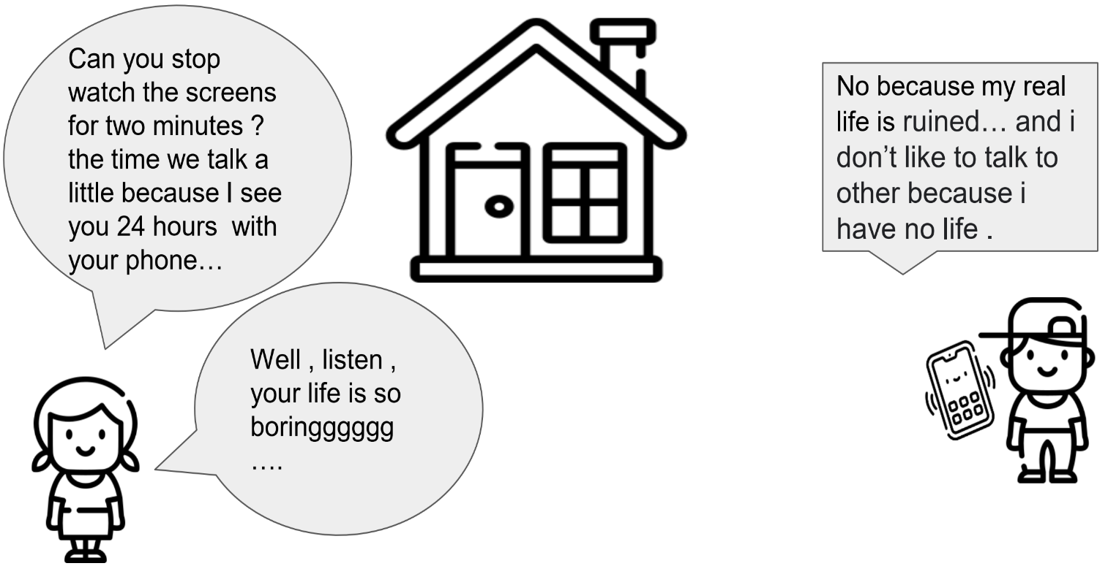
Case Study 2: Study Method

Slide 16
Case Study 2: Participatory Design Sessions
Group-Based
Session 1
Creating a Story
Session 2 Brainstorming and Mapping
Icons are from flaticon.com

Slide 17
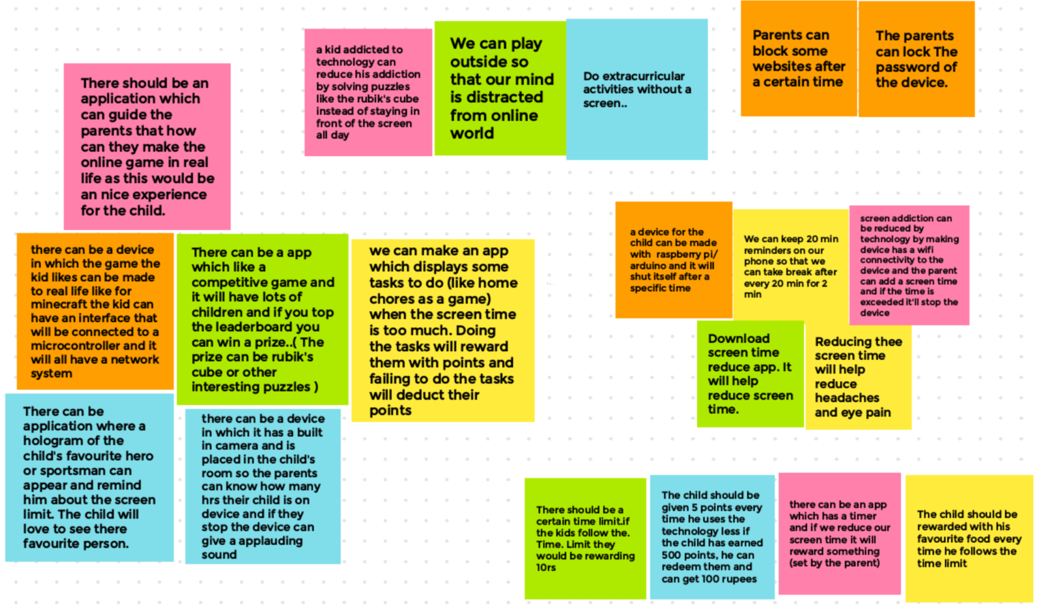
Case Study 2: Study Method

Slide 18
Case Study 2: Participatory Design Sessions
Group-Based
Session 1
Creating a Story
Session 2 Brainstorming and Mapping
Offline
Activity
Icons are from flaticon.com

Slide 19
Case Study 2: Participatory Design Sessions
Group-Based
Session 1
Creating a Story
Session 2 Brainstorming and Mapping
Offline
Activity
Session 3
Generating a Final Solution
Icons are from flaticon.com

Slide 20
Case Study 2: Study Method

Slide 21
Case Study 2: Conducting the PD Sessions
Maintaining engagement
- teambuilding and ice-breaking activities
- design competition among groups
Using virtual tools to facilitate online PD tasks
- prepopulated slides might restrict artistic expression
- free-hand drawing is difficult in Jamboard
Icon is from flaticon.com

Slide 22
Discussion: Access to Participants & Data Quality
Advantages:
Recruit internationally
Younger participants were more comfortable online than in-person
Flexible scheduling
Drawbacks:
Scheduling multi-session studies can be difficult across different time zones
Tech requirements might exclude participants from lower socio-economic backgrounds
Distractions, Internet issues, Technical difficulties
Icon is from flaticon.com

Slide 23
Discussion: Reflections from Researcher’s Perspective
Building rapport was easier in-person
Managing multiple virtual tools simultaneously can be challenging
Additional scruitiny over secure storage policies while using virtual tools

Slide 24
In-Person vs Online Participatory Design Study?
Icons are from flaticon.com

Slide 25
Thank You!

Slide 26
Reflections on Online Child-Centric Participatory Design Approaches: Two Case Studies with Children and Early Adolescents
Ananta Chowdhury, Andrea Bunt University of Manitoba, Winnipeg, Manitoba, Canada

