Slide 1


Gender Inclusivity in Online Question and Answer Communities: Investigating Community Member Practices and Perceptions to Work towards Equitable Interfaces
Patrick Dubois
Date: September 12th, 2022
Advisor: Dr. Andrea Bunt
Committee: Dr. Jim Young & Dr. Susan Prentice
Notes:
Thank you all for coming, and thank you Dr. Cameron for the introduction.

Slide 2






Graphic Design Software are Increasingly Accessible
Notes:
Image source: https://undraw.co/

Slide 3


Online Q&As are Used for Learning Graphic Design
Notes:
People play multiple roles in these communities
Promote good content
Community effort to build this knowledge repository

Slide 4
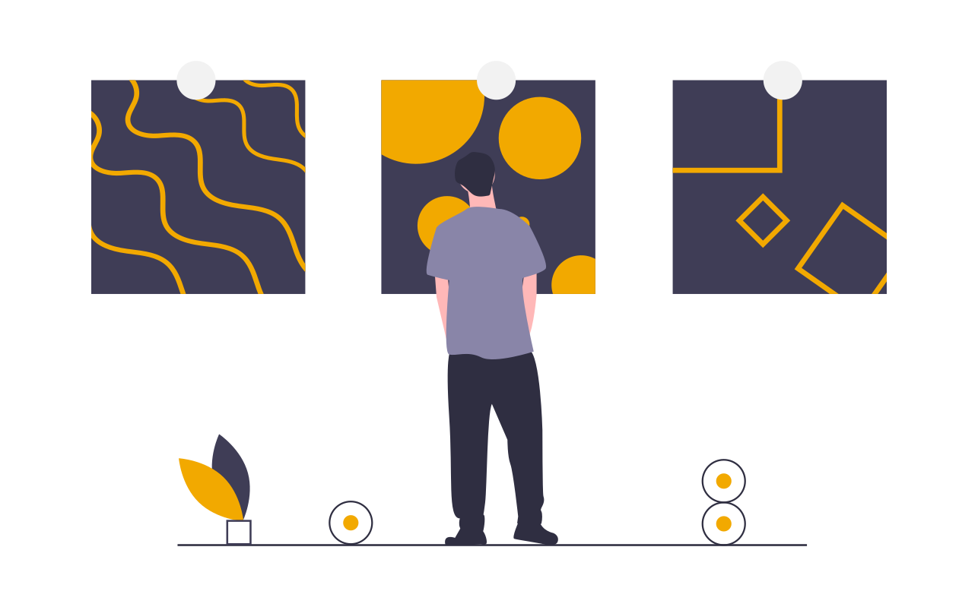
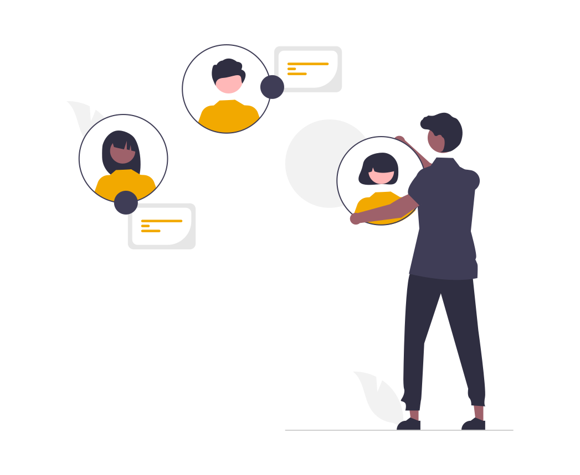

Benefits of Contributing to Graphic Design Q&As
showcase skills [Raban & Harper, 2008]
networking [Xu et al., 2020]
intrinsic rewards [Sun et al., 2014]
Notes:
Meant for everyone, but are they inclusive?
Images’ source: https://undraw.co/

Slide 5


Some Resources are not Gender Inclusive
[May et al., 2019; Vasilescu et al., 2012]
[Wagner et al., 2015; Reagle & Rhue, 2011]

Slide 6
Consequences of Gender Imbalance
content interests majority [Das et al., 2019; Reagle & Rhue, 2011]
perspectives are biased [Wagner et al., 2015]
Notes:
Wikipedia for example… misrepresentation of women’s accomplishments
But, it’s not clear if GD Q&As have a gender imbalance, but if so, what is an approach we can use?

Slide 7

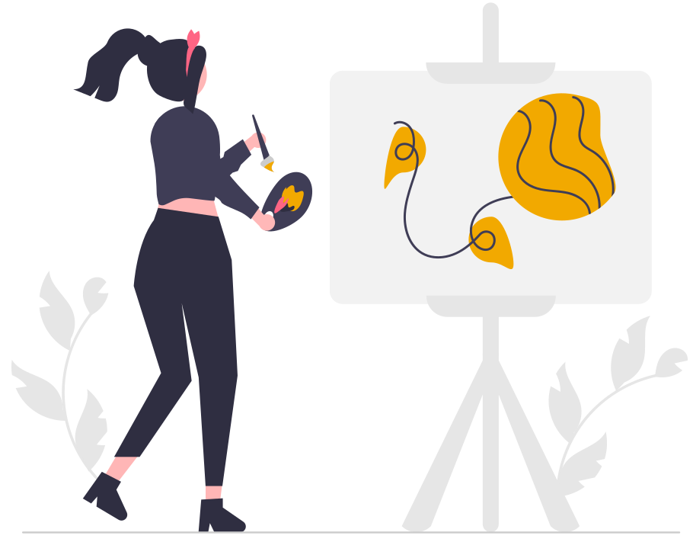
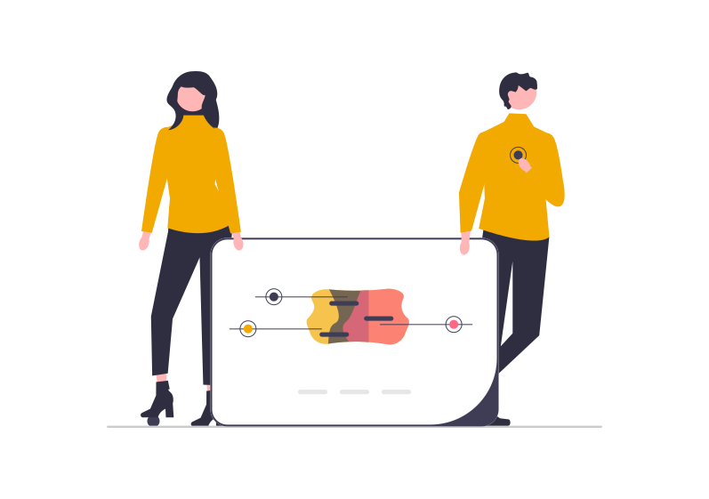
How are Graphic Design Q&As Different?
technological & non-technological
relative gender balance
Notes:
Images’ source: https://undraw.co/

Slide 8
Research Questions
How are people currently participating on Q&As? Are there any differences between men and women? Are there any differences between Q&As with different characteristics?
How do men and women currently perceive Q&As? What do they see as motivations and deterrents to participation?
How do people of different genders use and perceive a novel Q&A with additional community presence information? Do users perceive Q&As to be more inclusive environments because of community presence information?
Notes:
Third RQ based on answers of first two

Slide 9


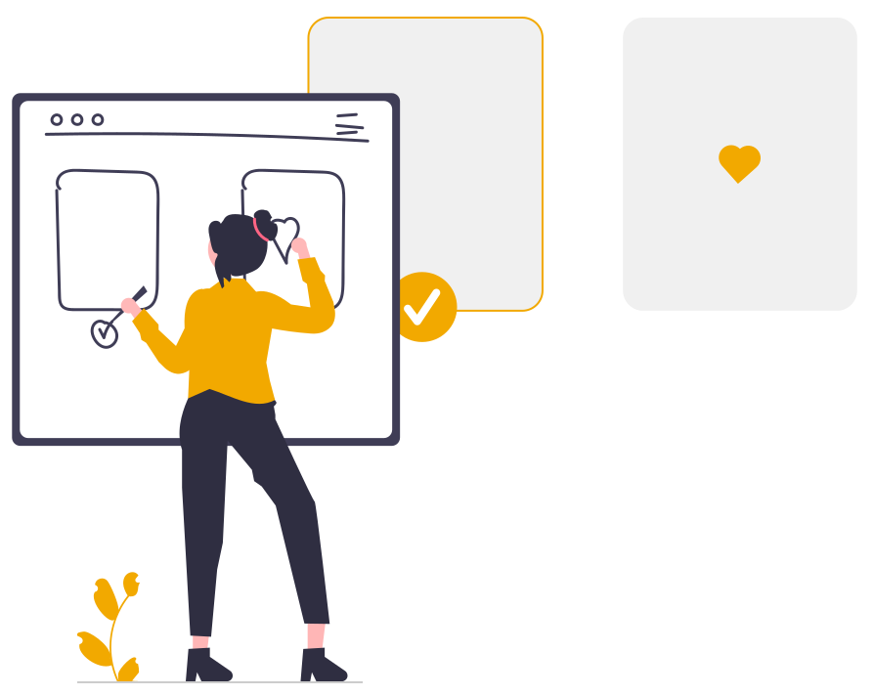
Thesis Overview
Current state of Q&As? Are there gender differences? Are there Q&A differences?
content analysis
interviews
prototyping and field study
Notes:
Images’ source: https://undraw.co/

Slide 10

Content Analysis: Method
collected answers from Stack Exchange and Quora
manually and automatically assigned gender to authors
quantitative and qualitative analyses
Notes:
Image source: https://undraw.co/

Slide 11
Content Analysis: Some Findings
men (~70%) post more answers than women (~12%)
women post more on Quora (~19%) than Stack Exchange (~4%)
Quora has more subjective and socially-oriented content (~59%) than objective (~41%)
Stack Exchange is far more objective (~96%) than subjective (~4%)
women (MED:96) receive less validation than men (MED:13,184) on Stack Exchange
→ women posted to the more socially-oriented community relative to men
Notes:
Image source: https://undraw.co/

Slide 12
Thesis Overview
Current state of Q&As? Are there gender differences? Are there Q&A differences?
Perceptions of Q&As? Motivations and deterrents? Are there gender differences?
content analysis
interviews
prototyping and field study
Notes:
Images’ source: https://undraw.co/

Slide 13

Interview Study: Method
recruited 24 graphic designers: 11 women, 13 men
discussed motivations and deterrents to participate on Q&As
thematic analysis of transcripts
Notes:
Image source: https://undraw.co/

Slide 14
Interview Study: Some Findings
important for graphic designers to share perspectives
The whole world gets to talk to each other and say, "you could also do this thing." (W10)
Quora has a stronger sense of community
Quora is a little bit more […] like a social site. […] But Stack Exchange is more professional. (W6)
pressure to create high-quality content, which is time-consuming
It just turns into a competition sometimes. [T]his is internet points. None of this is real at all. (W25)
Notes:
3: felt by everyone, but men emphasized the importance
Image source: https://undraw.co/

Slide 15
Working Towards Inclusivity
women post more on Quora, and more socially-oriented content
strong sense of community on Quora, and diverse perspectives valued in graphic design
→ social considerations might be lacking
Notes:
Taking a step back, and looking at the findings of the content analysis, the interviews and prior work, we can see some themes emerge
A common theme we found in the previous results, and in prior work is social considerations

Slide 16
Community Presence
social presence and awareness: “reciprocal awareness of others of an individual, and the individual’s awareness of others within an interactive social space” [Cutler, 1995]
homophily: phenomenon describing a person’s preference to interact with other, similar individuals [Lazarsfeld & Merton, 1954]

Slide 17
Thesis Overview
Current state of Q&As? Are there gender differences? Are there Q&A differences?
Perceptions of Q&As? Motivations and deterrents? Are there gender differences?
Perceptions of community presence information? Does the Q&A seem more inclusive?
content analysis
interviews
prototyping and field study
Notes:
Images’ source: https://undraw.co/

Slide 18

Showing Community Presence
social presence and awareness: display who is viewing which questions
homophily: identify the viewers who share something in common with user
Notes:
Image source: https://undraw.co/

Slide 19
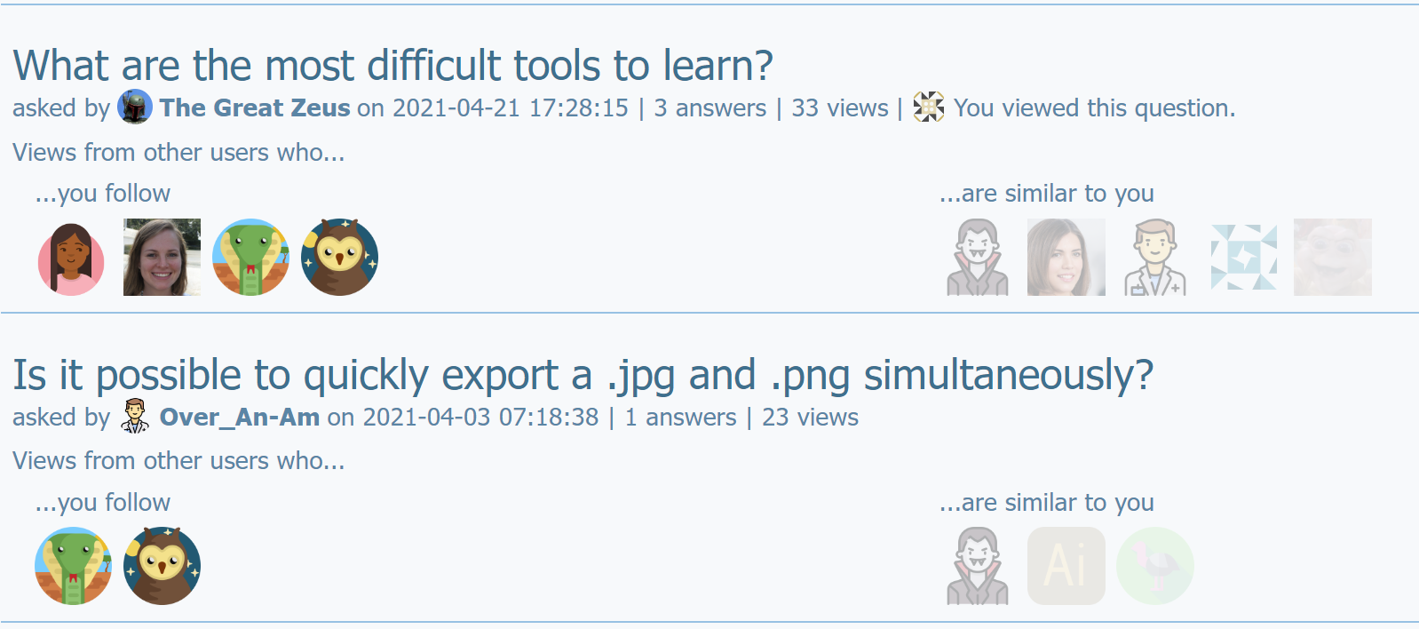
Community Presence Interfaces
Notes:
We created community presence interfaces. They show X. For example.
Image source: https://undraw.co/

Slide 20
Field Study: Method
recruited 30 graphic designers: 14 men, 14 women, 2 non-binary
each participant used a Baseline and one Community Presence interface
participants used each interface for five days
data from interviews, questionnaires and usage logs
Notes:
Image source: https://undraw.co/

Slide 21
Field Study: Some Findings
community presence information humanizes Q&As
greater sense of empathy
I would [do research] for [people]. [Without the info] I would just put a "Google it.” (M08)
shifts focus from content to community members
I want to help and be helped but when I [am here], I'm just in for the content, not [to] make friendships. (M05)
homophily and heterophily can both be used to promote a sense of inclusion
Notes:
2: heterophily from women
Image source: https://undraw.co/

Slide 22
Thesis Overview
Current state of Q&As? Are there gender differences? Are there Q&A differences?
Perceptions of Q&As? Motivations and deterrents? Are there gender differences?
Perceptions of community presence information? Does the Q&A seem more inclusive?
Dubois et al., PACM HCI 2020
content analysis
interviews
Dubois et al., PACM HCI 2022
prototyping and field study
Notes:
Summarize steps of thesis. It was published. Proceedings of the ACM on HCI
I would like to end this presentation with some points to consider about this research, including limitations of this work and avenues for future work
Images’ source: https://undraw.co/

Slide 23
Gender is One Piece of the Puzzle
moving beyond binary gender
other characteristics and intersectionality
ensure representation when creating communities and systems
Notes:
1) Research fatigue
3) Curb-cut

Slide 24
Generalizing to Online Communities
different degrees of socializing
social considerations might not address root cause of structural imbalances
investigating changes in behaviour
Notes:
1) Community norms
1) Other communities might have different needs

Slide 25
Contributions
gender differences in Q&As: contribute different types of content, receive different levels of validation
motivators and deterrents to participation
community presence information has potential to promote inclusivity

Slide 26
Gender Inclusivity in Online Question and Answer Communities: Investigating Community Member Practices and Perceptions to Work towards Equitable Interfaces
Contributions
gender differences in Q&As: contribute different types of content, receive different levels of validation
motivators and deterrents to participation
community presence information has potential to promote inclusivity
Notes:
I would like to thank all the people who have helped me get here including friends, family, lab mates and collaborators, but I would like to especially thank
Dr. Jessica Cameron for chairing my defense
Dr. Tony Tang for agreeing to serve as the external examiner
Drs. Jim Young and Susan Prentice for being on my committee, providing feedback throughout the research, and for the general encouragement
And Dr. Andrea Bunt for supervising me for almost 10 years all degrees considered, and without which I would not be here today

