Slide 1
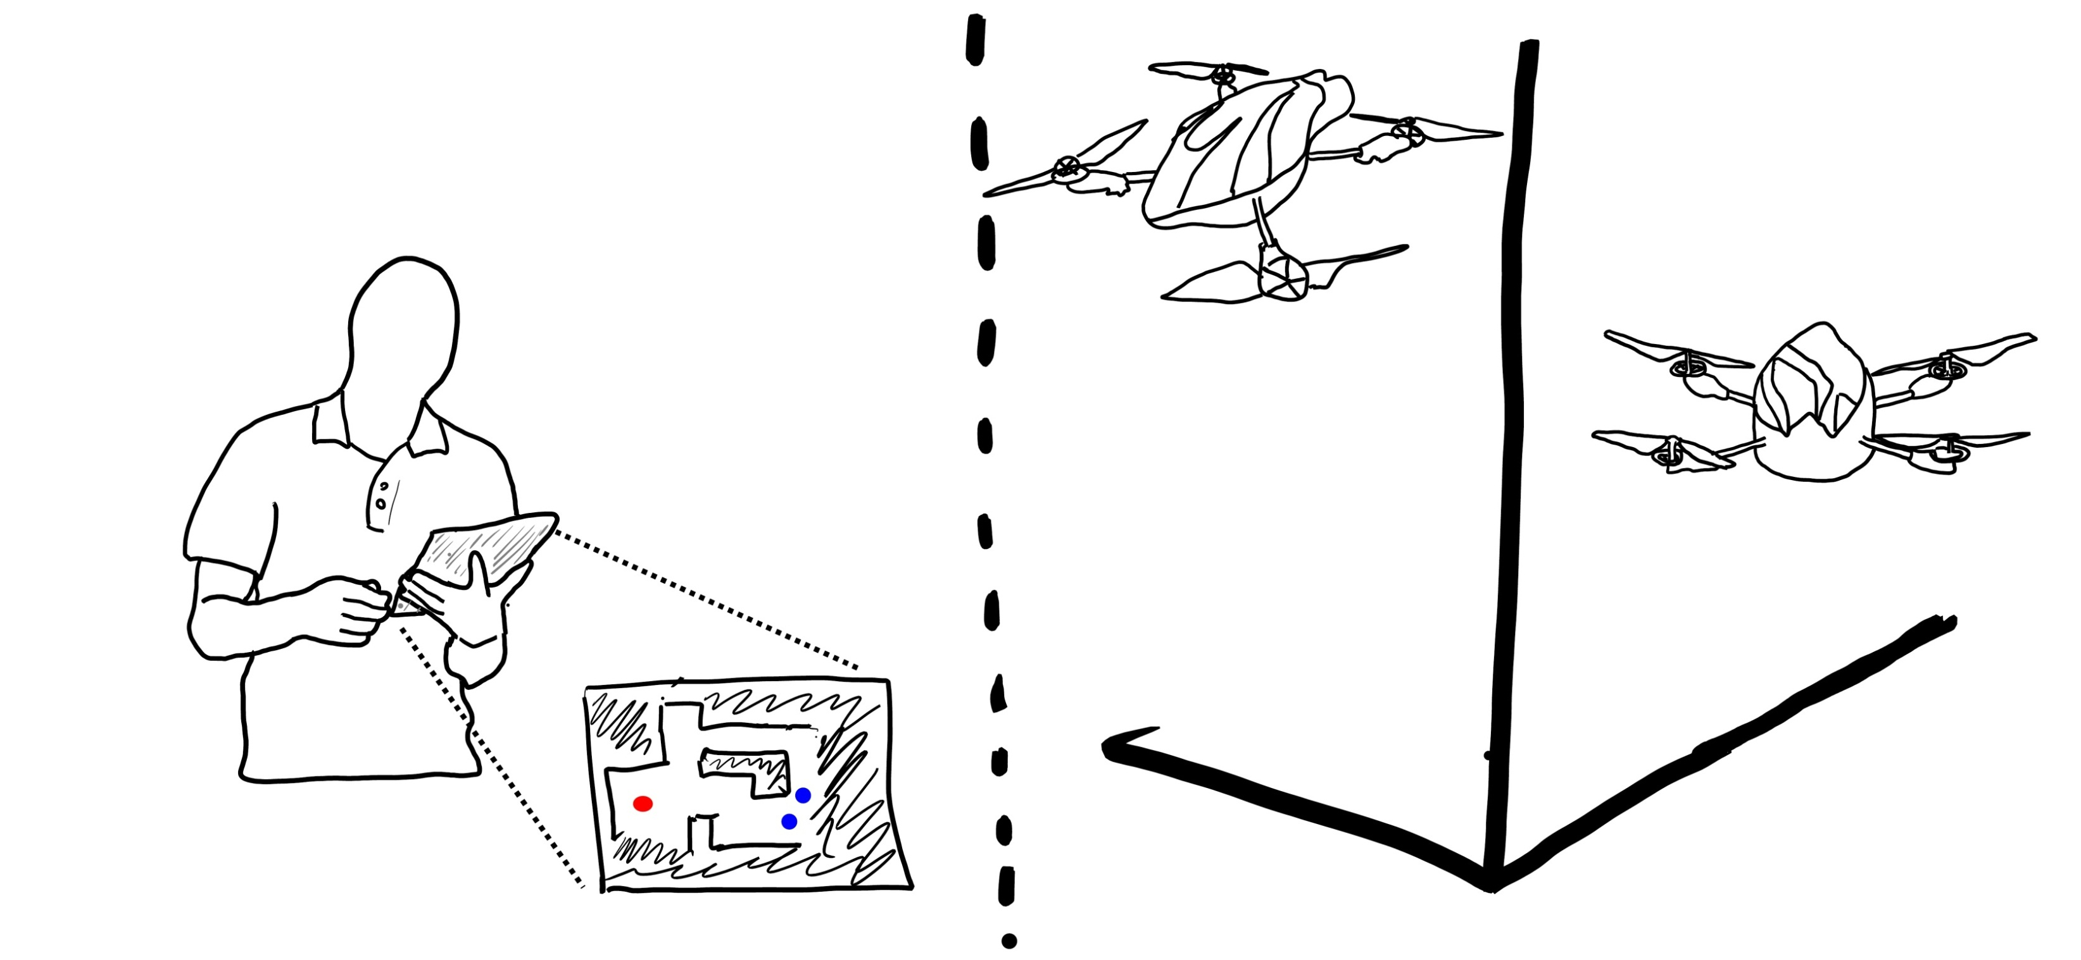
Developing Guidelines for In-The-Field Control of a Team of Robots
Exploration Focus
Interface design to support the effective control and monitoring of a robot team in the field
Sliding Scale Autonomy
Explore use of various touch screens, from small touch phones to large tablets.
Use of different types of gestures, sensors and touch methods best suited to given tasks.
Enable the user to move between low level robot interaction and high level group interaction.
Task View
Individual Robots View
Research Questions
How do various device formats integrate into use for tasks?
How do different input mechanisms lend themselves to use in the field?
How can portable interfaces support sliding-scale autonomy for robot control?
Controlling a Robot Team of Quadrotor Robots for a Mapping Task
Robot with Sensing Capabilities
Robot Team
Single and Multi Touch Gestures
Megha Sharma, James E. Young , Rasit Eskicioglu {megha, young, rasit}@cs.umanitoba.ca

