Slide 1



An Investigation on Automatically Assessing an Application Tutorial’s Difficulty
MSc. Thesis:
Shahed Anzarus Sabab
Supervisor: Dr. Andrea Bunt
December 18, 2019

Slide 2









Feature-Rich Software
Software Tutorials
Feature-Rich Software
Photoshop
Notes:
I will start by talking about feature rich software. For example, Autocad, Fusion 360, Photoshop. These software comes with tons of features to explore. It becomes intimidating to the learners to learn about these. Therefore, learners often refer to online tutorials.

Slide 3
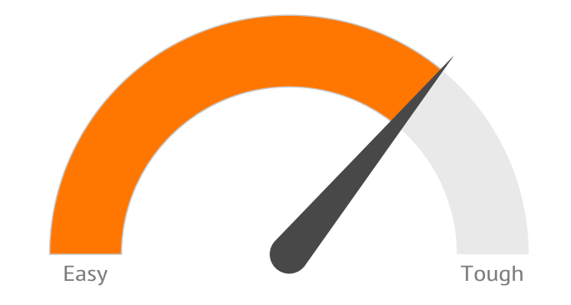


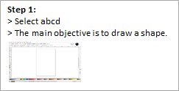

Software Tutorials
or
Text tutorials
Video tutorials
Notes:
Online tutorials can be of different forms. Some are text based and some are videos. Again, there are thousands of software tutorials available online. But hardly they offer any guideline to the user to say which one is appropriate for the particular expertise. Let’s suppose I am a beginner and I want to learn about Photoshop. So I am searching for tutorials but I really don’t know which one is designed for me.

Slide 4




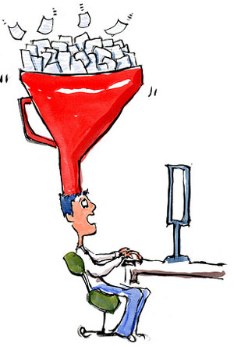




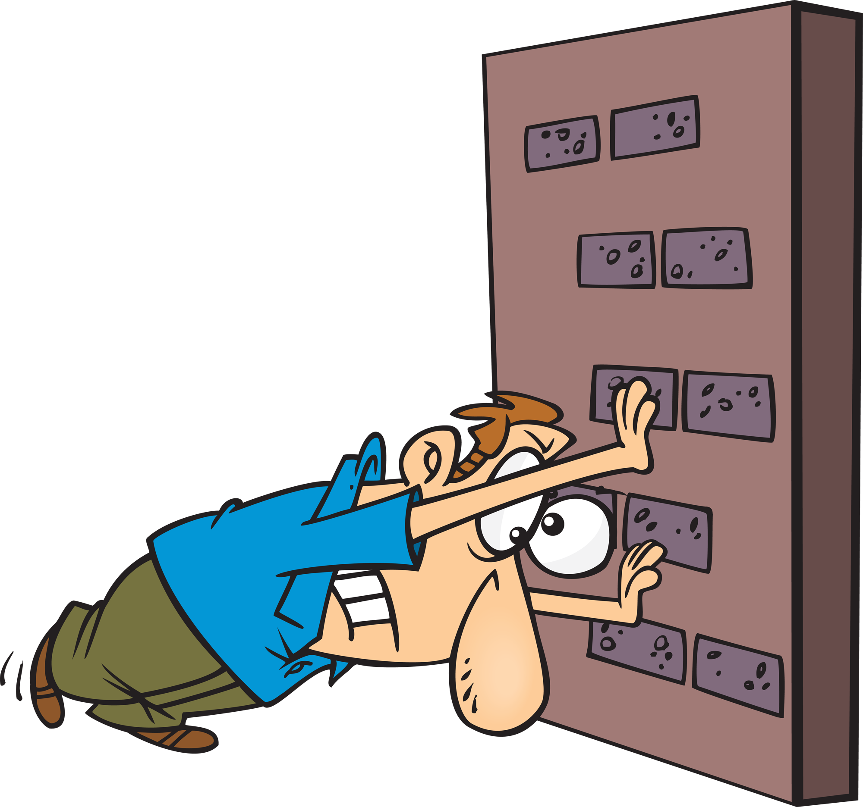
Tutorial’s Difficulty
BEGINNER
ADVANCED
Lack experience and expertise
Require detailed information
Have experience and expertise
Require high-level information
Cognitive Overload
[Pass et al., 2003]
Frustration
[Locke et al., 2002]
Limited Task Success
[Kiani et al., 2019]
Time Consuming
[Grossman et al., 2009]
Notes:
At the two extreme of expertise we have beginner and advanced user. Beginner users lack experience and expertise so they require more detailed info whereas advanced users have working experience so they only require high level info.
>> Advanced tutorials assume certain software skills and knowledge of the application’s vocabulary
>> beginner tries to follow this assumed knowledge, experience cognitive overload
Cognitive overload: learning task exceeds the processing capacity of the human cognitive system.
>> Expert user > compact workflow, tutorials cover more advanced or novel techniques

Slide 5




Research Goal
BEGINNER
ADVANCED
Machine Learning System
Tutorial Selection
Classifying Tutorials
Notes:
From this, my research goal is to develop a machine learning system which can automatically detect tutorial’s difficulty. In other words, my objective is to build a classifier to classify advanced vs beginner tutorials and finally using this to develop a system to help users to select the appropriate tutorials.

Slide 6



Classification Task
Machine Learning System
Feature 1
Feature 2
Truck
Car
Vehicle Type | Weight | Dimension
Car | 4,000 lb | 4.7m x1.70m
Truck | 14,000 lb | 8.10m x 2.45m
Notes:
Let’s suppose we have a classification problem to differentiate between cars and trucks. In case of a machine learning system, it learns about the different objects from their attributes. Two of the attributes can be for example their dimension and weight. We refer these attributes as the features.

Slide 7

Research Questions
What are the features that differentiate advanced tutorials from beginner?
How can I build a machine learning model?
How can I leverage the model to assist users in the tutorial selection?

Slide 8
Research Questions
What are the features that differentiate advanced tutorials from beginner?
How can I build a machine learning model?
How can I leverage the model to assist users in the tutorial selection?
Notes:
First, I would like to talk about my first research question which is to find out differentiable features for advanced vs beginner tutorials.

Slide 9


Investigate Differentiable Features
Data Collection
(Text + Video)
750 Labeled Tutorials
Photoshop tutorials
Only text
Equal Advanced and Beginner tutorials
Notes:
For investigating features, I collected 750 photoshop tutorial from 9 different sources
Equal number of beginner and advanced tutorials

Slide 10

Investigate Differentiable Features
Data Collection
(Text + Video)
Data
Preprocessing
750 Labeled Tutorials
Noise Reduction
Photoshop tutorials
Only text
Equal Advanced and Beginner tutorials
Removed articles, special characters, numerals…
Notes:
This is to remove the unnecessary words from the corpus

Slide 11
Investigate Differentiable Features
Data Collection
(Text + Video)
Data
Preprocessing
Feature
Engineering
750 Labeled Tutorials
Noise Reduction
Generate Features
Photoshop tutorials
Only text
Equal Advanced and Beginner tutorials
Removed articles, special characters, numerals…
Topics
Command Ratio
Word Repetition
Text Difficulty
Length

Slide 12


Investigate Differentiable Features
Feature Engineering
Length
Word Repetition
Wordcounts
Percentage of repeated words
Notes:
Advanced > Lengthy
Advanced > Creating a sketch effect > Specific > more repeat
Beginner > Demonstrating the use of different tools > Broader > less repeat

Slide 13
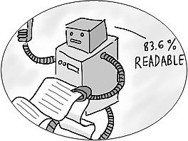

Investigate Differentiable Features
Feature Engineering
Text Difficulty
Command Ratio
Measures how difficult a text is to read
Expert users have heavier commands usage [Li et al., 2011 ]
Percentage of words refereeing to any Photoshop command
Consensus score of 7 formulas [Eltorai et al., 2015]
Notes:
Text difficulty measures how difficult a text is to read. To calculate this feature I followed earlier literature introduced by Eltorai et al. who used a consensus score of 7 different formulas.

Slide 14

Investigate Differentiable Features
Feature Engineering
Topics
Tutorials’ topics have different difficulties
[Lafreniere et al., 2013] [Wang et al., 2018]
[Blei et al., 2003]
2 models
(Topics-All, Topics-Commands)
30 topics
(Based on topic coherence)
Notes:
My next feature is topic. From the previous literature I found out topics have different difficulties. I used one of the established methods available to generate topics from the tutorial’s text. So, I took my preprocessed tutorial text passed it to a topic modeling algorithm LDA (introduced by Dr. David Blei in 2003) which represents tutorials as a distribution of the topics and gives a probability score associated with it. Likely I generated 2 different topic models using this algorithm they only differs by the input data. So the first Topic-All model uses all the texts of the tutorials and the other model topic-commands only uses commands annotated from the tutorials. For selecting the number of topics I chose to generate 30 topics based on a metric called topic coherence.

Slide 15

Investigate Differentiable Features
Data Collection
(Text + Video)
Data
Preprocessing
Feature
Engineering
Feature
Analysis
750 Labeled Tutorials
Noise Reduction
Generate Features
Analyze Features
Photoshop tutorials
Only text
Equal Advanced and Beginner tutorials
Removed articles, special characters, numerals…
Topics
Command Ratio
Word Repetition
Text Difficulty
Length
2 tailed independent t-test

Slide 16
Investigate Differentiable Features
Feature Analysis (2 tailed independent t-test)
 | Beg. mean (s.d.) | Adv. mean (s.d.) | Sig. | Cohen’s d
Command Ratio | 34.3 (11.2) | 33.3 (10) | p = 0.10 | 0.1
Length | 1461 (841.8) | 2275.8 (1124.1) | p < 0.001 | 0.8
Word Repetition | 68 (7.9) | 71.7 (8.5) | p < 0.001 | 0.5
Text Difficulty | 8.1 (1.7) | 7.5 (1.6) | p < 0.001 | 0.4
Notes:
For features that could be summarized using means (e.g., command ratio, length, word repetition, and text difficulty), I looked for statistically significant differences between the advanced and beginner tutorials in the dataset (using 2-tailed Independent T-Tests).
Adv signifiantly longer than beg
Adv tutorials more repeated words than beg
Beg tutorials use more complex language (effect size is small)

Slide 17
Research Questions
What are the features that differentiate advanced tutorials from beginner?
How can I build a machine learning model?
How can I leverage the model to assist users in the tutorial selection?

Slide 18

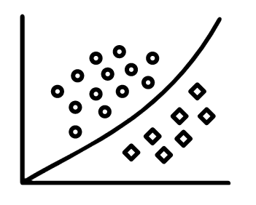
Model Generation & Evaluation
Machine Learning System
Features
Classification
Topics
Command Ratio
Word Repetition
Text Difficulty
Length
Random Forest
10 fold Cross Validation

Slide 19
Model Generation & Evaluation
Model performance using individual feature
*Error bars represent standard deviation
Notes:
This figure representing different models performance whereas each model is build on individual feature contribution. Here x-axis represents the features and y axis represents the accuracy of the model.

Slide 20
Model Generation & Evaluation
Model performance using individual feature
*Error bars represent standard deviation

Slide 21
Model Generation & Evaluation
Model performance using combined features
CR: Command Ratio, TD: Text Difficulty, WR: Word Repetition, Len: Length
*Error bars represent standard deviation
Notes:
This figure represents my models’ performance which are build on different combinations of features. I reported some of the results.

Slide 22
Model Generation & Evaluation
Model performance using combined features
CR: Command Ratio, TD: Text Difficulty, WR: Word Repetition, Len: Length
*Error bars represent standard deviation

Slide 23

Model Generation & Evaluation
Length
Word Repetition
Topics
Text Difficulty
Command Ratio
85 % Accuracy
Notes:
>> In summary when I used photoshop as my training data and features as length,

Slide 24
Research Questions
What are the features that differentiate advanced tutorials from beginner?
How can I build a machine learning model?
How can I leverage the model to assist users in the tutorial selection?

Slide 25

Development of the Prototype
Features
Develop
Prototype
Model Decision
Advanced / Beginner
Notes:
So now we have the generated features and we also have a decision from my model. I want to develop a prototype by leveraging these information. While doing so, I came into a problem. Some of my features which my model uses are not human readable.

Slide 26
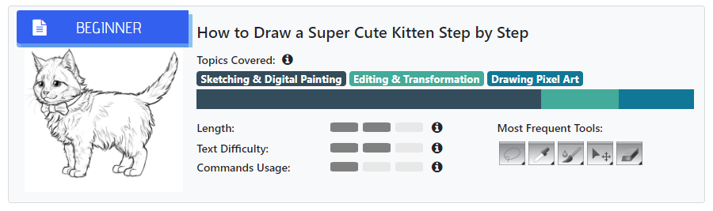
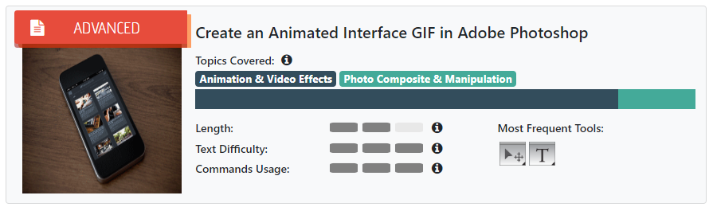
Topics
Notes:
Lets look at 2 examples. Here topics are confusing. They are not meaningful information to a user.

Slide 27
Development of the Prototype
Topic Label
Meaningful name
Dominant topics
Make tutorial clusters
Notes:
My next step was to find meaningful name of this topic for which I used the concept of Dominant topic. For the topics distribution of a tutorial a topic giving highest probability score is the dominant topic. For example, for the first sample tutorial, the dominant topic is 1. So, after finding out the dominant topic my next step was to group tutorials together and making a cluster which I call tutorial cluster.

Slide 28
Development of the Prototype
Tutorial Clusters
Each cluster has same dominant topic
Qualitatively analyze top tutorials under each cluster to uncover the common theme
Notes:
Here, each cluster has same dominant topic. Then I qualitatively analyzed some of the top tutorials under each cluster.

Slide 29



Development of the Prototype
Label
Analyze Tutorials
Titles
Commands used
High-level tasks
Objective
Themes
Codes
Notes
Sample Tutorials
Notes:
>> For analyzing tutorials I used open coding technique. I noted some meta data of the tutorials by listing their tittle, commands, high-level tasks and objective. After that I looked into the common pattern and thus generated a suitable labels.
>> Notes: Meta data > how to set up a flyer in InDesign > create border > add colorful ribbons >>> code background creation

Slide 30
Development of the Prototype
Notes:
After the naming process we got the labels such as, composites, sketching and video effects.

Slide 31
Topics

Slide 32

Feature Representation
Length
Word Repetition
Topics
Text Difficulty
Command Ratio
Notes:
So now lets see what do we have here

Slide 33

Feature Representation
Length
Word Repetition
Topics
Text Difficulty
Command Ratio
Notes:
>> We figured out ways to represent topics. Still not sure about the other features.
>> After a series of pilot testing I realized word repetition is hard to interpret so I decided not to show this feature on the interface prototype.

Slide 34
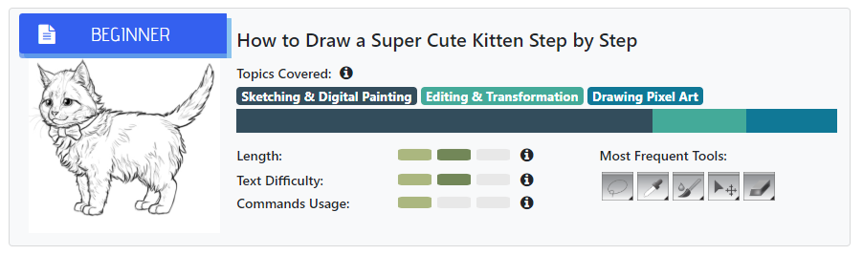
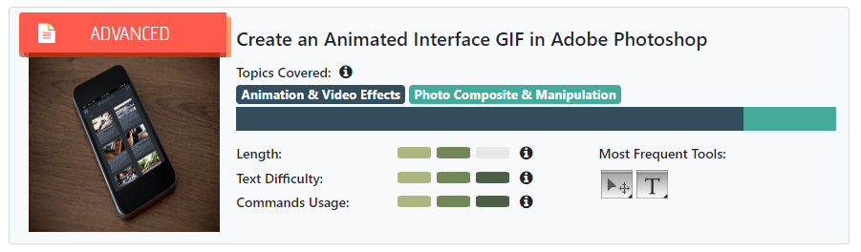
Length, Text Difficulty, Command Usage

Slide 35
Frequent Tools
Notes:
Earlier literature showed that tutorials could be useful in finding tutorials. Therefore, I also added this feature on the interface.

Slide 36
Development of the Prototype

Slide 37
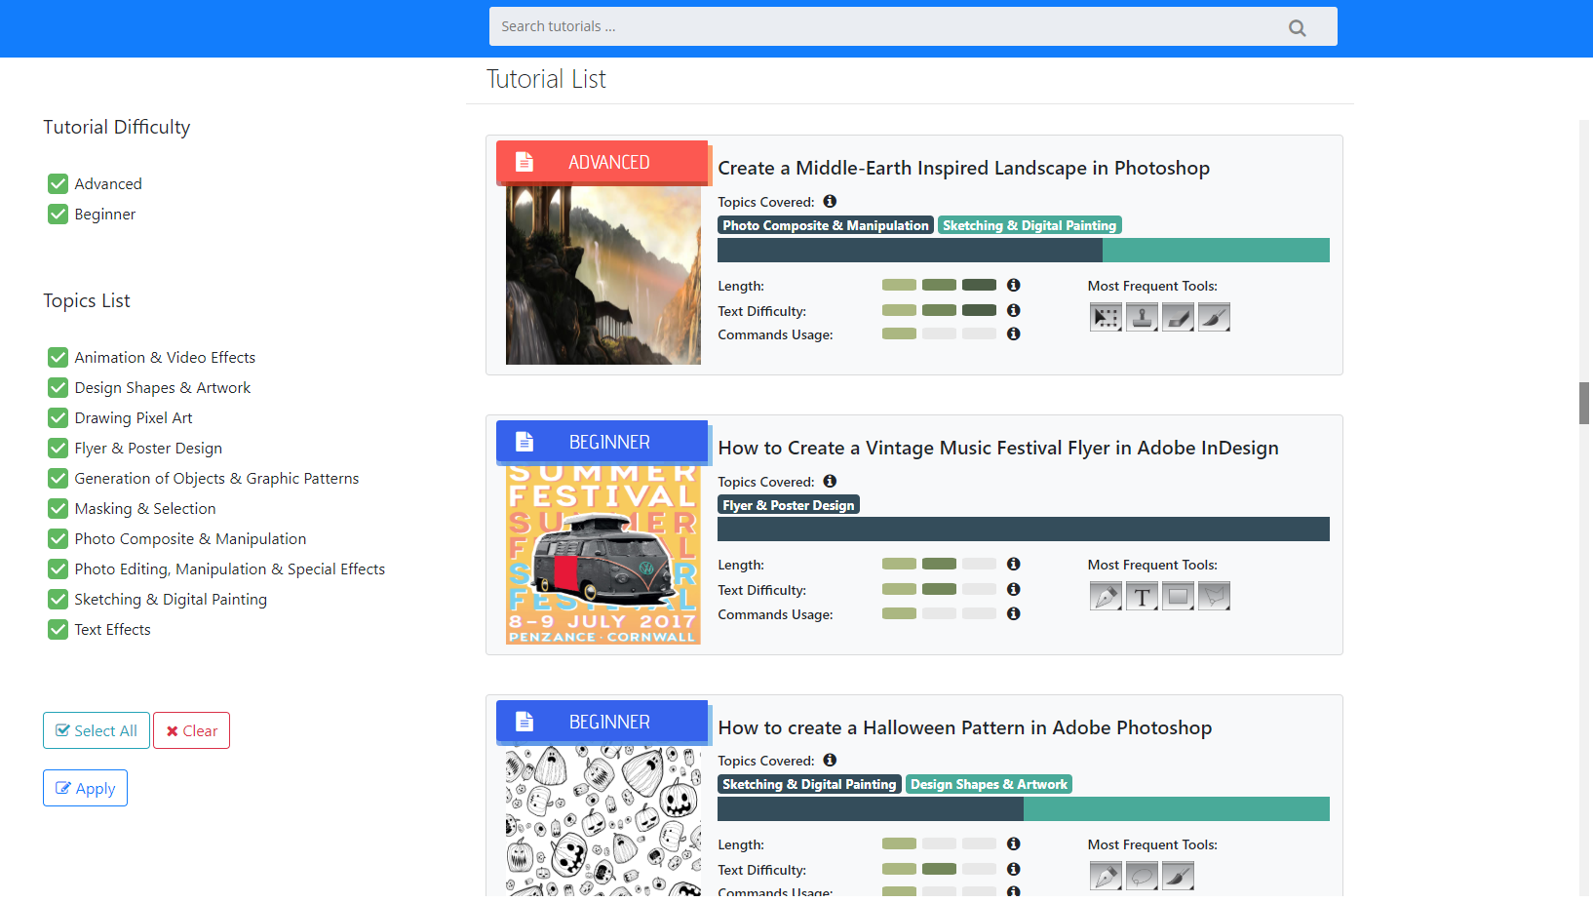
TutVis: Tutorial browsing system
TutVis
Tutorial Browsing System

Slide 38
TutVis: Tutorial browsing system

Slide 39
TutVis: Tutorial browsing system
Tutorial Selection Study
Evaluate the utility of TutVis
Value of the interface components in selecting tutorials

Slide 40




Tutorial Selection Study
Participants:
12 participants
(8 M, 4 F)
Range of expertise (Novice-Expert)
Interface Conditions:
Baseline: No features and labels (beg/adv)
TutDiff: Labels
TutVis: Features + Labels
Tutorial Repository:
3 different mutually exclusive sets
Each set containing 50 tutorials of varied topics, length and difficulty
Study Design:
Within subject
Each participant encounters 3 interfaces
Notes:
I started my study by recruiting 12 participants having a range of expertise. Among which 8 were female and 4 were male. I gave them 3 interface conditions. So, apart from TutVis I also developed other 2 variants which only varied in the amount of information they presented. For example, baseline interface did not have any feature or adv/beg labels for tutorials. Another variant TutDiff only had labels but no features. TutVis had everything. I also made 3 tutorial repositories where each set has 50 tutorials of varied topicsand difficulty levels. My study design was within subject. SO each participant encountered 3 interfaces.

Slide 41



URGENT
EXPLORE
Tutorial Selection Study
DIFFICULTY
Task: Select tutorials under certain scenario. [Dziubak et al., 2016] [Kong et al., 2012]
Suppose you have a deadline and you want to complete a poster design for an advertisement quickly…
Suppose you are free for the whole afternoon, and you are interested in learning about digital drawing. Find a tutorial…
Suppose you have a friend who has never used Photoshop before. Find a suitable tutorial for your friend…
Notes:
Scenarios are motivated from the findings of the previous research on different reasons that users search for tutorials online
3 sets of isomorphic tasks

Slide 42
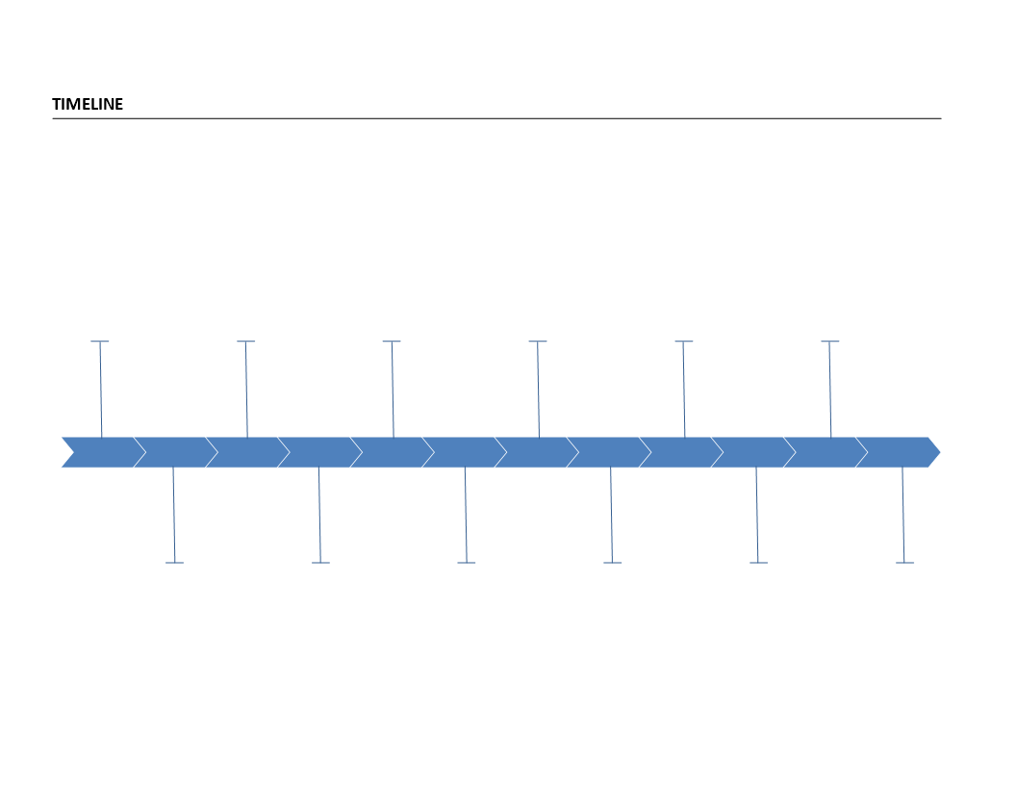
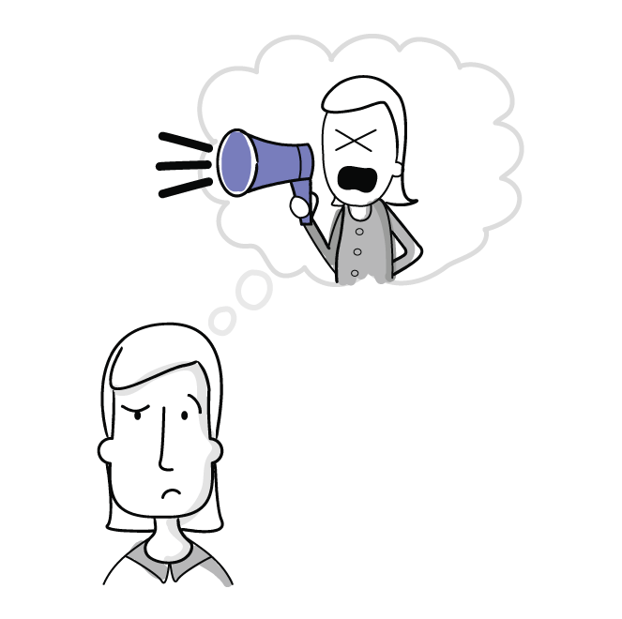

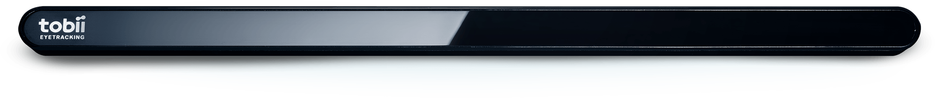
Tutorial Selection Study: Procedure
Meet Participant
Interface Condition 1
Tasks
Urgent
Explore
Difficulty
Post Condition Questionnaire
Interface components used ?
Confidence in selection ?
5-pt Likert
Interface Condition 2
Tasks
Urgent
Explore
Difficulty
Post Condition Questionnaire
Interface components used ?
Confidence in selection ?
5-pt Likert
Interface Condition 3
Tasks
Urgent
Explore
Difficulty
Post Condition Questionnaire
Interface components used ?
Confidence in selection ?
5-pt Likert
Semi Structure Interview
1.5 Hours
Think aloud
Gaze Tracking
tobii Eye Tracker 4C
Data Collection
Notes:
Meet and fill up the demographics
Tasks: Spend around 7-10 min per selection task did not require them to finish selected tutorials motivated from [kong et al. 2012]
Confidence in 5 likert scale
Semi structure interview: experience with the 3 interfaces.
Counter balanced across participants.
Think aloud describing their thoughts.

Slide 43



Tutorial Selection Study: Results
TutVis
TutDiff
Baseline
All participants preferred TutVis
Statistically significant main effect
(χ²(2) = 11.267, p = 0.004)
on tutorial selection confidence
Post hoc comparisons revealed a trend
p < 0.05
p < 0.05
TutVis
TutDiff
Baseline
Notes:
I asked participants to rank the three interfaces according to their subjective preferences. All 12 participants ranked TutVis as their most preferred interface
Friedmans 2 way ANOVA with interface as the within subject factor.

Slide 44
Tutorial Selection Study: Results
Self-reported interface components used
Notes:
From the participants self reported questionnaire I found every one of them reported using topics. They also reported using difficulty labels, tittle and thumbnail during tutorial selection tasks.

Slide 45
Tutorial Selection Study: Results
Interface components used according eye-gaze and think-aloud data
Notes:
From the think a loud and eye gaze data I found participants used topics for each of the task. Interestingly they also looked at difficulty levels in almost every tasks but heavily relied on it during difficulty task and the same for length.

Slide 46
Tutorial Selection Study: Discussion
Topics provide a useful preview
“It is giving you a type of outline […]. It is like a preface to a book. Like when you start reading, you should know the contents.” – P10
Notes:
Now I move to the qualitative result.
From the interview, I found participant considered topics as the preview. Even one participant considered it as the preface of the book.

Slide 47
Tutorial Selection Study: Discussion
Difficulty labels help with filtering and uncovering advanced techniques
“For event flyers [task scenario] I think that one [beginner tutorial] is really fit for the task. But in my mind, if I am doing this […] I vote to have something more stylish more attractive […] eye catchy. So that’s why I am choosing this advanced tutorial […]” – P7
Notes:
They used difficulty labels to filter or to uncover advanced techniques. For example, one participant said to use advanced flyer design tutorial because that looked eye catchy than the beginner tutorials. In case of the other features, participants felt length is important but they hardly talked about using command usage and text difficulty.

Slide 48
Tutorial Selection Study: Discussion
Participants worried more about misclassifications related to beginner tutorials
“I think that [following misclassified tutorial] is not difficult for me here because I can follow each level [advanced or beginner]” – P7(Expert)
“If I am sharing a tutorial to someone else like in it said a grandparent [sharing advanced tutorial to beginners] and it is actually advanced […] that’s not gonna be very good” – P1(Novice)
Notes:
When participants were asked about misclassification I had different responses. To expert participant it was not a huge deal as they could follow any tutorial. For beginner misclassification was seeming to be a problem as they might be misguided by the wrong information.

Slide 49
Tutorial Selection Study: Summary
Participants needed the labels and the features
Topics and labels were most heavily used components
Use of length was task and user dependent
Text difficulty and commands usage had little qualitative support
Beginners were more impacted by the misclassified results

Slide 50

Contribution: In Summary
Identify and
investigate differentiable features
Classify with 85 % accuracy
Design and
develop
TutVis
Proof of concept evaluation on tutorial selection

Slide 51




Future Direction
Reduce the impact of misclassification
Automate manual effort
Recommender system
Finer grain difficulty
Notes:
Classifier need to be particularly conservative when labelling any tutorial as beginner (augment the label with community based feedback about tutorial difficulty)
Hand analyze tutorials to generate topic labels. >> Crowd workers to assign labels
Recommend related tutorials with similar topics
Deploying in real world to see how TutVis supports tutorial browsing and selection. | Finer grained difficulty assessment. |

Slide 52
An Investigation on Automatically Assessing an Application Tutorial’s Difficulty
Thank you
Presenter
Shahed Anzarus Sabab
Supervisor
Dr. Andrea Bunt
Committee Members
Dr. Danny Mann, Dr. Olivier Tremblay-Savard

Slide 53
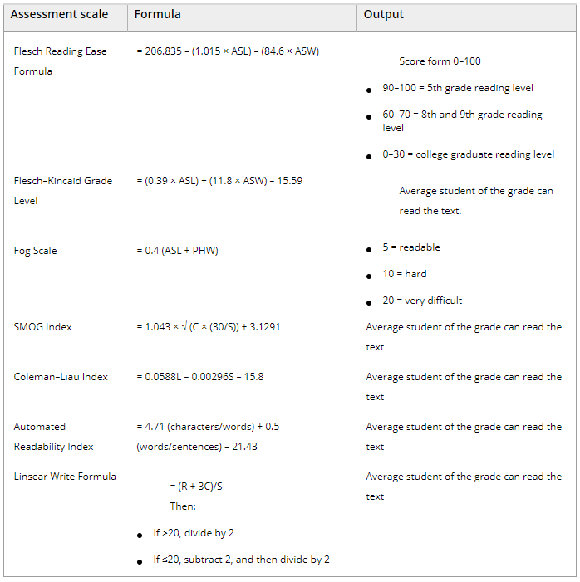
ASL = average sentence length (i.e., the number of words divided by the number of sentences [S]);
ASW = average number of syllables per word (i.e., the number of syllables divided by the number of words);
PHW = percentage of hard words (i.e., the number of 3+ syllable words [C] divided by the number or words in the sample passage);
R = the number of words ≤2 syllables;
L = the average number of letters per 100 words
[Eltorai et al., 2015 ]
US Government Agencies use some of these formulas
Source: https://en.wikipedia.org/wiki/Flesch%E2%80%93Kincaid_readability_tests

Slide 54
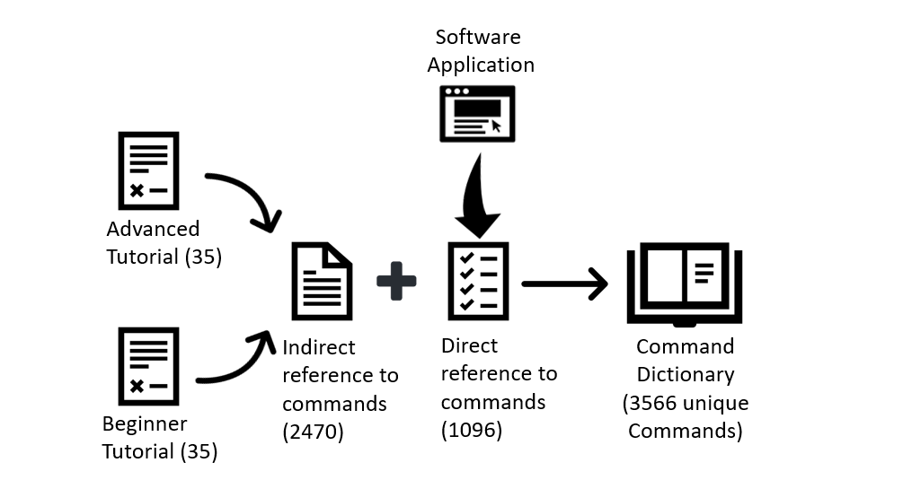
Detecting Commands
Feature Engineering
Command Ratio
Percentage of words refereeing to any photoshop command
[Pavel et al., 2013]
Notes:
Actual: Set blending mode Colloquial: adjust the blending mode

Slide 55
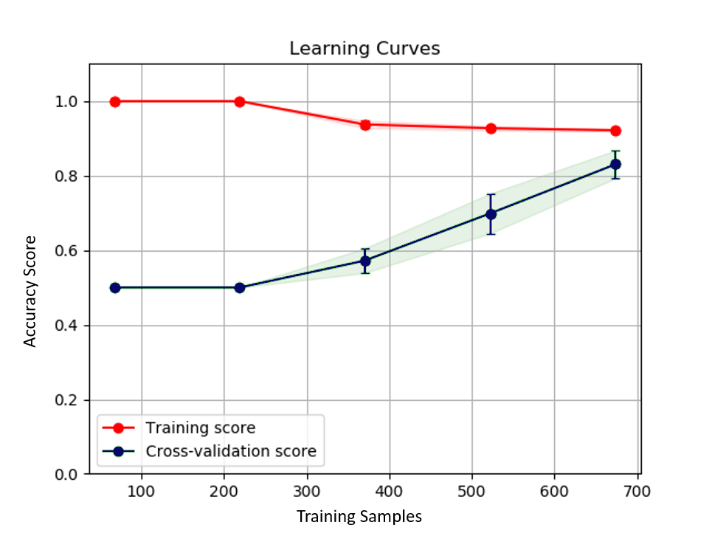
Learning Curves (Bias – Variance Trade-off)

Slide 56
Different types of topics

Slide 57


Topic Model In Summary
Label 1
Label 2
Label 3
Composite
Sketching
Video Effects
Topic Labeling:
Based on the type of tasks performed and the end result
Qualitative Analysis
Topic 1
Topic 2
Topic 3
Tutorial Clusters
Topic 1:
scene ,resize ,composite ,matte
Topic 2:
color, art, sketch,
line,
Topic 3:
animation, timeline, video, playback
Tutorials
(Preprocessed)
Topic Model
LDA
Table: Topic-Word Distribution
 | Topic 1 | Topic 2 | Topic 3
 | 0.7 | 0.2 | 0.1
 | 0.1 | 0.6 | 0.3
 | 0.2 | 0.3 | 0.5
Classification Model:
Based on the features
(i.e., topic distribution probability)
Quantitative Analysis
Sample Tutorials
Table : Document-Topic Distribution

Slide 58
Differences: Advanced vs Beginner Topics
Notes:
Advanced: special techniques > Smart object > Preserve source content
>Assumed knowledge (how-to)
>Use of additional complex software
Beginner: comprehensive description, no existing knowledge
> Multiple techniques that were covered in isolation in beg tutorials

Slide 59
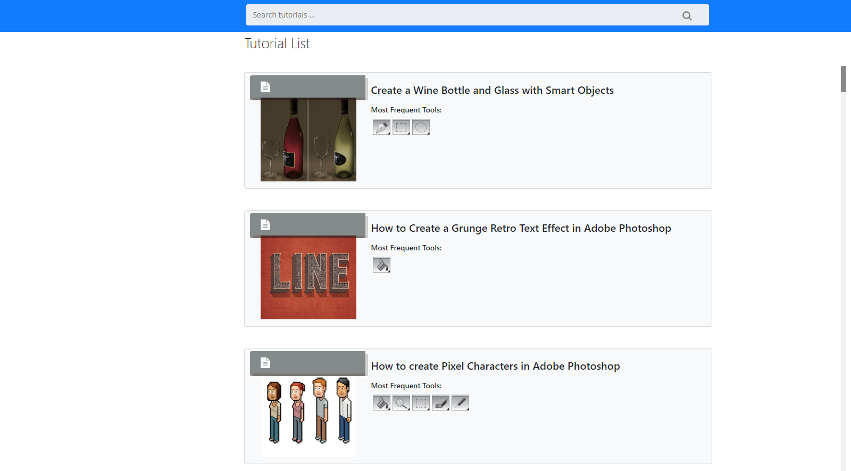
Baseline

Slide 60
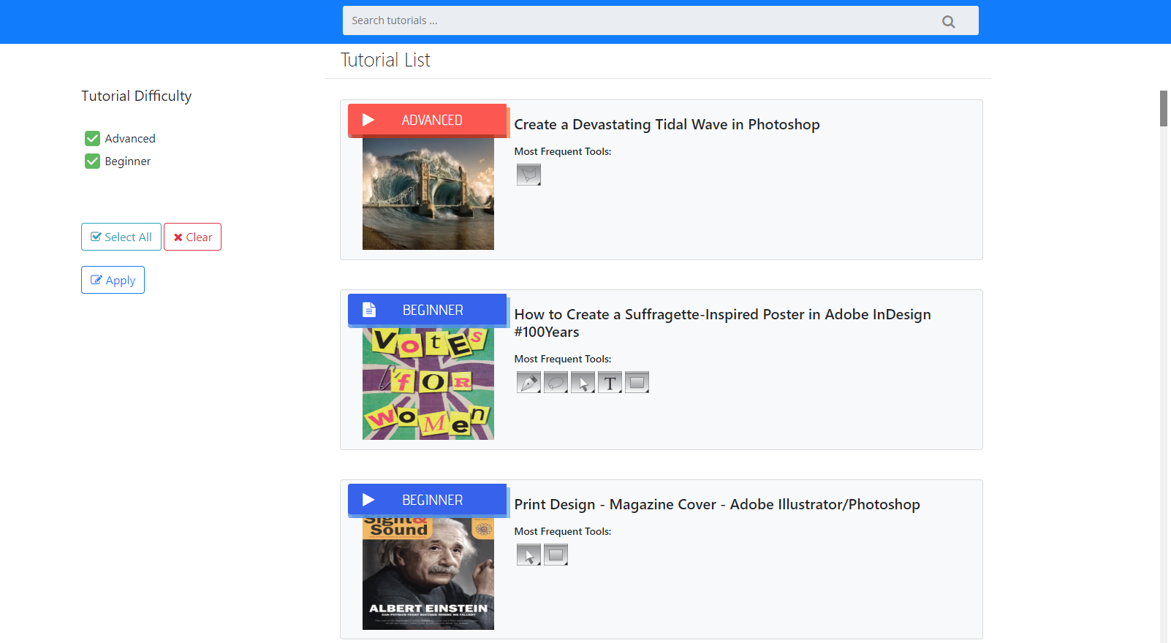
TutDiff

Slide 61
TutVis

Slide 62
Development of the Prototype
Tutorials
Sample | Length (# of words) | Word Repetition (%) | Text Difficulty (1-17+) | Command Ratio (%) | Topic 1 (0-1) | … | Topic 30 (0-1) | Decision
Tutorial 1 | 1322 | 45 | 10 | 27 | 0.23 |  | 0.04 | Advanced
Notes:
So lets see one example of the transformation. We have a tutorial and its representation using different features.

