Slide 1
Soliciting Reader Contributions to Software Tutorials
Tell Me More!
Patrick Dubois, Volodymyr Dziubak, Andrea Bunt
May 18th, 2017

Slide 2
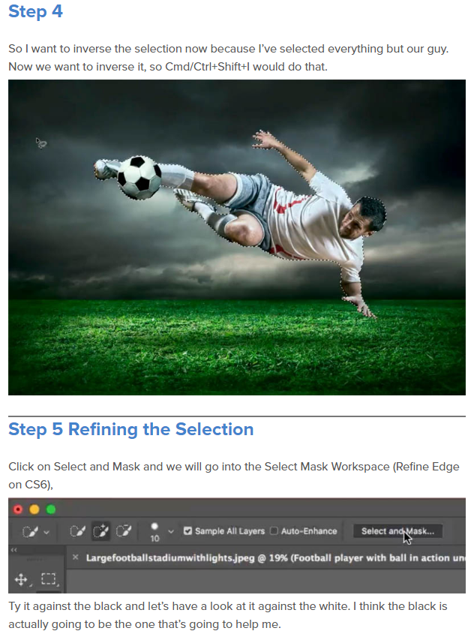
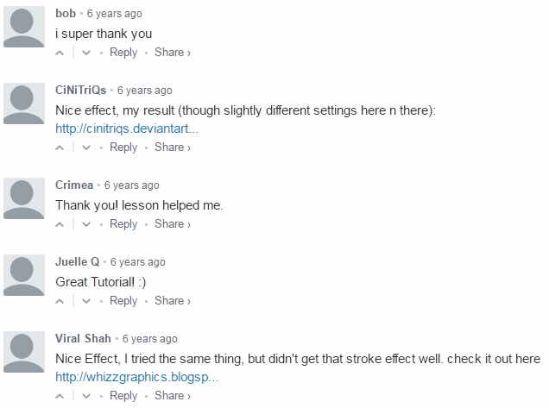
Notes:
targeted to different skill levels or software or software versions
incomplete, errors or omissions

Slide 3
Notes:
Some comment types that we can find are the following…

Slide 4
Contributions
Model for community enhancements
Multi-session evaluation
Design considerations
Notes:
1. Model for eliciting contributions that benefit the community, through a system we built that we call Antorial

Slide 5
Related Work
Eliciting and sharing software knowledge
e.g., Chilana et al. 2012, Matejka et al. 2011
Improving and authoring tutorials
e.g., Bunt et al. 2014, Kim et al. 2014, Lafreniere et al. 2013
Notes:
Our work is primarily influenced by two areas…
1. Previous work has found that user submit content to in-application help resources
It is encouraging that people do this, indication that people want to share, use this for tutorial comments
2. People value submitted content, but how need to adapt to tutorials

Slide 6
Goal: Elicit Tutorial Improvements
Add structure to guide content-specific notes
Emphasize the importance of notes
Notes:
2. … by better integrating into tutorial content
Introduce Antorial

Slide 7
Corrections
What is
this?
Tell me
more!
Questions
Other
Notes:
Notes hidden by default because
To summarize how this approaches our goal of eliciting tutorial improvments…

Slide 8
Multi-Session Evaluation
Notes:
To see how this model of community tutorial refinement impacts contributions
gather subjective impressions

Slide 9
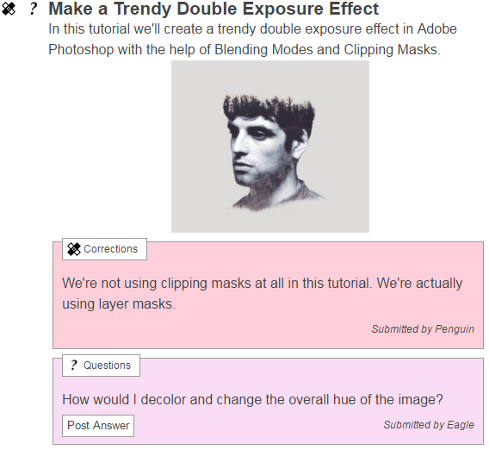
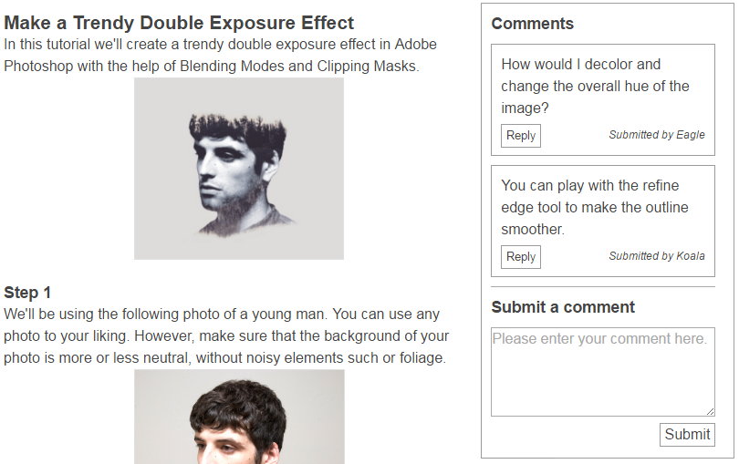
Antorial
Baseline
Notes:
Are goal was to get feedback on Antorial
Provided a baseline as a comparison, closer to a more traditional model

Slide 10
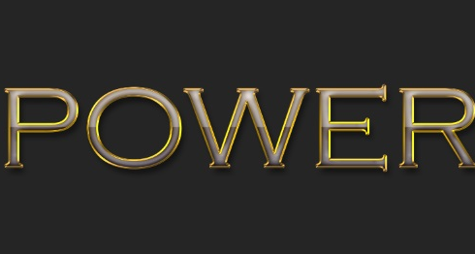
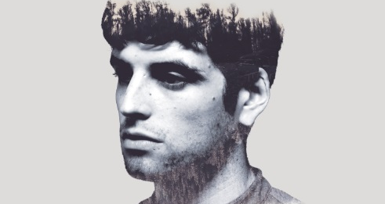
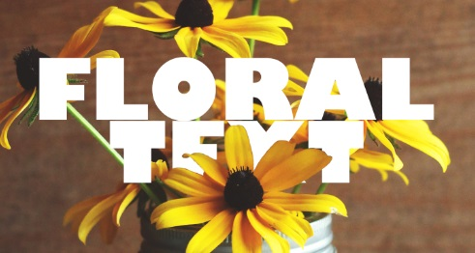
Antorial
Baseline
Notes:
Equivalent tutorials
Counter-balanced order of tutorials and conditions
Questionnaires in between

Slide 11
Setup
Thirteen expert Photoshop users
Two weeks each, to improve four tutorials
Motivation: tutorials will be used by students
Notes:
Experts are likelier to post meaningful content
Motivation for posting

Slide 12
Evaluation Results
Notes:
Submitted notes, questionnaires, interviews were transcribed
Today, I will present some highlights of our results.
Please take a look at our paper for more detailed results.

Slide 13
Mean number of notes per participant
*Error bars represent standard error
Notes:
Lends support that our model elicits more notes
We further analyzed the types of notes submitted, and have reason to believe that we have positive results.
Please refer to the paper for all the details.

Slide 14
Target Audience
13%
General
12%
9%
Reader
9%
78%
79%
Tutorial author
Antorial
Baseline
Notes:
Who was meant to consume the note
Better for readers when consuming notes, possibly leverage this…
For other dimensions, please look at the paper.

Slide 15
Overall Preference
Notes:
Interviews used to understand their choices

Slide 16
Notes are Direct to the Topic
The [baseline] is just for regular stuff, [Antorial] is much more specific. (P1)
Notes:
Antorial encouraged participants to be more on topic
Don’t need to mention step number

Slide 17
Categories Guide Contributions?
[The] icon guided me to make my comments. […] I would go here and say ‘maybe I need to look for something I don't understand, or something to correct. (P3)
I knew what my comment was but I really had a hard time figuring out what the category should be. (P11)
Notes:
Here, opinions diverge.
Suggest what kind of notes would help
Can’t find a good category, or too much thought
Preferred freeform
Overall, need refinement, still open to see how much they actually help

Slide 18
Social Effects of Hidden Notes
[The baseline] feels more like the commenting section - it feels like you'd have more discussion with the other artists than on [Antorial]. (P9)
[With the baseline,] I didn't want to annoy other people and post a lot. So I combined all the things I had to say […] into one comment […] (P11)
Notes:
Encouraged discussion, see what’s there
Concerned with taking over conversation, group comments in longer notes
To summarize our results, participants submitted more notes with Antorial, but had mixed reactions.
Next, we present some considerations for moving forward.
Because integrated
didn’t want all visible
Interfere
Self-conscious
Feel disrupting discussion

Slide 19
Design Considerations
Potential for categories to guide contributions
Tradeoffs of notes being scoped to tutorial steps
Design could emphasize learners as audience
Notes:
1. Took time creating categories, but proved to be detrimental for some participants.
Categories need to be designed with care, more thorough design process may be warranted

Slide 20
Future Work
Open-ended deployment
Exploring other posting models
Notes:
Study enabled us to see how
-community tutorial refinements impacted contributions
-gathered subjective impressions
1. Wider range of participants would have what kind of impact, see how tuts evolve over time, see how users interact with eachother.
2. (a) General comments (b) Categories, other formats (video)
Overall we feel that there are many exciting possibilities.

Slide 21
Tell Me More! Soliciting Reader Contributions to Software Tutorials
Model for community enhancements
Multi-session evaluation
Design considerations
patrick.dubois@cs.umanitoba.ca
hci.cs.umanitoba.ca

Slide 22
Tell me more!
What is this?
Corrections
Questions
Other
Notes:
Previous research found categories reflecting existing commenting behaviour
Created categories to encourage more useful notes

Slide 23
Procedure
Meet participant
Antorial
Set 1
Questionnaire
Baseline
Set 2
Questionnaire
Semi-structured interview
Set 2
Set 1
Baseline
Set 1
Antorial
Set 2
Set 2
Set 1
Notes:
Counterbalanced
Within-subjects

