Slide 1
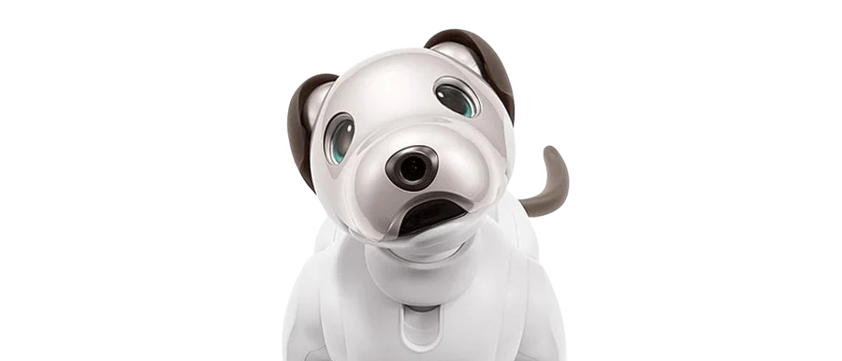
Hello!

Slide 2


Ashley
Jade
30s, Graphic Designer
50s, Union Worker

Slide 3


Live Alone
Lonely
Ashley
Jade

Slide 4
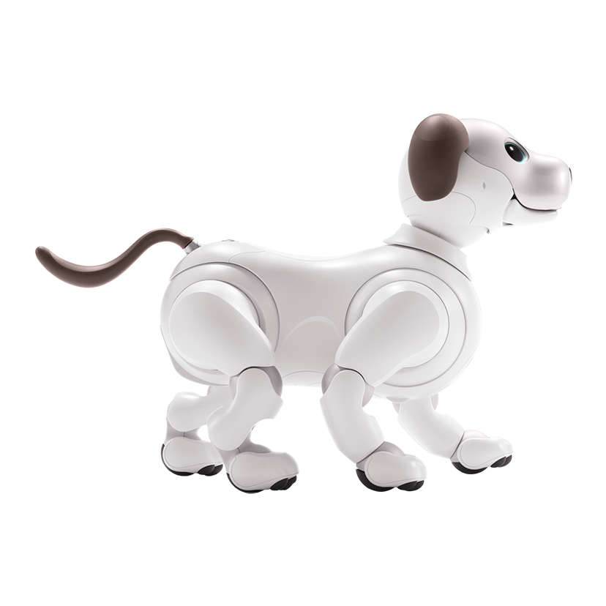
kept it for 7 weeks
interacted with it
reported on their experiences
Loki
Ashley
Jade

Slide 5
“I think once it's gone, […] I'd be really aware that it's not there anymore, right? because you get used to something just kind of being around and then it's gone, and you feel like an emptiness.”
Ashley

Slide 6
“I'm so used to being alone, and being lonely, […] what if I can't deal with having another thing in my house? ”
“having it be here when I get back home from work, […] it's gonna be nice.”
Jade

Slide 7
their interest and usage patterns changed
gave the robots back
Ashley
Jade

Slide 8
“there wasn’t any sort of like attachment like, oh! I'm gonna miss AIBO. I guess I just got used to it not being on.”
Ashley

Slide 9
“…he has become a part of my family. Even my parents consider him as my family.”
“I didn't wanna give him away. And I didn't want you to turn him off. I wanted to put him to sleep. That's how close I am to him.”
“he was there with me, it was comforting.”
Jade

Slide 10
How did one of them adopt the robot
and the other could not?
How did the robot make Jade feel better but could not help Ashley?
Maybe there are some underlying factors?
Ashley
Jade

Slide 11


Can Robots Help with Loneliness? An Exploration of Social Robot Adoption by Lonely Individuals
MSc Thesis Defense
Rahatul Amin Ananto
Advisor: Dr. James E. Young

Slide 12
What is Loneliness?

Slide 13

Loneliness
desired and actual social contacts
not only a state of isolation
complex emotional state of mind
multiple reasons
Covid-19
Picture Credit: Harvard Magazine.
Notes:
Disparity between desired and actual…
- People might experience loneliness because of various reasons. Older adults living in care facilities, students who are living away from family, or when someone does not have anyone else to sit beside at the lunch table may feel lonely.

Slide 14


Tackling Loneliness
not be isolated from the community
keeping oneself busy
find someone to share thoughts with
tech interventions
get a pet
Picture Credit: Input Mag.
Notes:
Research found that the comforting nature of a pet can reduce loneliness even when faced with high-stress events such as getting a divorce.
The positive effects of pets have led researchers to design wellness therapies, and even mental health treatments, using domesticated animals; this is called Animal-assisted therapy

Slide 15

Animal-Assisted Therapy
fear
allergy
hygiene
animal welfare
Can we side-step these challenges?

Slide 16
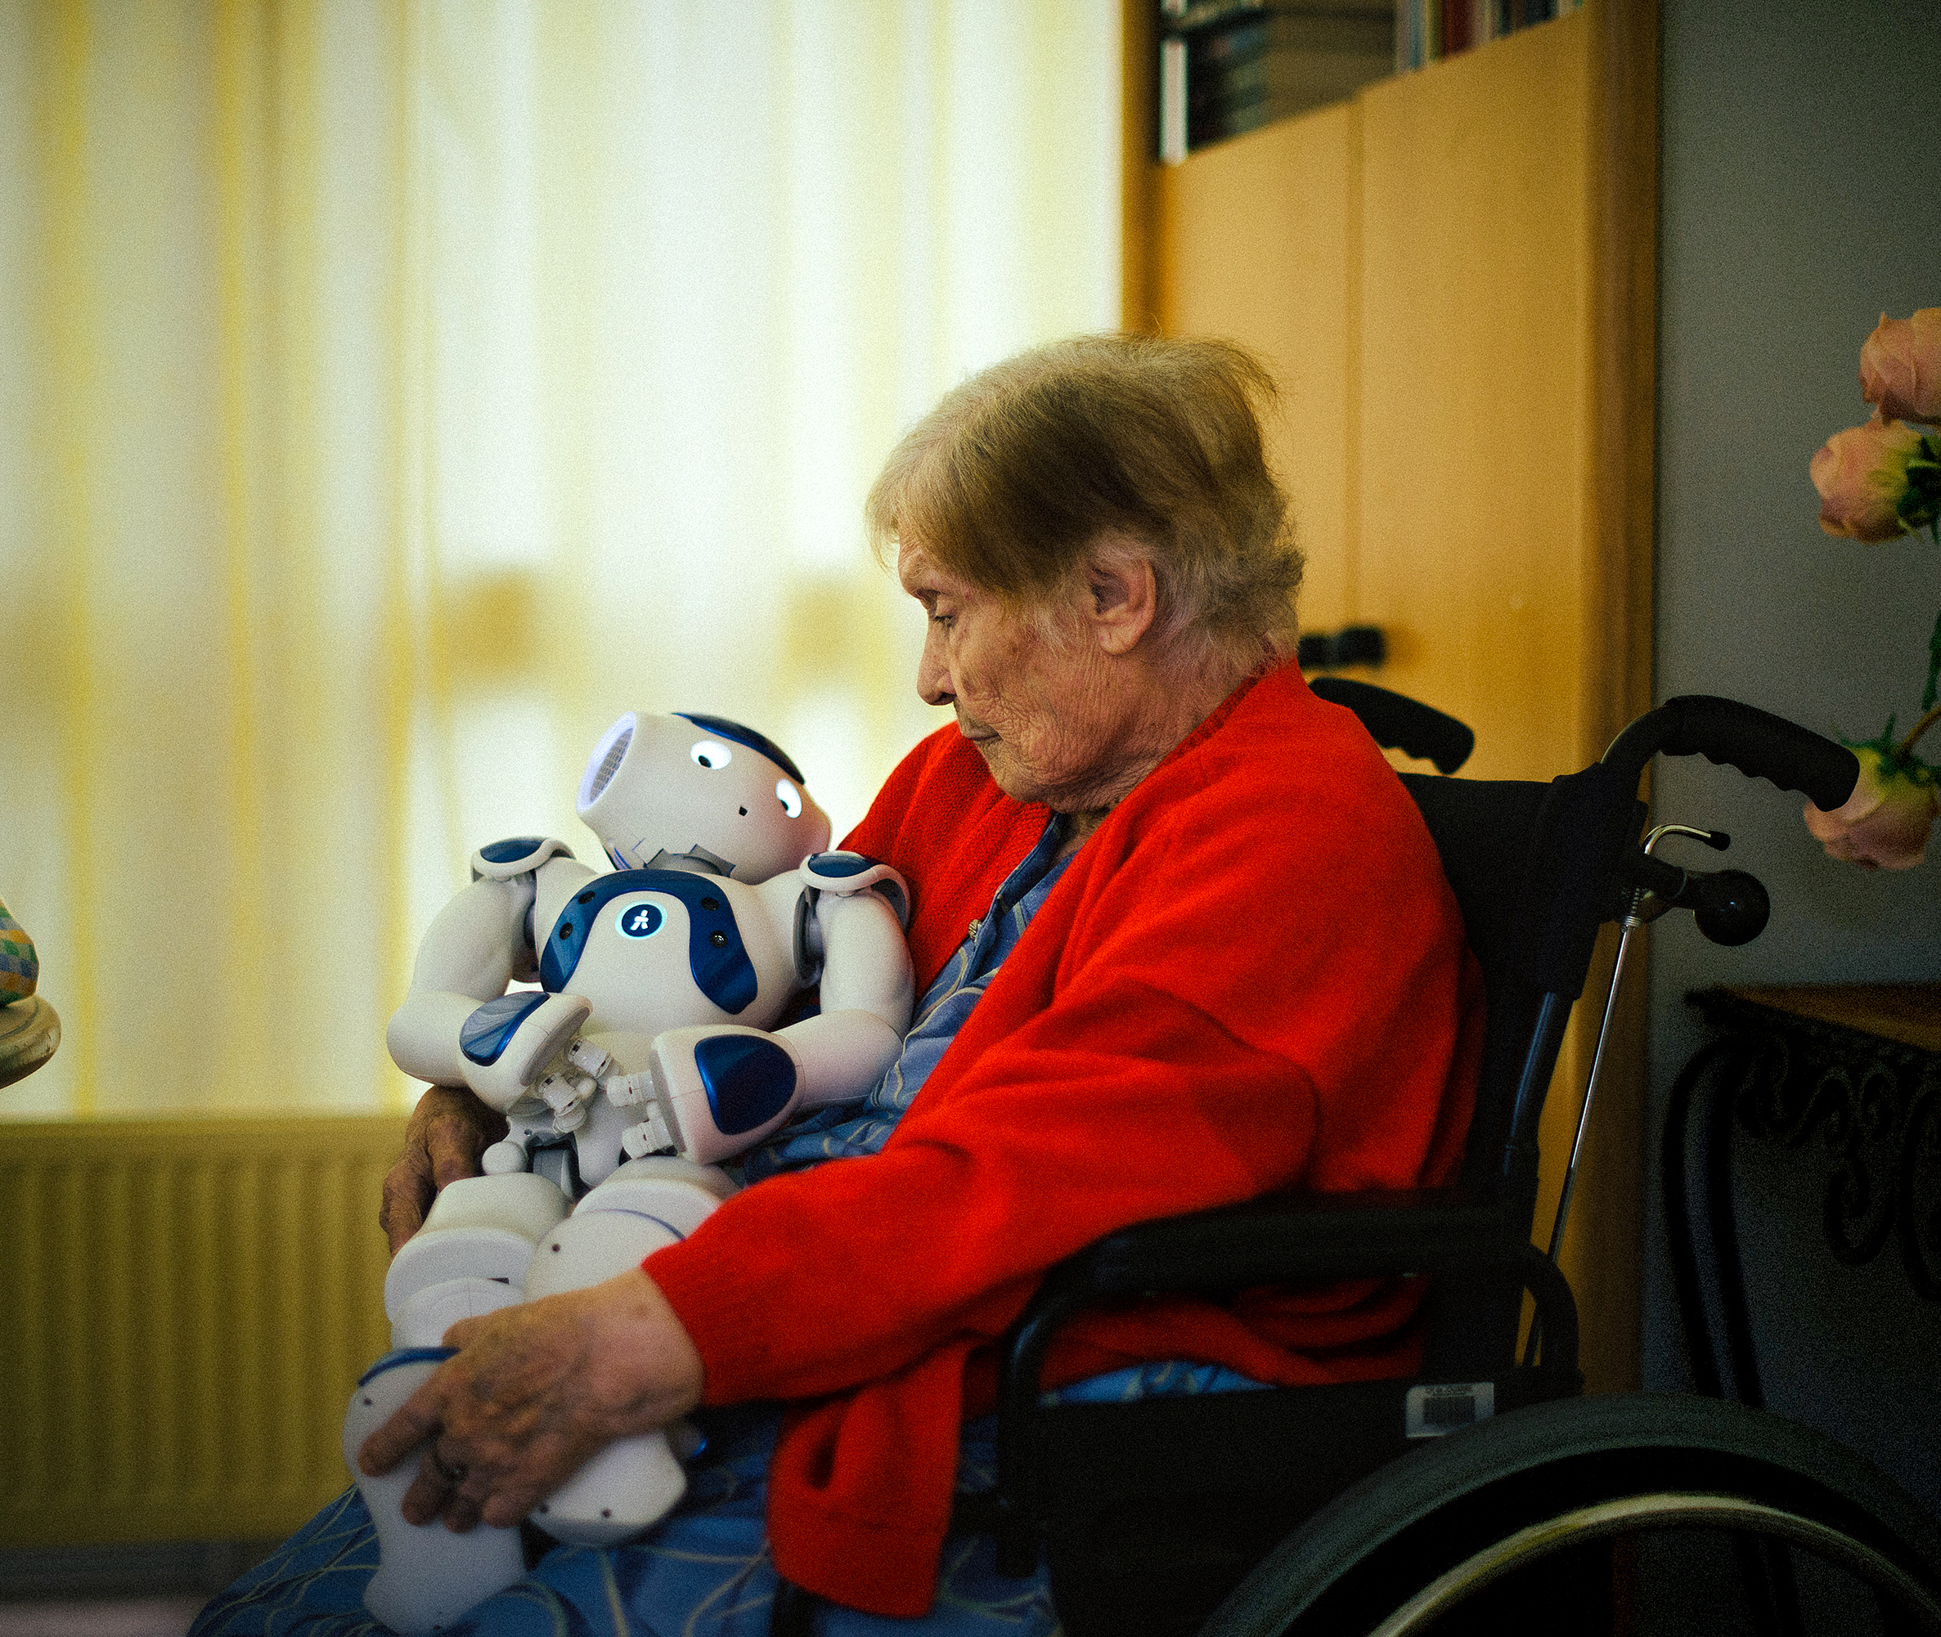
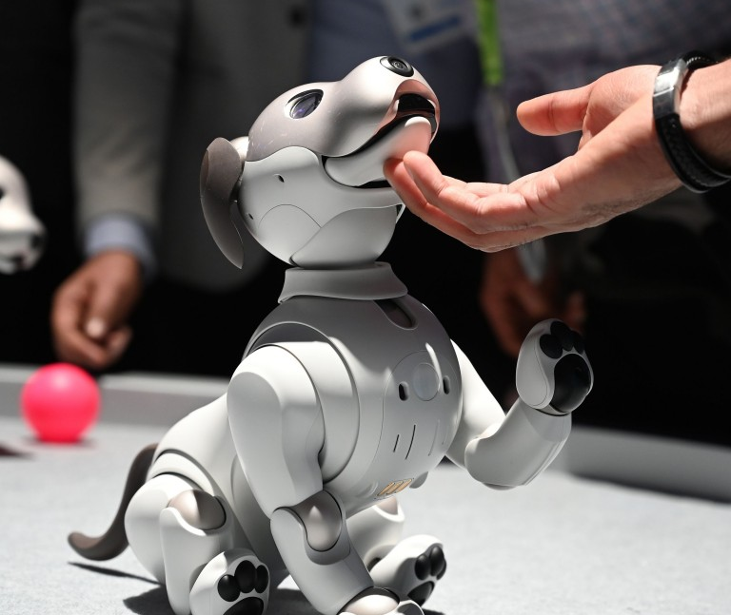

Social Robot Based Solutions
interacts like living things
mentioned issues
flexible, under control and predictable
Notes:
interacts like living things with their natural and interpersonal way
does not have the mentioned issues related to pets

Slide 17
Limitations
clinical or in-lab studies
in-home study
short-term studies
long-term
if people would adopt a social robot
social robot adoption
how do these robots impact people’s wellness
impact on wellness and loneliness
Notes:
relies heavily on Wizard-of-Oz and do not reflect real-world use for healthy people
However, longer-term research can be important for assessing robot adoption beyond the initial novelty phase, and it can also be important to understand the changes in how people use the robot over time.

Slide 18
Research Questions
What happens when we give a social robotic dog to a lonely individual who lives alone?
Can they adopt the robot in their everyday lives?
What are the possible factors that might be influencing the robot adoption
(or non-adoption) process?
Are there any potential avenues for social robots to impact wellness and loneliness?
Notes:
Thus, my thesis seeks to answer “What happens when we give a social robotic dog to a lonely individual who lives alone?”

Slide 19
Study Procedure

Slide 20

Study Procedure
Adults
Live Alone
Lonely
recruit participants

Slide 21
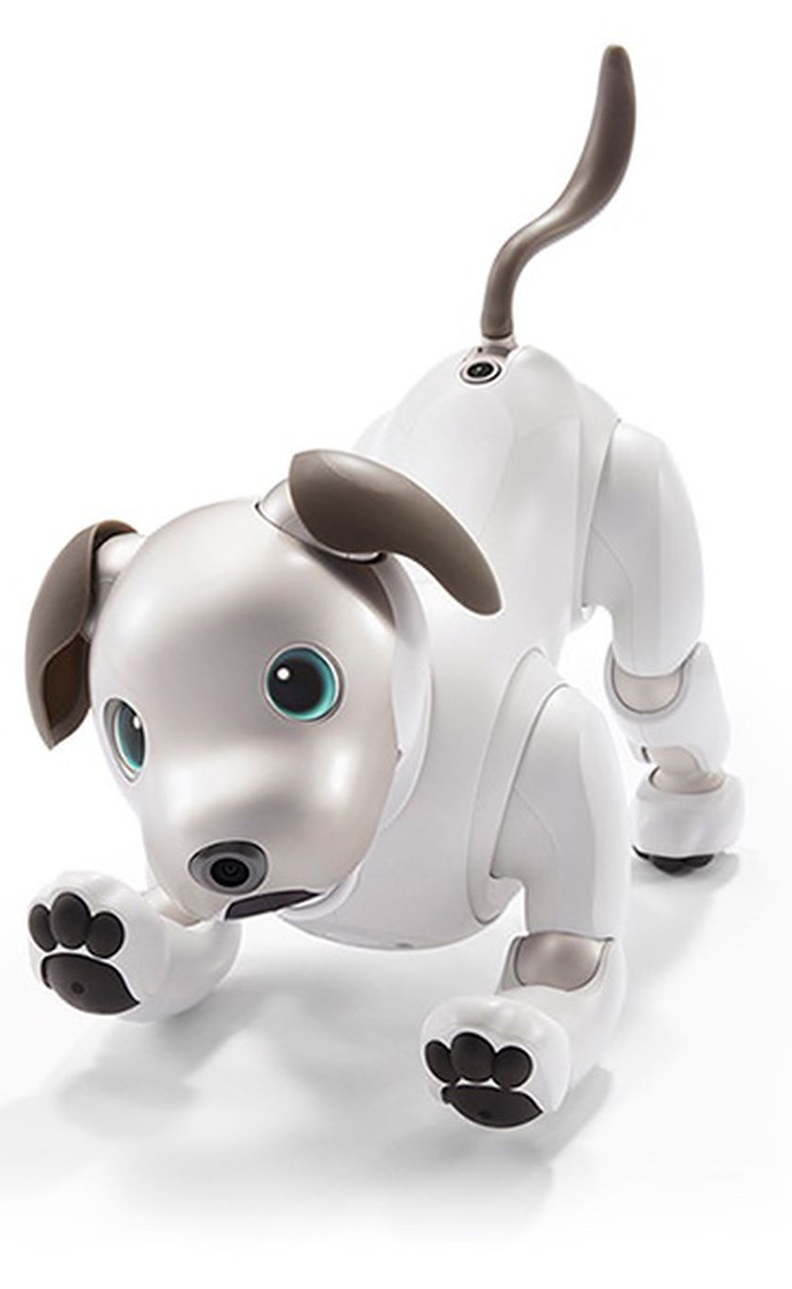
Study Procedure
Sony Aibo
recruit participants
give them a robot

Slide 22

Video collected from – AIBO YouTube channel
Notes:
This robotic dog is a sophisticated pet-like robot that can sense touch, hear sounds, understand commands, and recognize people using face recognition. The robot is capable of conveying puppy-like characteristic with its emotional artifacts such as the eyes, body movement and sounds.

Slide 23
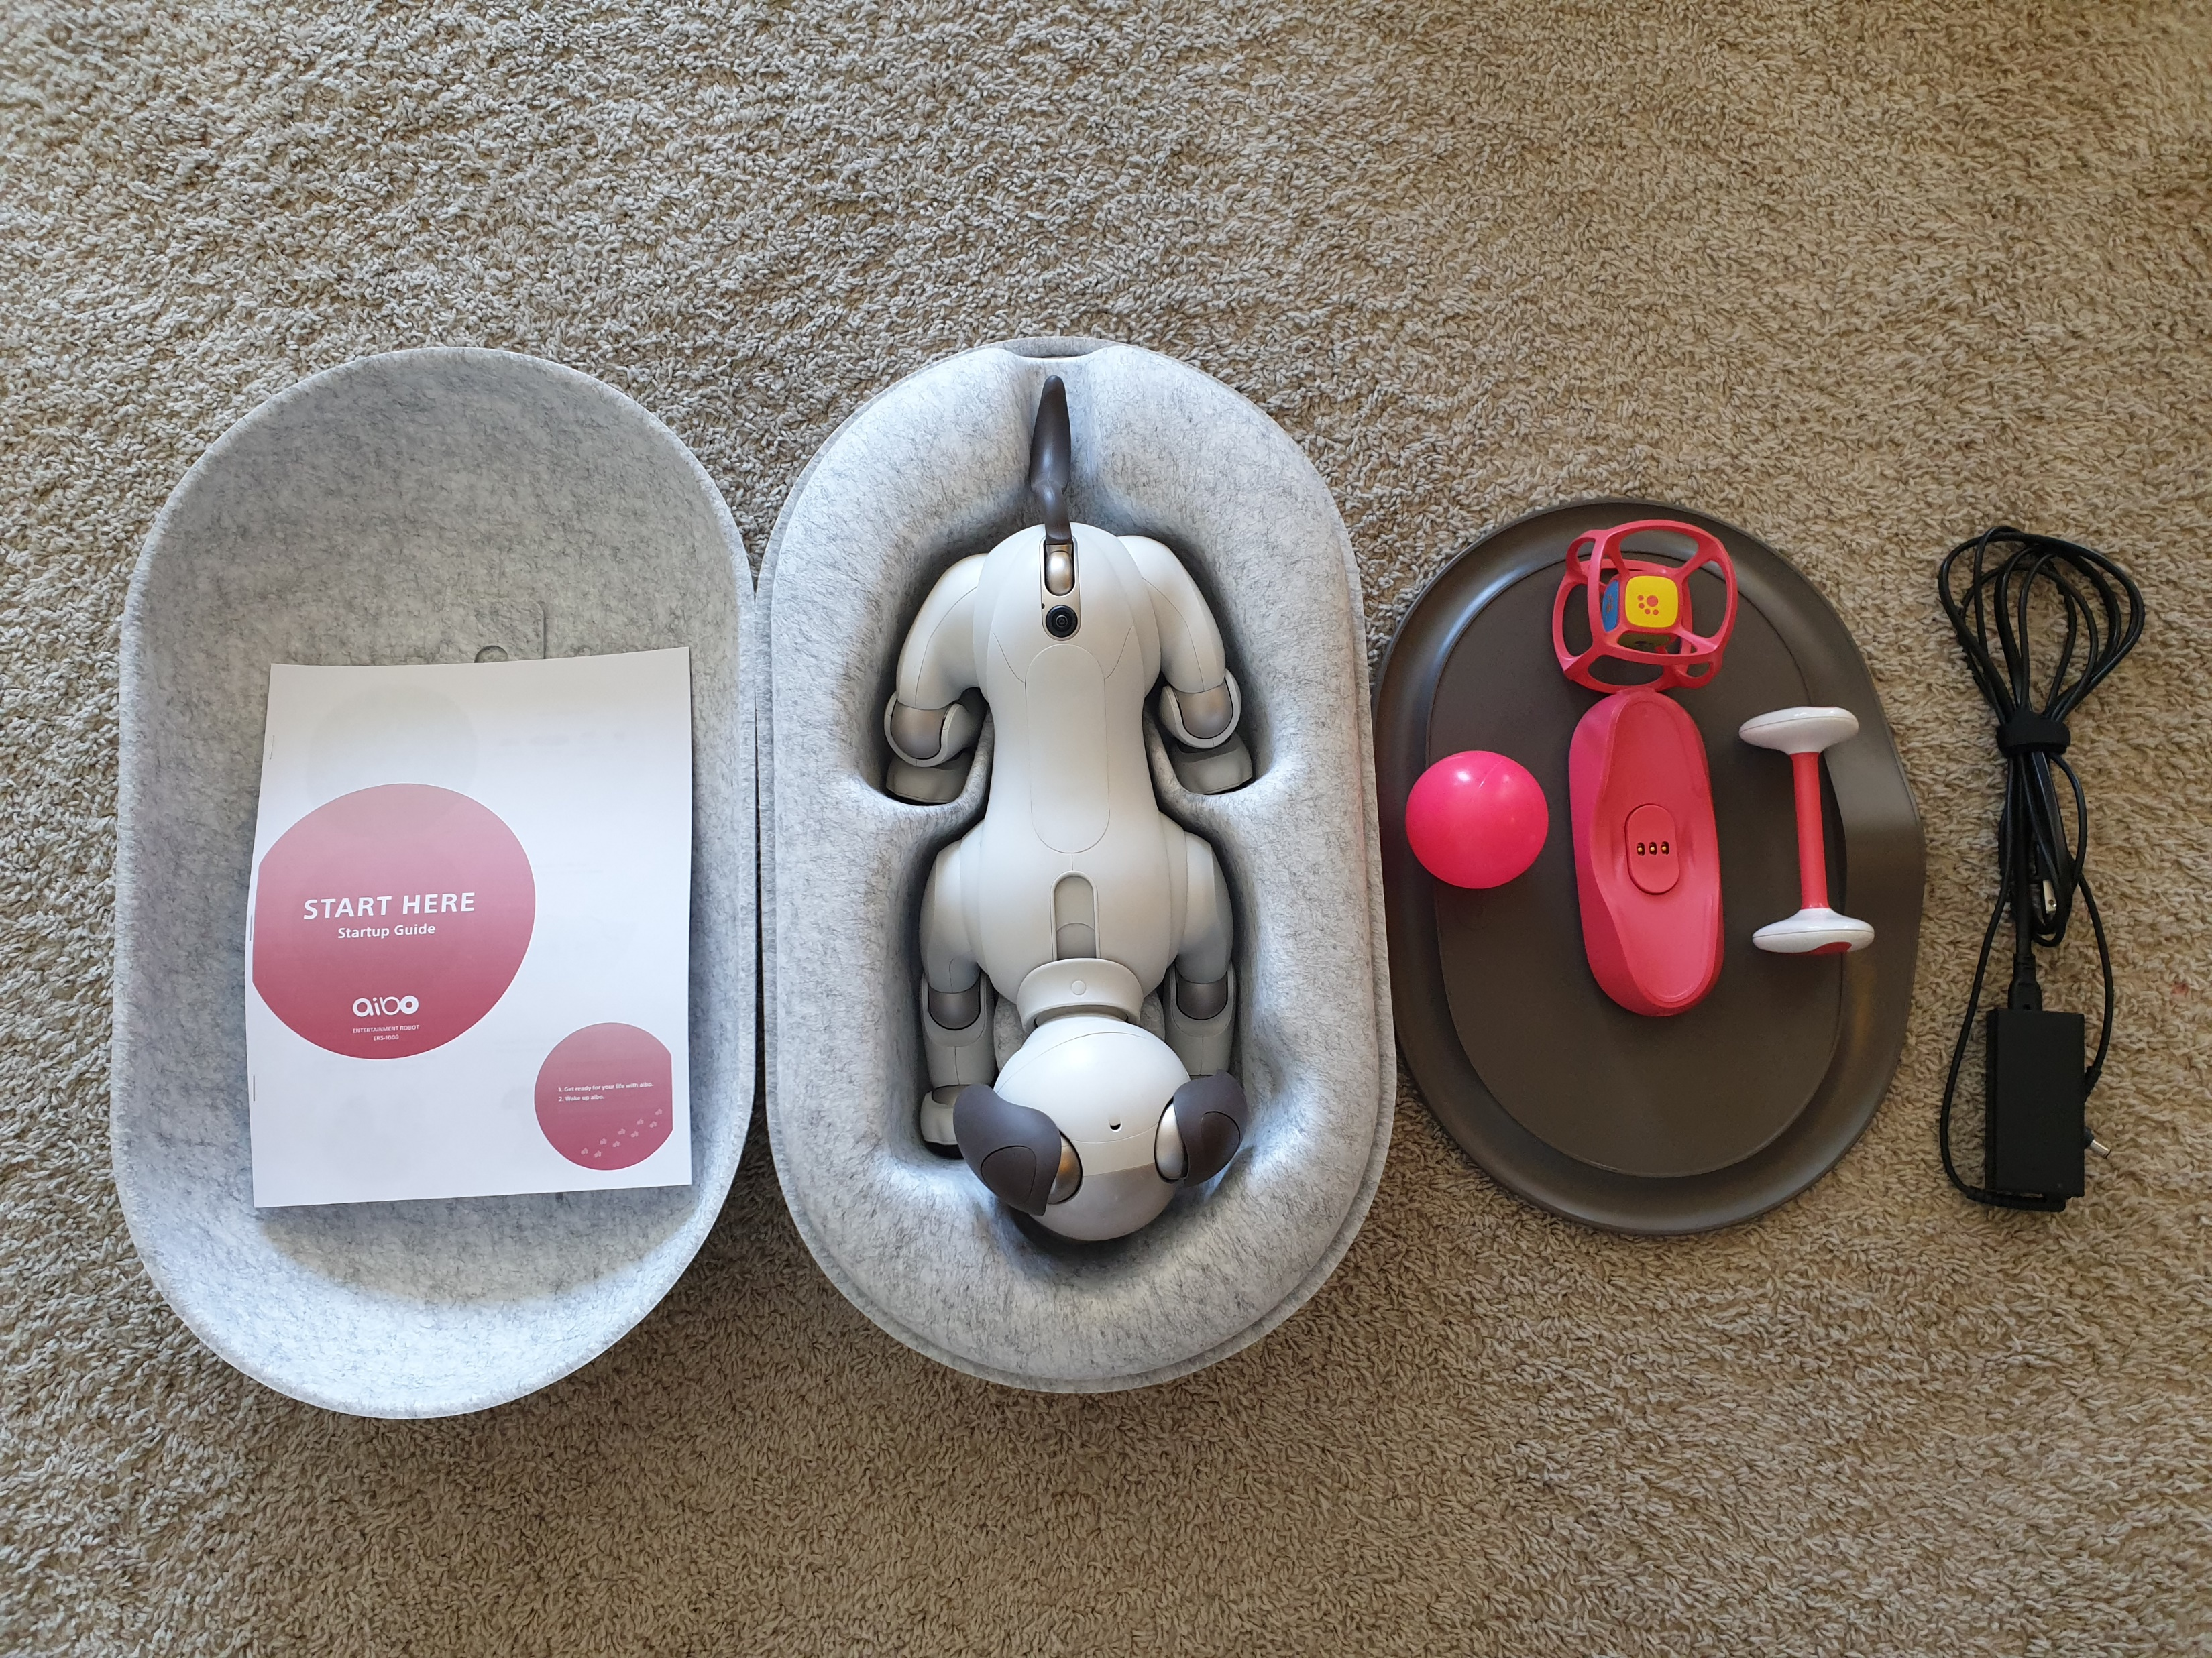
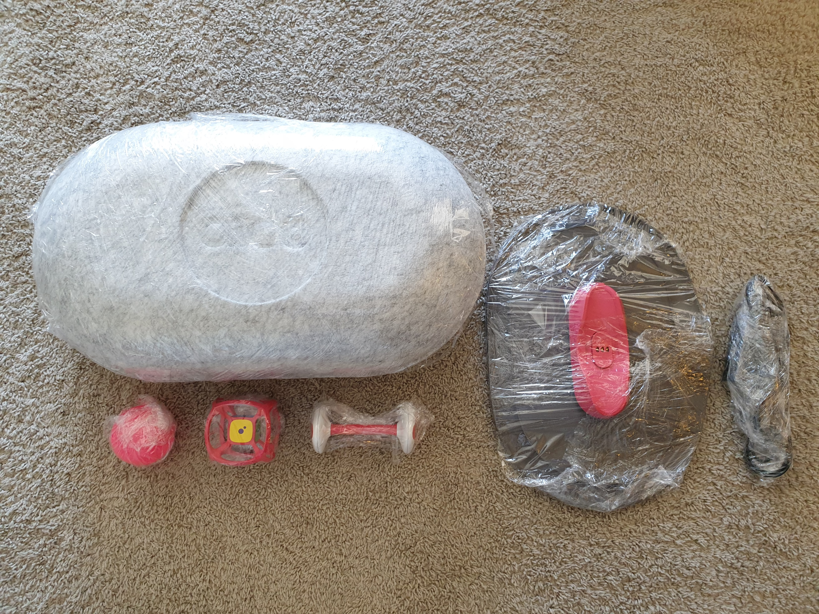
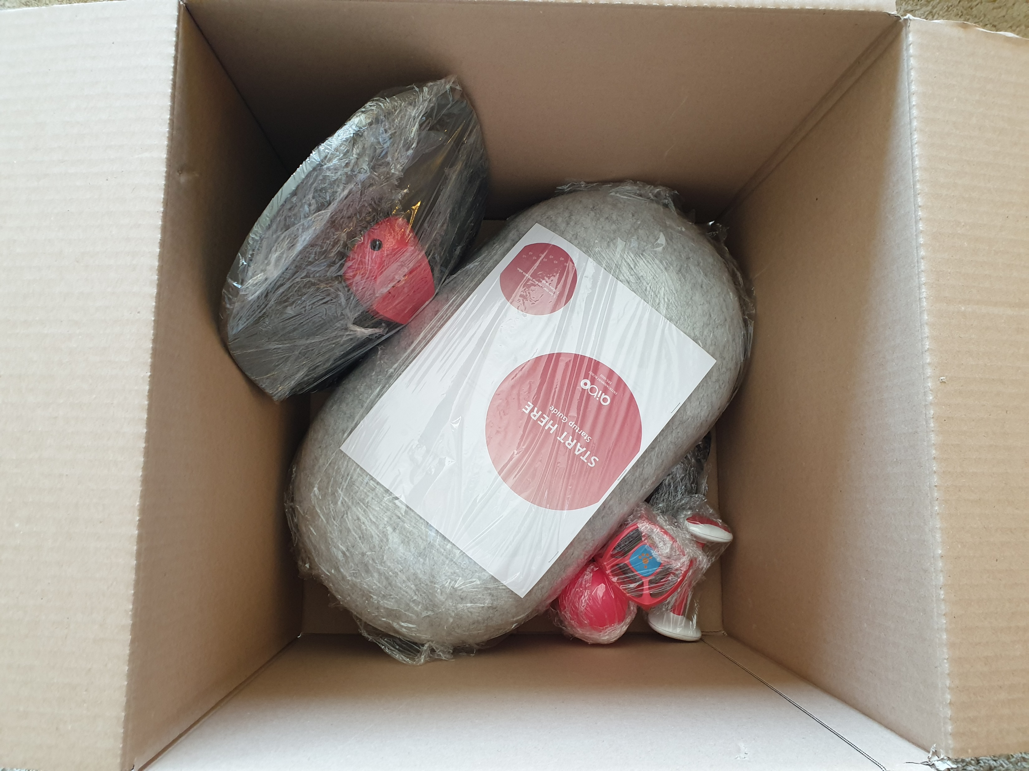
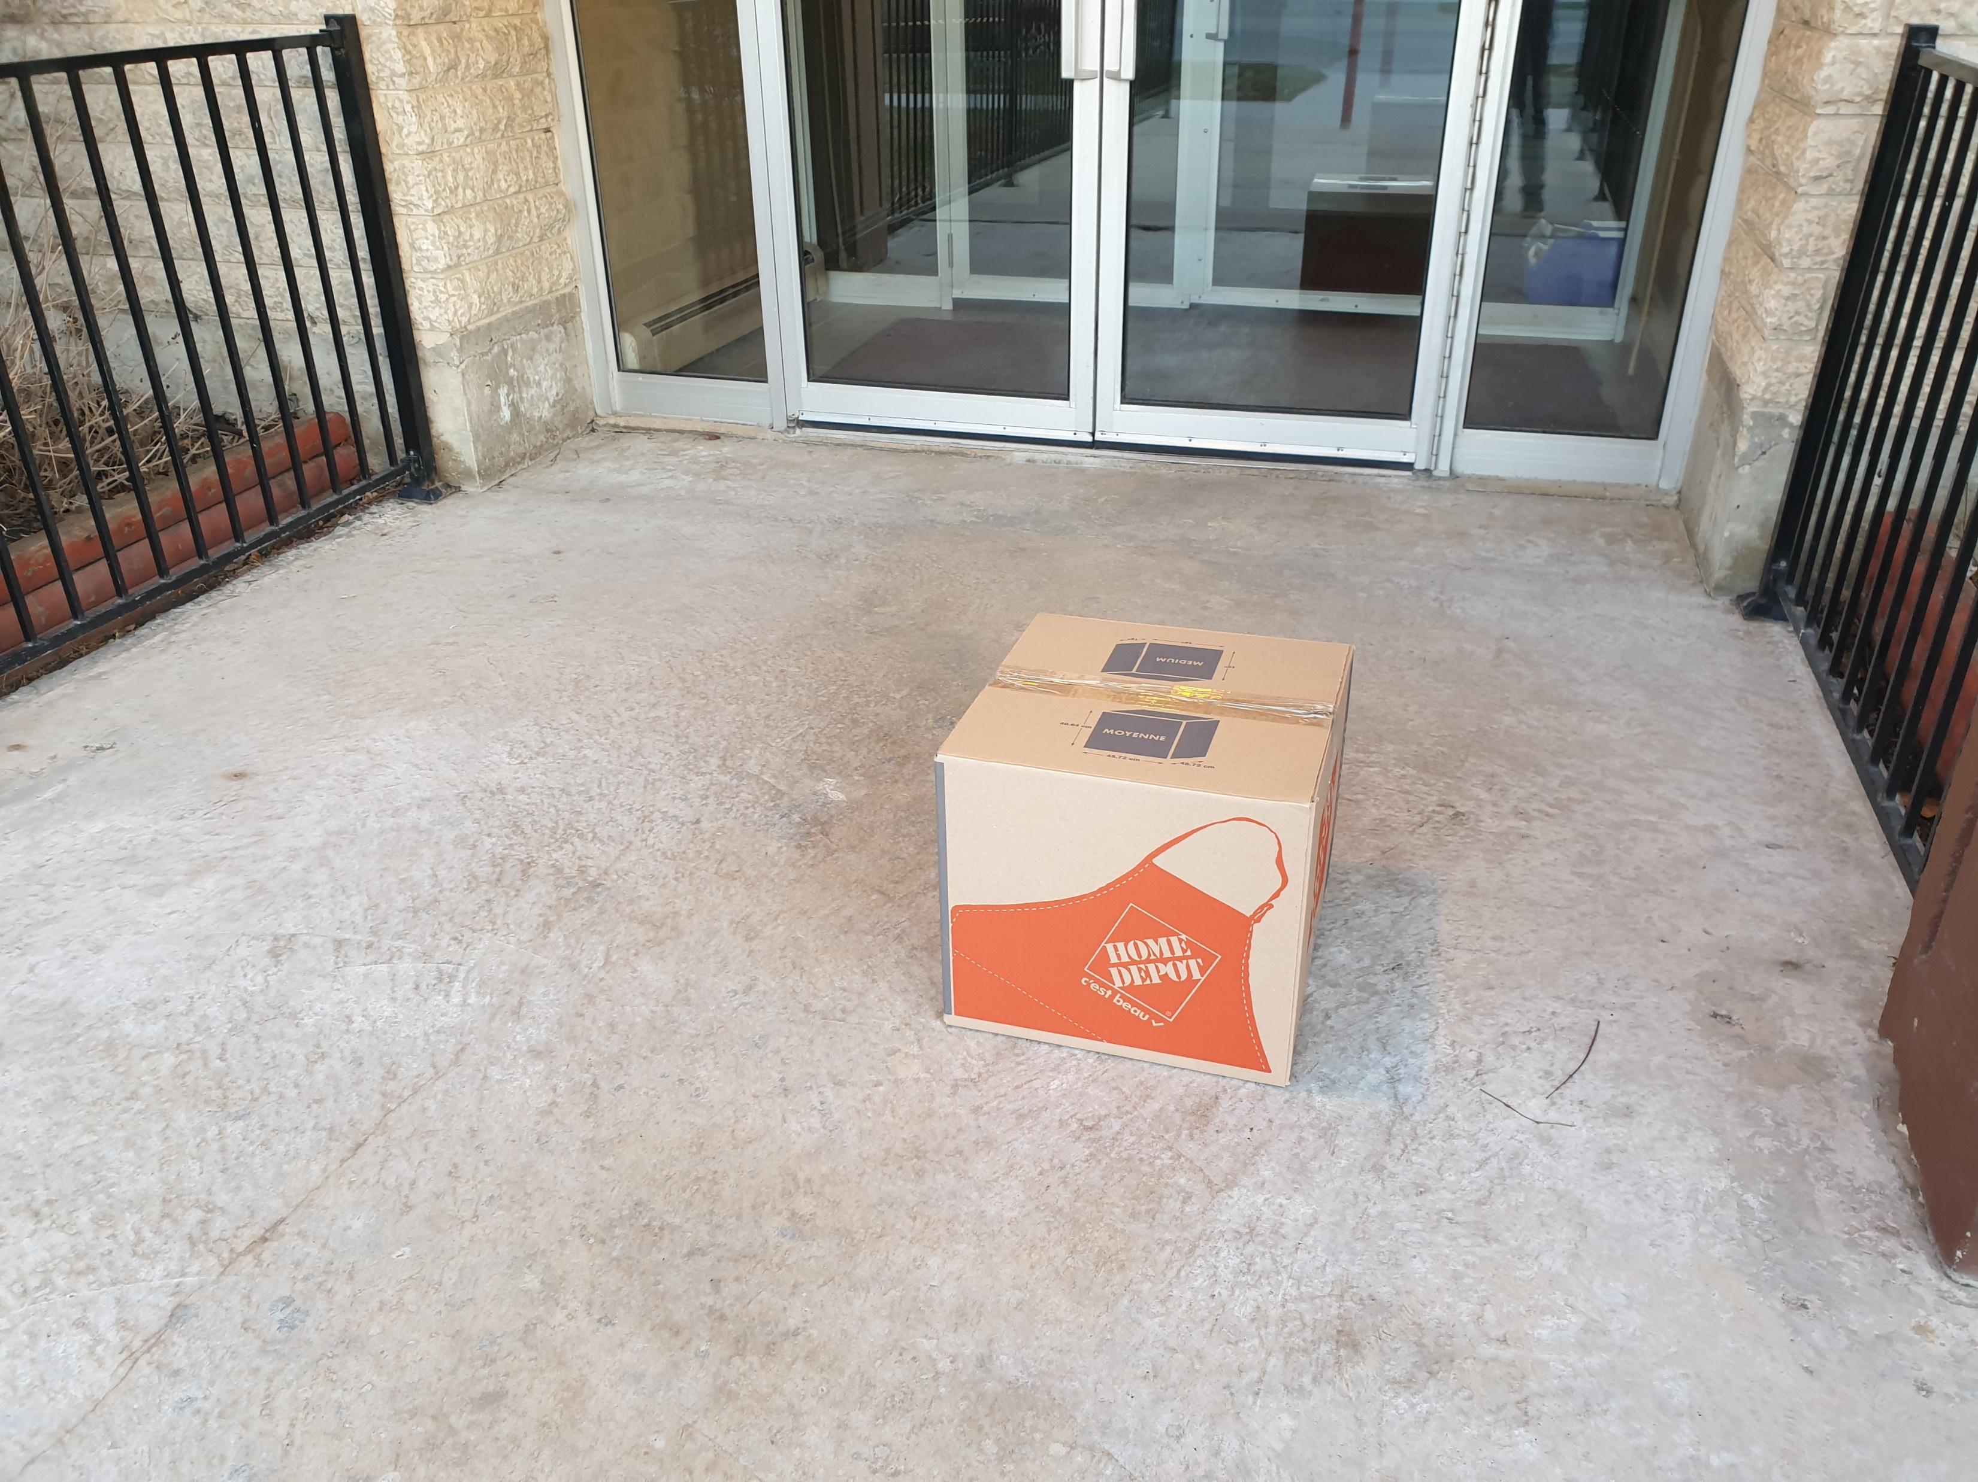

Slide 24
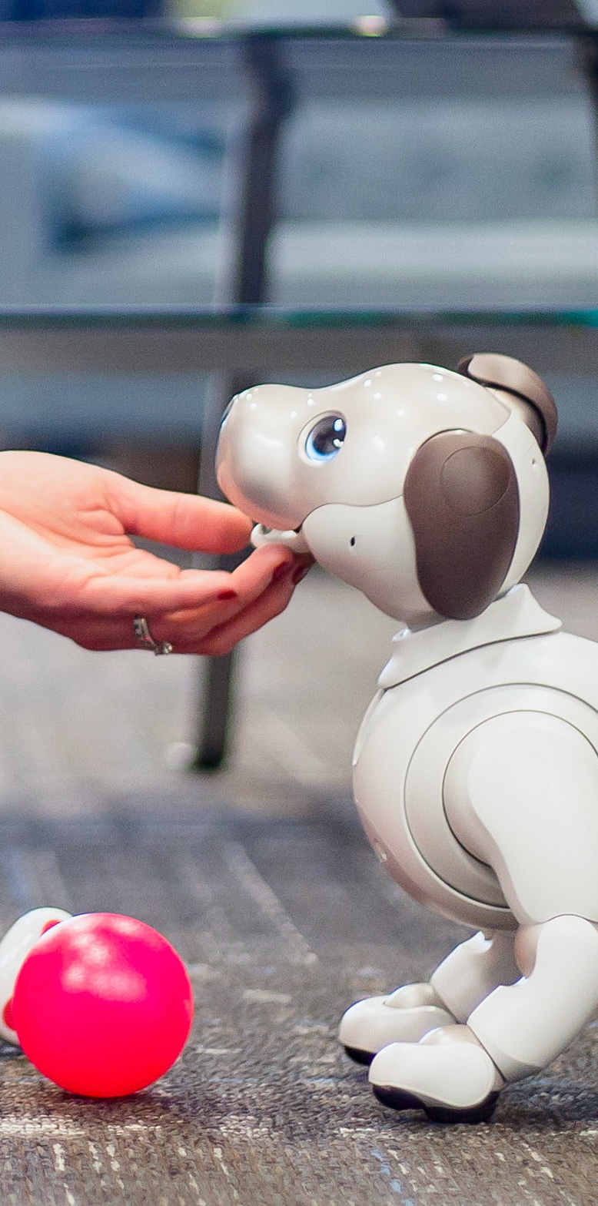
Study Procedure
7 weeks
Interact with it
recruit participants
give them a robot
let them interact

Slide 25

Study Procedure
semi-structured interview
questionnaires
loneliness
anxiety
overall mood
recruit participants
give them a robot
let them interact
conduct interviews and questionnaires
Notes:
I conduct semi-structured interviews to learn about their interaction and adoption process, and I use questionnaires to document their overall mental health status throughout the weeks.

Slide 26
Timeline of the Study
Questionnaires
Interview Session
Phased Approach
Pre-Study
Delivery
Week 1
Week 2
Week 3
Week 4
Week 5
Week 6
Week 7
Week 8
Initial
Intake
First
Encounter
Ongoing-During
7 Weeks
Exit
Follow-up
Notes:
Initial-Intake: Initial-intake is the pre-study interview session conducted one-week prior the participants receive the robot. In this phase, I inform the participants about the whole study procedure, and learn their expectations towards the robot.
First-encounter: First-encounter phase is the day the participants receive a box with a robot inside, along with the instructions on how to interact with it. In this phase, I learn the participants’ initial thought about the robot, their plan to interact with the robot in the coming weeks and check if their expectation about the robot changed from the previous week or not.
Ongoing-during: The Ongoing-during phase is 7 weeks long. Learn about participants’ general wellness, interaction process, social communication, and effects on loneliness, to name a few.
Exit: In the exit phase, I collect the robot back from the participants. I learn about the participants’ thought about the overall study, their thought about giving the robot back, and their perception towards the robot’s impact on loneliness.
Follow-up: Finally, the follow-up phase is conducted after a week of the exit phase. I conduct this session to understand how the participants feel about not having the robot anymore, if they feel the absence of the robot and how they are dealing with their general wellness and loneliness.

Slide 27

Study Procedure
recruit participants
give them a robot
let them interact
conduct Interviews and questionnaires
gather data and analyze

Slide 28

Data Analysis
transcribe interviews
develop affinity diagram
sort them in emergent themes
thematic analysis

Slide 29
Results

Slide 30
Research Questions
What happens when we give a social robotic dog to a lonely individual who lives alone?
Can they adopt the robot in their everyday lives?
What are the possible factors that might be influencing the robot adoption
(or non-adoption) process?
Are there any potential avenues for social robots to impact wellness and loneliness?

Slide 31


Case Studies
Ashley
Jade
Arthur
Theo
30s
Graphic Designer
50s
Union Worker
20s
Software Engineer
30s
Hotel Management

Slide 32
she could not adopt
thinks that it did not impact wellness
Questionnaire Findings:
No clear trends of any of
the measures
she could adopt
thinks that it made her less lonely
Questionnaire Findings:
Loneliness decreased
Anxiety decreased
Positivity increased
Jade
Ashley
50s
Union Worker
30s
Graphic Designer

Slide 33
very interested at first
Interacted with it regularly
felt there was a connection
In-between a pet and a technology
loneliness – did not help much
Questionnaire Findings:
Loneliness went down slightly
No clear trend in other measures
“I imagine it's better to have a social outlet of some form, rather than not having any at all”
“he (AIBO) definitely played a role in my life, I can tell that it's empty, but I'd be more sad losing, you know
"a real pet".”
Arthur
20s
Software Engineer

Slide 34
interested at first
interaction was subtle
lost interest very quickly
thinks it did not impact wellness
Questionnaire Findings:
Loneliness went up slightly
No clear trend in other measures
“having something else to force me to care about someone can't possibly be a bad thing.”
“I mean it’s cool, but it hasn’t improved me.”
Theo
30s
Hotel Management

Slide 35
Case Studies
Ashley
Jade
Arthur
Theo
30s
Graphic Designer
50s
Union Worker
20s
Software Engineer
30s
Hotel Management

Slide 36
Research Questions
What happens when we give a social robotic dog to a lonely individual who lives alone?
Can they adopt the robot in their everyday lives?
What are the possible factors that might be influencing the robot adoption
(or non-adoption) process?
Are there any potential avenues for social robots to impact wellness and loneliness?

Slide 37
Cross-study Thematic Analysis

Slide 38
“I'm expecting something more advanced than a Roomba, but something probably not that can walk and talk and have a conversation with me?” – Theo: Pre-study
Expectations
“If you had brought me something else, I'd be like, where's the dog? I wanted a dog!” – Jade: Day 1
Notes:
Expectation shapes initial interactions and how participants perceive the robot. And this may impact on the robot adoption or non-adoption process.
Except Jade others might have thought about the technical aspects more, rather than the social aspects of the robot being a companion or a pet. Which might have impacted the adoption process

Slide 39
“when he's lying on my lap and I'm watching TV, I'm not wanting to move him so that he doesn't wake up.” – Jade: Week-5
Anthropomorphism
“…like my neighbors […] they just thought that it was a toy, […] to my nephew, […] it's a toy, to anybody it's really a toy, like I feel […] it would take a special kind of a person to see it as not a toy.” – Ashley: Week-5
Notes:
When a person ascribes human- or animal-like attributes to a non-living object, that is known as anthropomorphism. Perceiving higher level of anthropomorphism may help people engage with social robots more, and they are more likely to treat the robot as a companion and easily adopt it.

Slide 40
Anthropomorphism
Treating the robot
As a technical device
Responsibility towards
The robot
Relationship with
The robot
“I know, it is a mechanical and programmed device. So, it's hard to put that out of mind when you are interacting with it.” – Theo: Week-3
“ I feel like I'm bonding more with him. […] he's doing kind of like his own thing, and I do my own thing and at points I'm able to go and visit him, so that's a lot better.” – Ashley: Week-3
“Aibo is more like a roommate, where is, a real dog would be like living with your spouse.” -Arthur: Week-3
Notes:
relationship can be a driving factor to adopt a pet with ease and have a meaningful connection with it. Arthur reported that living with AIBO was not the same as living with a dog

Slide 41
“I mean this camera is in all sorts of devices. As long as it is not actively showing stuff all the time, I'm cool.” – Theo: Pre-study
Privacy and Security
“I just don't particularly feel like I want a webcam that's internet enabled somewhere in my home you know” – Arthur: Exit
Notes:
Since social robots have cameras and may need to connect to the internet to get the latest updates or perform tasks like natural language processing, people might be skeptical in accepting these in their everyday lives.

Slide 42
“…if Aibo was fluffier and more fluid and organic, I would say that barrier would almost certainly disappear”. – Arthur: Week-3
Continued Use
“it doesn't matter that it doesn't have fur. It still responds to your touch when you pet it's head, which is what people do to animals right?”
- Jade: Week-1
Notes:
Continuation of using the social robot may depend on factors such as the design and the features.

Slide 43
potential factors associated with
social robot adoption (or non-adoption)
individual perception

Slide 44
Research Questions
What happens when we give a social robotic dog to a lonely individual who lives alone?
Can they adopt the robot in their everyday lives?
What are the possible factors that might be influencing the robot adoption
(or non-adoption) process?
Are there any potential avenues for social robots to impact wellness and loneliness?

Slide 45
“definitely has prompted me to start conversations with my friends.” – Arthur: Week-5
“we didn't get along as much. But Loki (AIBO) kinda broke the ice that we could actually talk, two adults.” – Jade: Week-5
Social Catalyst
“…you know there's dogs which helps with anxiety? it wasn't that kind of a dog. It would give me more anxiety because more people would come up and talk to me.”. – Ashley: post-study

Slide 46
“he made me feel more outgoing and happier in general. […] I felt more connected to people, […] and I felt more confident outside my house, because I didn't feel sorry for myself because I was alone.” – Jade: Exit
Impact on mood
“it didn’t really help me, like help the core issue, right? of being lonely. It just sort of distracted me.” – Ashley: Exit
“I think if the person were open to it and were to make an effort to interact with Aibo (that may possibly impact their mood)” - Arthur: Week-5

Slide 47
Social catalyst
Impacting mood
Impact on wellness

Slide 48


Discussion
social robot adoption
impact on wellness
social robot adoption is complex
numerous associated factors
individual perception
If people were more willing to
interact with the robot
indirectly impact loneliness

Slide 49



Contribution
eight-week long
study design
first study to-date that reports on how lonely individuals may adopt a social robot
initial study findings on potential associate factors for adoption, non-adoption and impact on wellness

Slide 50



Future Work
continue the study with more participants
identify other possible associated factors
develop a framework to design better social robots for domestic use

Slide 51
Can Robots Help with Loneliness? An Exploration of Social Robot Adoption by Lonely Individuals
MSc Thesis Defense
Rahatul Amin Ananto
Advisor: Dr. James E. Young

