Slide 1


Software Learning Strategies and Perceptions of Rural Individuals
Patrick Dubois, Andrea Bunt
Department of Computer Science
University of Manitoba
hci.cs.umanitoba.ca
November 4th, 2018
Notes:
Hi, I’m Patrick Dubois, a Ph.D. student in the Human-Computer Interaction Lab at the University of Manitoba

Slide 2
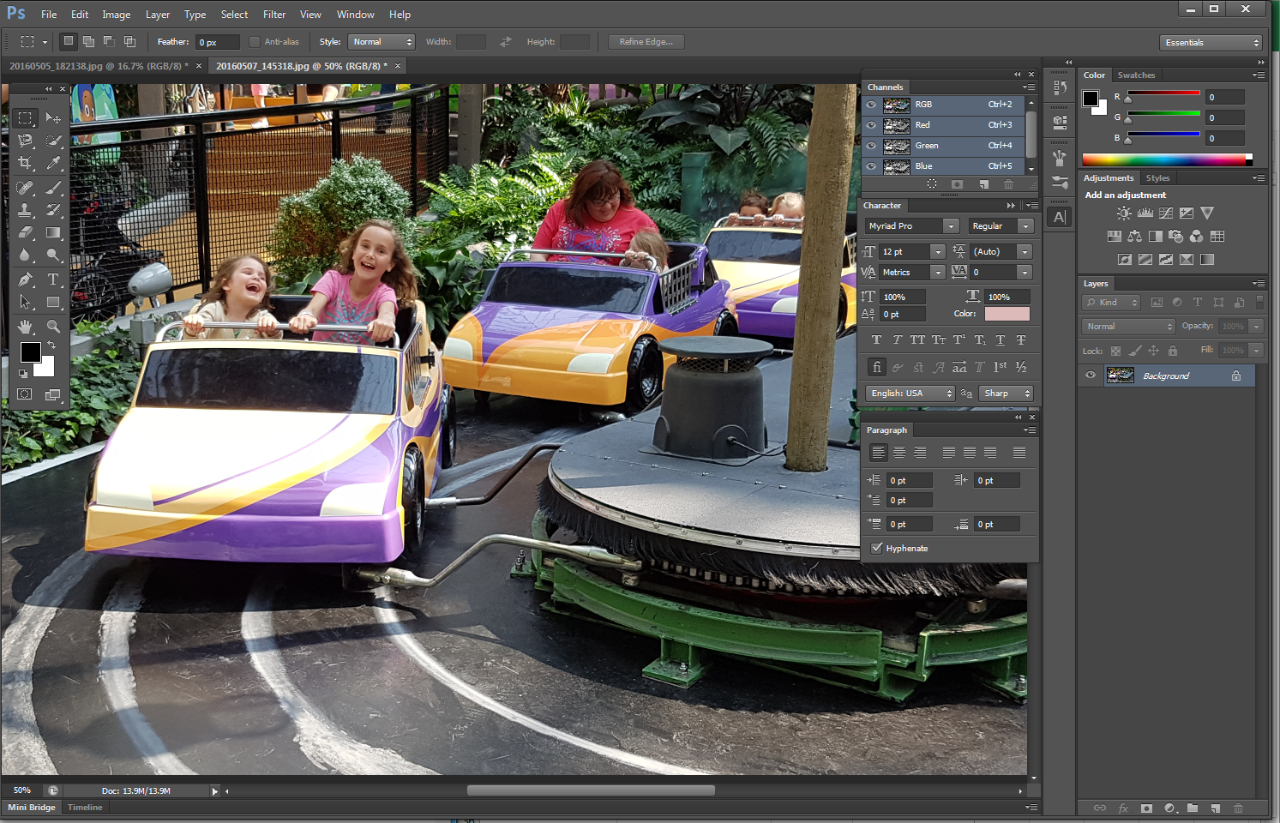
Notes:
One area of research out lab focuses on is software learnability.
Questions involving learning and sharing knowledge about complex software
From Microsoft Word to Adobe Photoshop

Slide 3
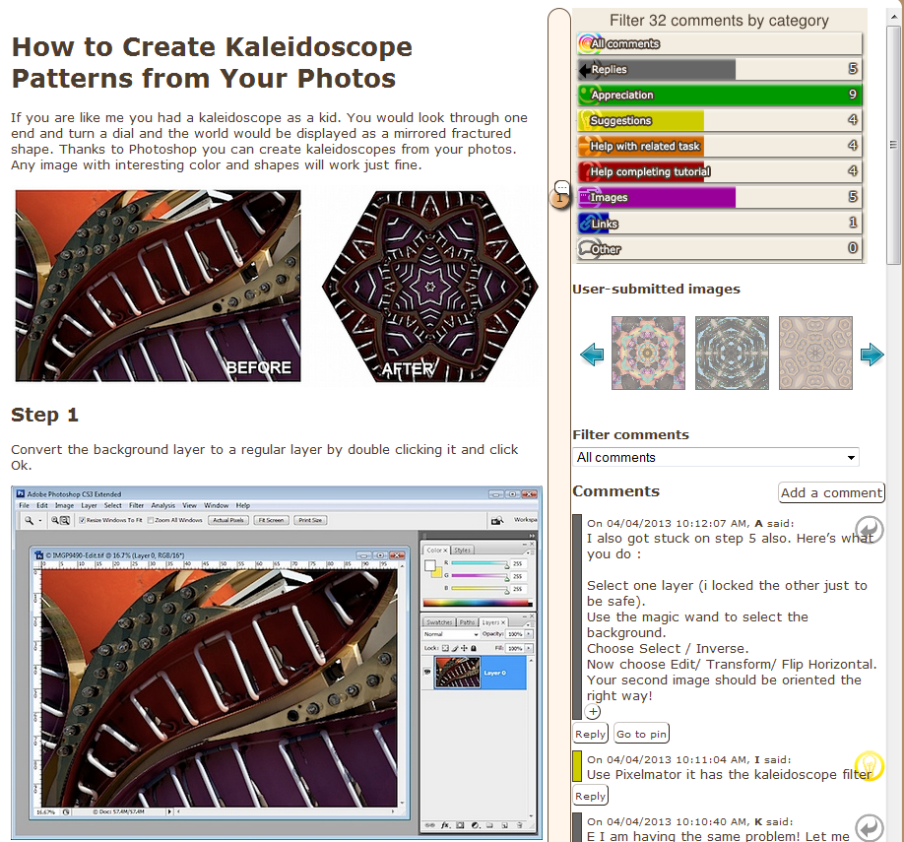
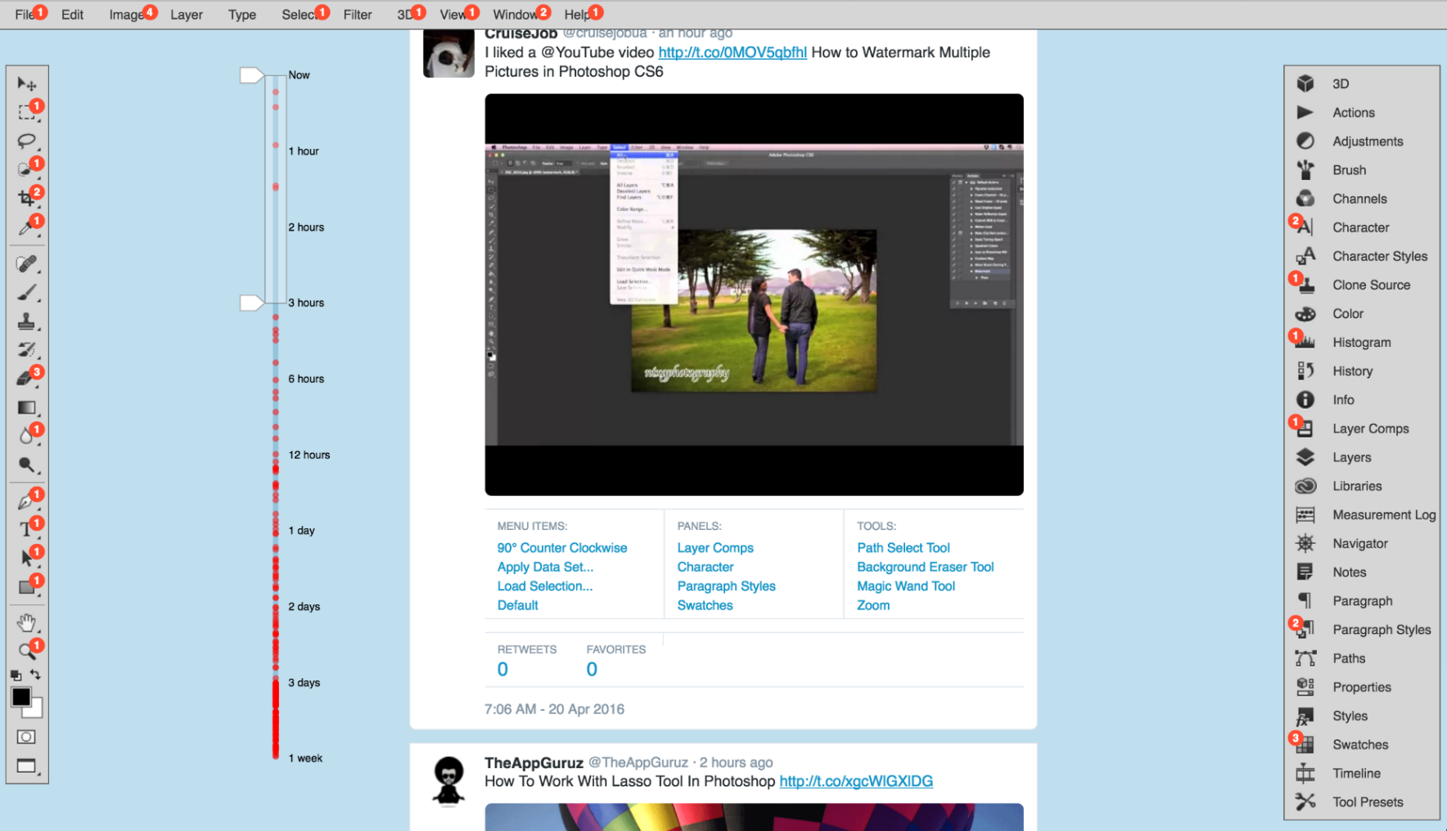
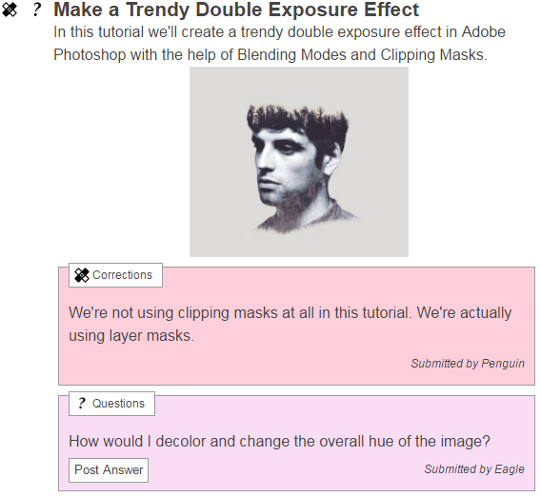
Notes:
We do this by employing a range of research methods, often using prototype systems.
However, often make assumptions that may not be completely true or be problematic
A common one is to assume that people have access to internet, to watch videos, for example
For this project in particular, we are interested in seeing if known learning strategies extend to people living in rural Manitoba, where I grew up and currently live, where assumptions may not hold.
I will briefly describe the province to describe its particular challenges.

Slide 4
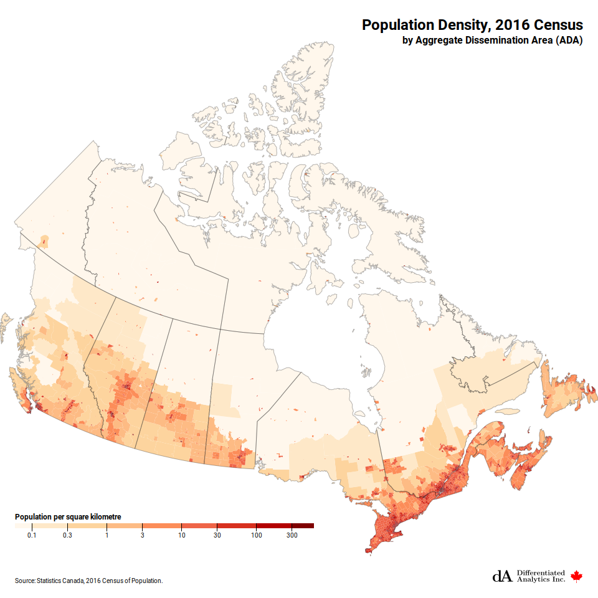
Source: Statistics Canada, 2016 Census of Population
Notes:
Manitoba is the province at the center of Canada, with a population of just over 1,200,000, of which 60% live in its capital, Winnipeg.
As illustrated by this population density map, the remainder live throughout the province in small isolated social centers.
Statistically, this makes it unlikely that a software learner lives close to some sort of software learning resource, such as schools, libraries or knowledgeable person, except for the most common software.
One might consider using online resources to access learning material instead.

Slide 5

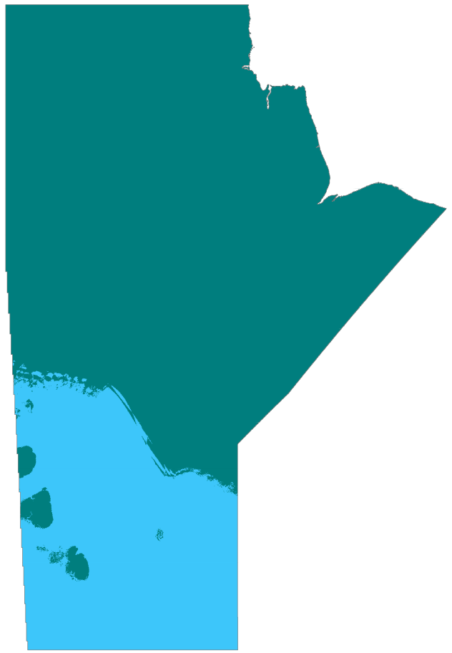


Subarctic
Source: Wikipedia – Ice Road
Continental
Source: Wikipedia – Canadian Shield
Source: WorldClim.org
Source: @dustshootme on Instagram
Notes:
But that has its own drawbacks.
Manitoba has difficult climate and terrain.
Towns are spread out over large distances, separated by forests or bogs.
Some communities can’t even be reached by conventional land travel.
Add to that, temperatures regularly peak from -45 to +35 degrees Celsius, or -50 to +95 degrees Fahrenheit.
Regardless of available resources, this makes infrastructure improvements and maintenance quite a task, which lead to slow or unstable internet connections.
For some, it is easier to rely on satellite-based internet, which is highly dependent on the weather.
From a related study, one participant could only do their banking on the sunny days for this reason.
So overall, online learning resources are there, but not the most convenient for rural individuals to access.

Slide 6
Returning to Software Learning…
What are challenges rural users face?
What are the learning strategies being used?
Why do they use these strategies?
Notes:
Goal: Build a stepping stone for creating inclusive learning resources or tools
First answer questions…

Slide 7
Exploratory Interview Study
Semi-structured interviews with 9 rural participants, 12 urban participants
Participants reported experiences from throughout the world
Participants used a range of software
Notes:
Countries include Canada, Malaysia, Nigeria
Software included productivity software like Microsoft Office, and image manipulation software like Photoshop

Slide 8
Software Learning Among Rural Users
Online material takes too long to load
Ask for help in person – if available!
Hinted at user-generated content being untrustworthy
Notes:
Worsens impact of another problem, is resource helpful in the first place?
User distance communication like email and phone, but cumbersome.
Urban participants did not mention trust. Hints at cultural differences.

Slide 9
Challenges
Recruiting from a specialized set of participants
Apply findings to prototype solutions
Notes:
Moving forward, challenges to address
We had a breadth of participants in different contexts
We plan on focussing on rural Canadian individuals
Need to be rural AND learning or tried to learn software

Slide 10
Software Learning Strategies and Perceptions of Rural Individuals
Patrick Dubois, Andrea Bunt
patrick.dubois@cs.umanitoba.ca
Department of Computer Science
University of Manitoba
hci.cs.umanitoba.ca

