Slide 1


Data-Centric Explanations: Explaining Training Data of Machine Learning Systems to Promote Transparency
MSc Thesis:
Ariful Islam Anik Advisor: Dr. Andrea Bunt
November 18, 2020

Slide 2


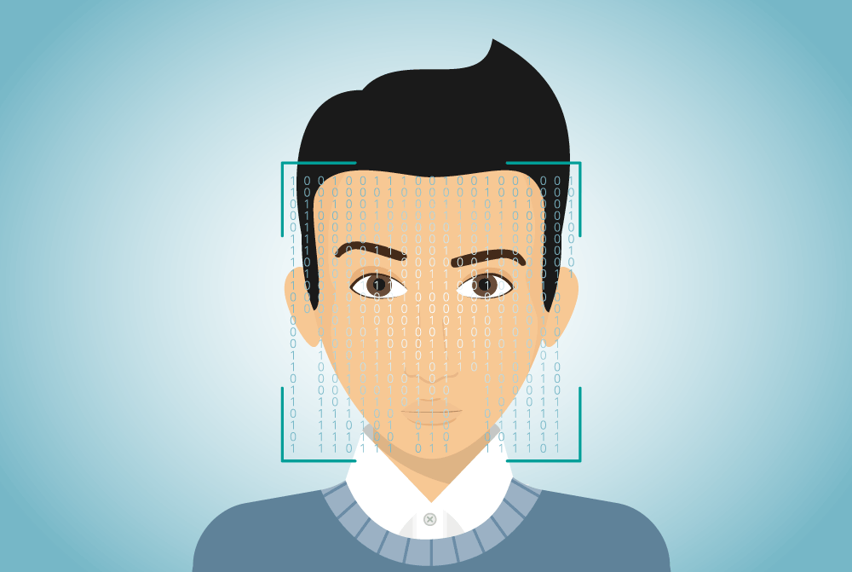


Slide 3


black-box systems
difficult to interpret and understand the system

Slide 4




doctor - man
nurse - woman

Slide 5



problem of biases
fairness in the system
trust in the system

Slide 6
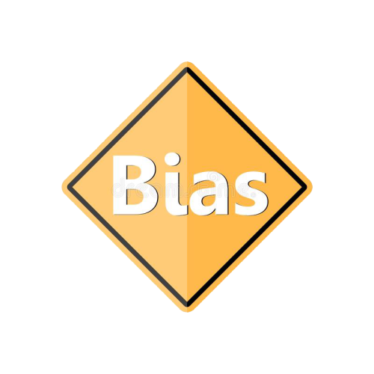

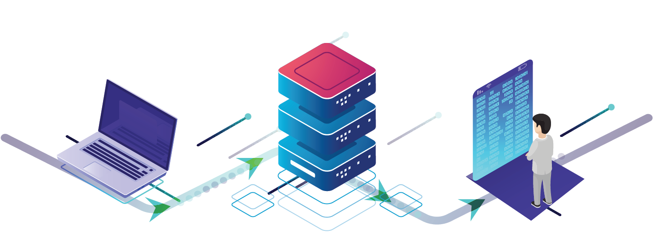
training data
data-driven systems

Slide 7


industry practitioners first focus on training datasets when faced with problems [Holstein et al., 2019]
training data

Slide 8




not clear on how to communicate training dataset information to end-users
rarely communicated to end-users
Notes:
despite all this, rarely communicated to end-users
we don’t have any clear idea -> how to cimmnicate

Slide 9


motivation
how do we communicate training dataset information to end users?
how would it impact users’ perception of the system?

Slide 10



my approach
design explanations
information on training data

Slide 11



research questions
what types of training data information might be available to communicate to end-users?
how should such information be presented to end-users of varying backgrounds in machine learning?
what impact could data-centric explanations have on end-users’ perceived trust and fairness judgments of ML systems?
11

Slide 12
research questions
what types of training data information might be available to communicate to end-users?
how should such information be presented to end-users of varying backgrounds in machine learning?
what impact could data-centric explanations have on end-users’ perceived trust and fairness judgments of ML systems?
12

Slide 13




content for explanation
what information could be captured about training data?
selected and categorized information
investigated prior work
dataset
documentation
[Gebru et al., 2019]

Slide 14

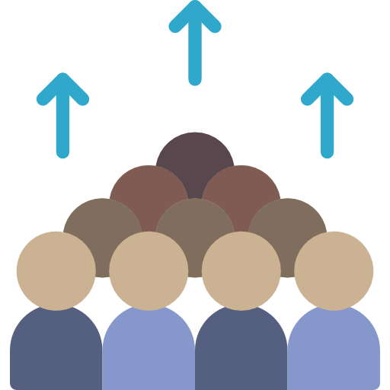



categories of information
collection
demographics
recommended
usage
potential
issues
general information

Slide 15
research questions
what types of training data information might be available to communicate to end-users?
how should such information be presented to end-users of varying backgrounds in machine learning?
what impact could data-centric explanations have on end-users’ perceived trust and fairness judgments of ML systems?
15

Slide 16



designing data-centric explanation
sketched up different presentation styles
pilot testing of the explanation
created digital interface for the chosen style

Slide 17
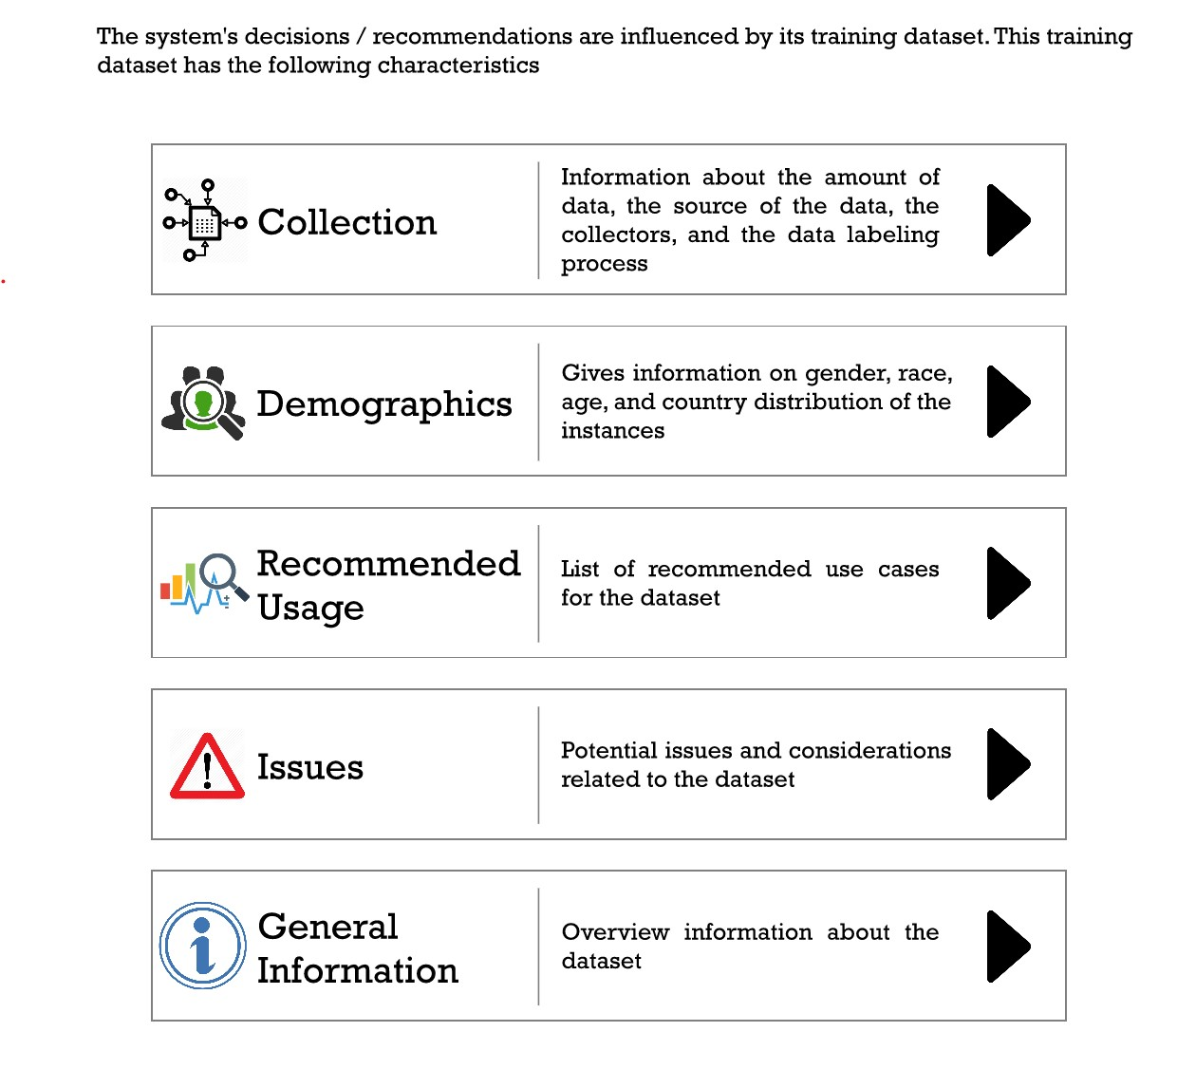
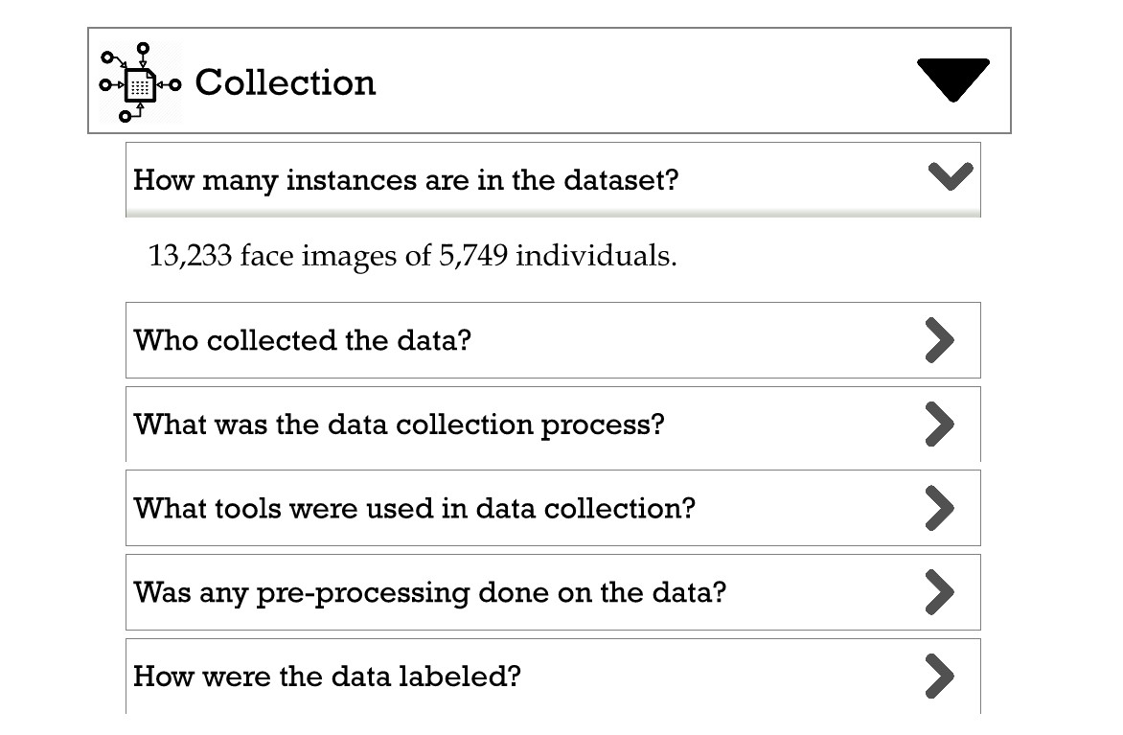
initial prototype

Slide 18




concept exploration study
feedback on design of our explanations
gather information on what they want
involving end-users in the design process
use the explanation in an exploratory study

Slide 19



concept exploration study
interviewed 17 participants
different levels of expertise
transcribe and analyze data

Slide 20


interview findings
positively received but need more depth
“the answers are way too short and not detailed enough. It probably needs to be bit more detailed and technical.” – P15

Slide 21

interview findings
value questioned by ML experts
“as long as they have a tab for issues, [people are] always going to say that this dataset is not working.” – P2

Slide 22

improving data-centric explanations
used feedback from participants
update prototype

Slide 23
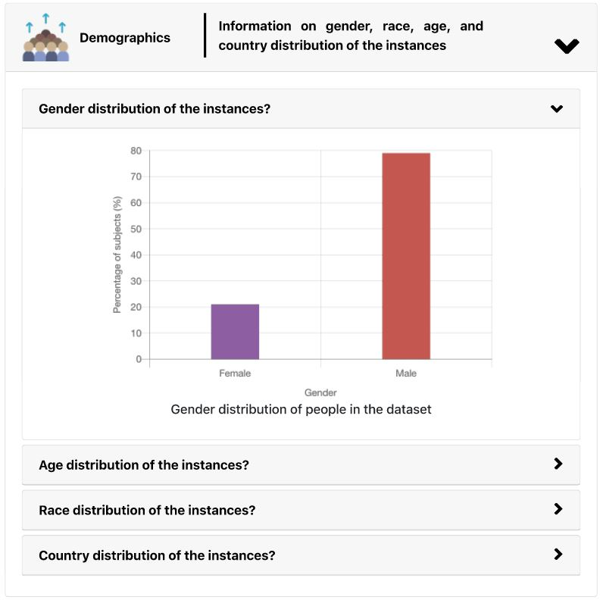
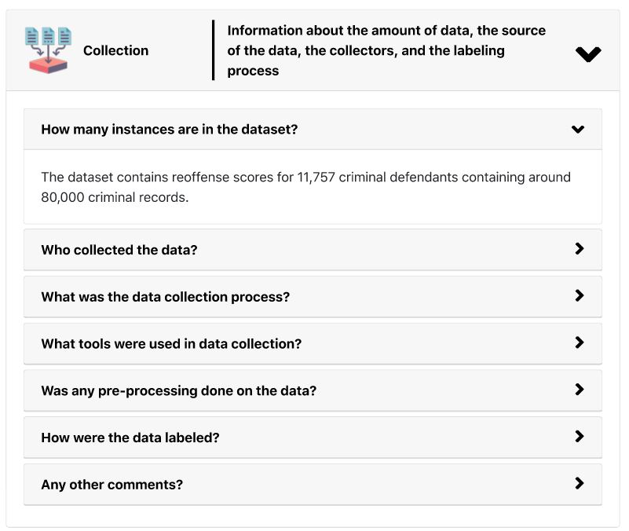
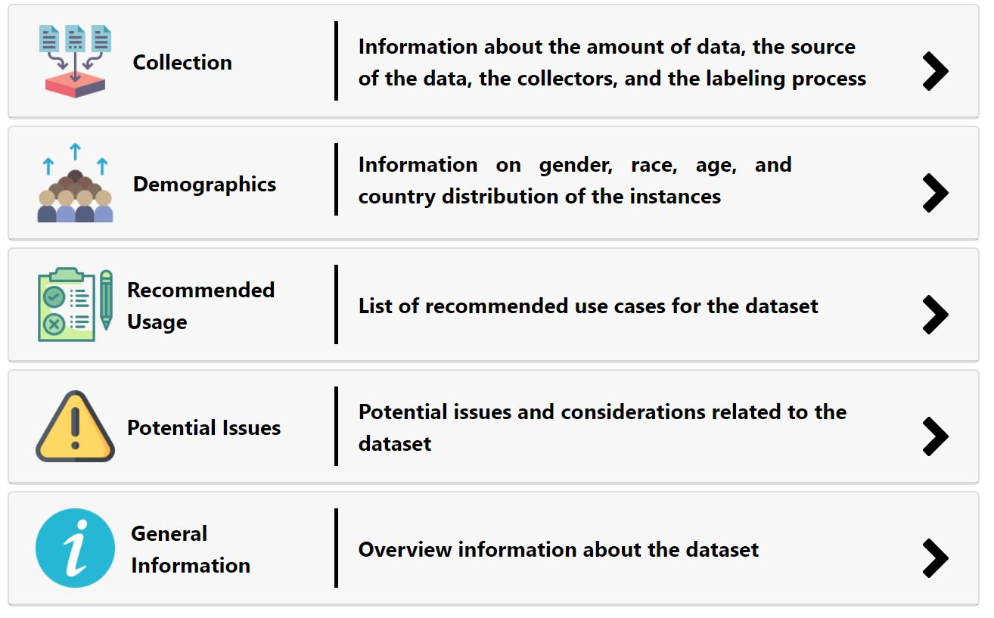
prototype
23
23

Slide 24
research questions
what types of training data information might be available to communicate to end-users?
how should such information be presented to end-users of varying backgrounds in machine learning?
what impact could data-centric explanations have on end-users’ perceived trust and fairness judgments of ML systems?
24

Slide 25




utility investigation study
does user expertise affect the perceived utility of data-centric explanations?
user expertise
characteristics of the training data
study design factors

Slide 26





utility investigation study - factors
expertise
dimensions
training dataset
characteristics
expert
balanced
intermediate
red flags
beginner

Slide 27




utility investigation study - scenarios
predictive bail decisions
automated ad- mission system
facial expression recognition
automated speech recognition
red flags
balanced
red flags
balanced

Slide 28


utility investigation study - explanations
generate explanation for the scenarios
predictive bail decisions
automated ad- mission system
facial expression recognition
automated speech recognition
consulted reference datasets

Slide 29





utility investigation study - procedure
introduce the
experiment
decision-making
scenario
present the
explanation
post scenario questionnaire
semi-structured interview session
x4

Slide 30

utility investigation study
15 male
12 female
27 participants
semi-structured interviews
10 beginners
8 intermediates
9 experts
different levels of expertise
likert scale based questionnaire
30

Slide 31



quantitative findings
kruskal-wallis test across expertise group
wilcoxon test across training dataset characteristics
no significant differences
significant differences for trust and fairness

Slide 32

interview findings
“I actually trust [the systems] more now that I have [seen the explanations].” – P7-I
impact trust and fairness in the system
“by making sure [the population is] diverse enough would help me know that's fair.” – P20-B

Slide 33

interview findings
demographics help to identify biases in the data
“I found the bar graphs […] more meaningful Because you could really immediately spot over inherent bias” – P30-B

Slide 34

interview findings
stakes of the systems matter
“I think that's very important to know especially in the higher stakes situation. Because it can really affect someone's life” – P19-E

Slide 35

interview findings
nuanced differences among expertise groups
“I think if a user does not have any machine learning background or CS background, they will find it hard at first” – P8-E

Slide 36


summary
potential of explanations for impacting trust and fairness in the systems
potential mismatch between expectation and capabilities of the end-users
36

Slide 37






contributions
identify communicable information
design for data-centric explanations
data-centric
explanation
end-users’ attitudes to data-centric explanations
potential for data-centric explanations
study findings

Slide 38





future directions
prioritizing
explanation contents
scenario-based approach
data-centric information vs feature-oriented information
lack of consequence and significance in the scenario
complementing established explanation approaches
more direct interaction with real systems

Slide 39






future directions
individual and
expertise differences
use cases of the
explanations
general trust and distrust towards ML systems
participants as a end-user of the systems
better characterization of ML expertise
potential audiences for data-centric explanations

Slide 40

Data-Centric Explanations: Explaining Training Data of Machine Learning Systems to Promote Transparency
design data-centric
explanations
impact of explanations
on users’ perception
data-centric explanations
Ariful Islam Anik Advisor: Dr. Andrea Bunt

Slide 41
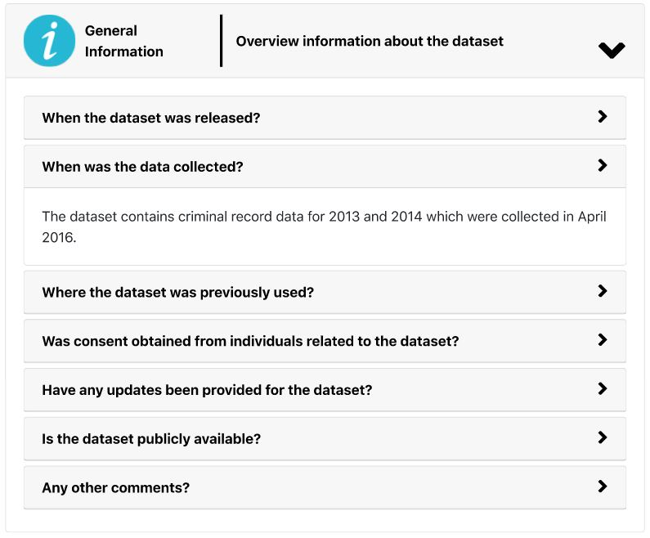
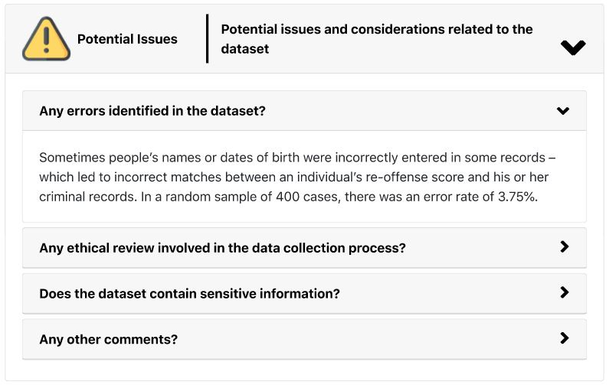
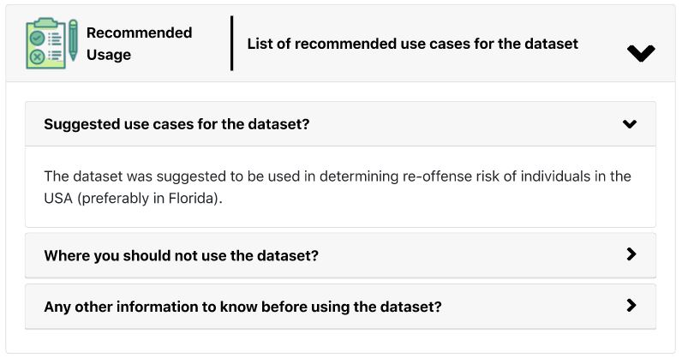
prototype
41

Slide 42
quantitative findings
trust
fairness
perception of fair training
comfort
ideas about the system
reflect on the training process
kruskal-wallis test across expertise group
wilcoxon test across training dataset characteristics
no significant differences
significant differences for first 4 measures

Slide 43
questionnaire
I am confident in the system
the system has integrity
the system is dependable
the system is reliable
I can trust the system
I am familiar with the system
trust
the system is free of bias
the system upholds ethical and moral standards
the system’s explanations are reasonable
I would agree with the system’s decision based on the explanation.
fairness
perception of fair training
the system was trained in a fair way.
comfort
I would feel comfortable using the system’s decision
ideas about the system
the explanation gives me ideas about the data used in the system
reflection on training process
the explanation helps me to reflect on whether the training process was fair

Slide 44

demographics
15 male
12 female
12 countries
27 participants
10 beginners
8 intermediates
9 experts
5 M, 5 F
5 M, 3 F
different levels of expertise
5 M, 4 F
44

