Slide 1
An Automated Approach to Assessing an Application Tutorial’s Difficulty
Presenter
Shahed Anzarus Sabab
Shahed Anzarus Sabab, Adnan Khan, Parmit K. Chilana, Joanna McGrenere, Andrea Bunt
Notes:
Hi everyone! This is Shahed and I will be presenting our work - an automated approach to assessing an application tutorial’s difficulty

Slide 2
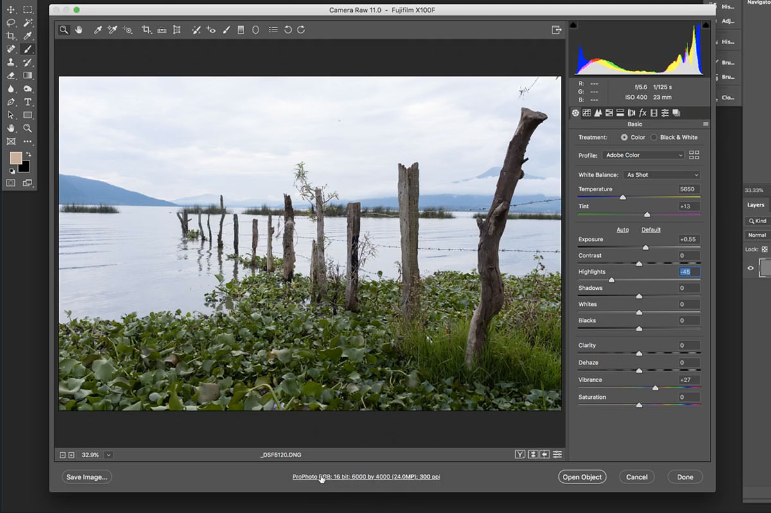
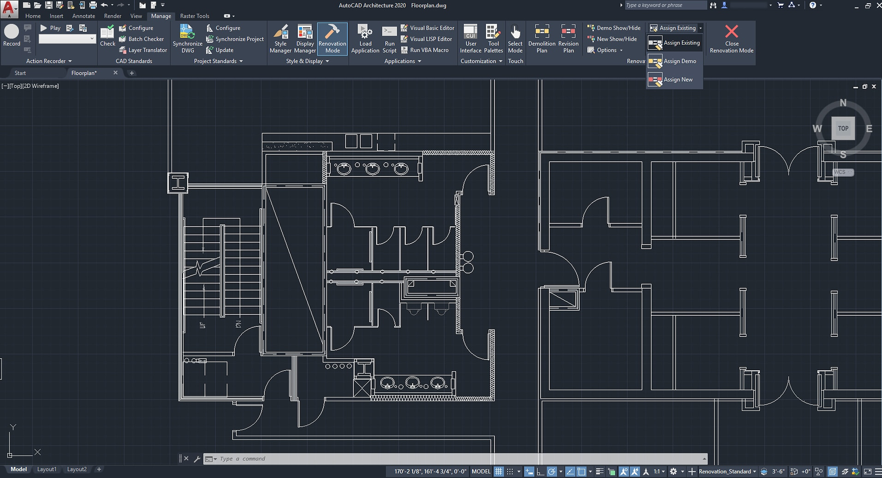
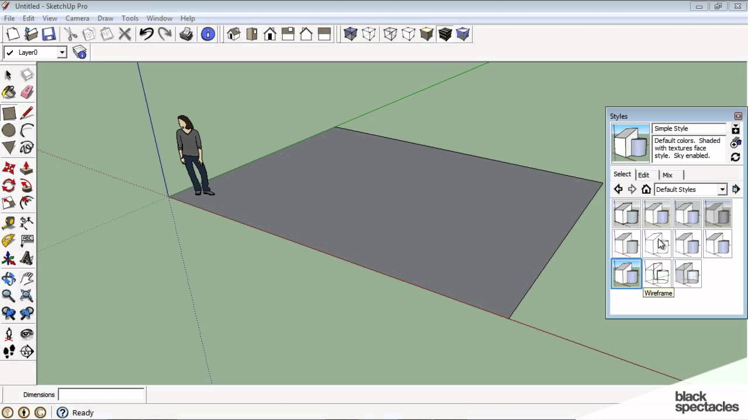
Feature-Rich Software
Software Tutorials
Notes:
There are many feature rich software available for our use case. Some of them are for example, Photoshop, Autocad, and Sketch Up. As we can see, they come with tons of features to explore so it becomes intimidating for us to learn about these. As we are wondering, what to do if we want to learn about these software. The answer is perhaps simple!!! Just follow software tutorials.

Slide 3
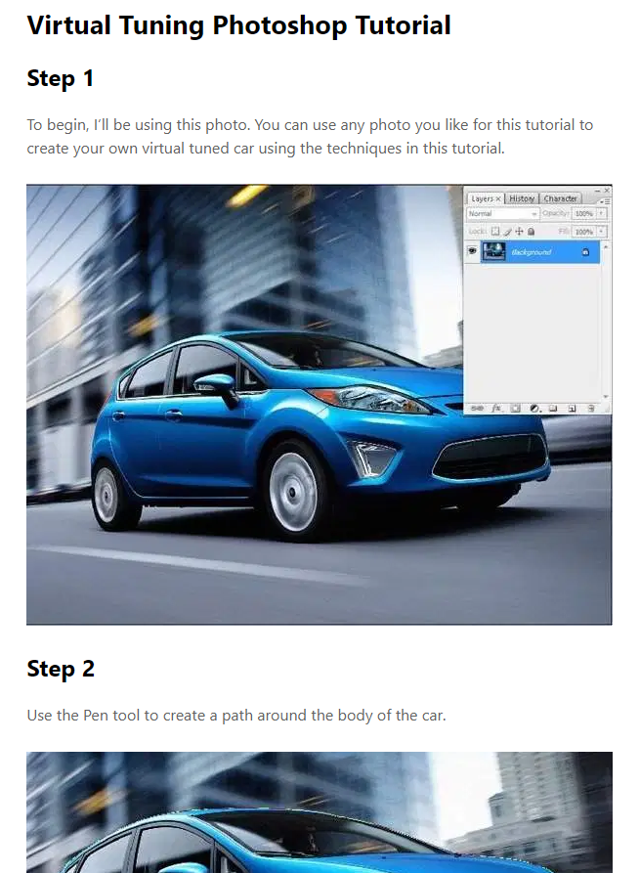
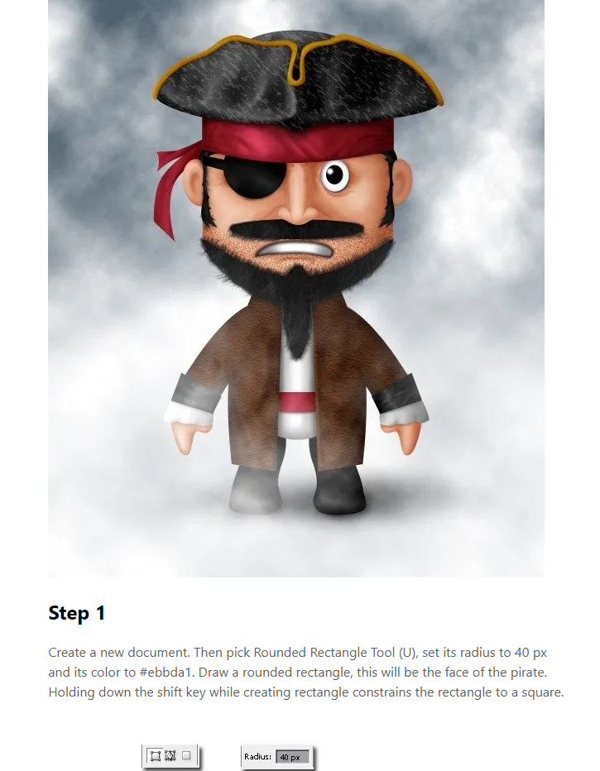
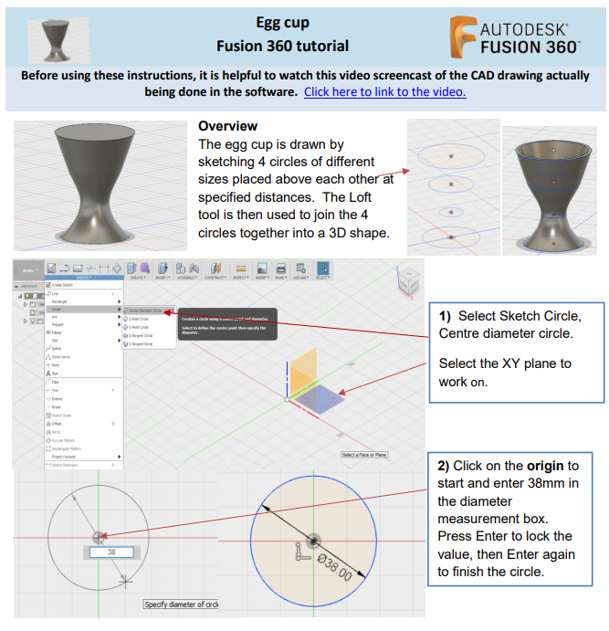
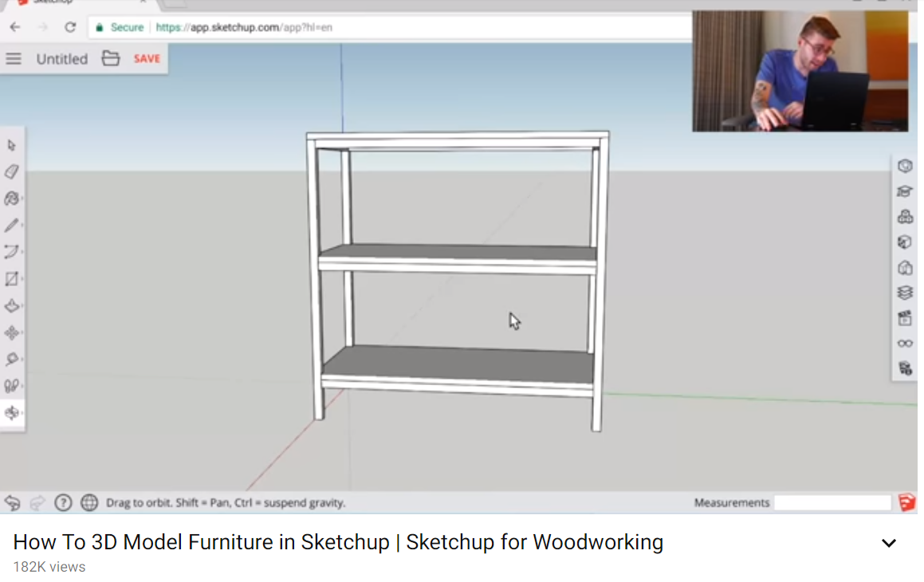
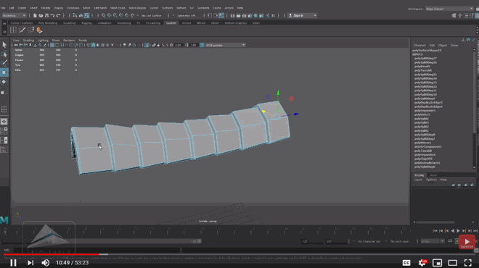
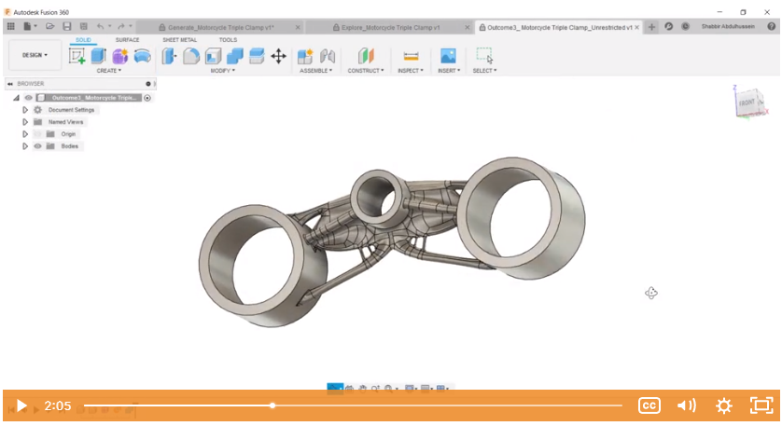
Software Tutorials
Text tutorials
Video tutorials
Notes:
Software tutorials can be of different forms. They can be text based or video based. Again, there are thousands of tutorials available online. So these are really easy to find. But its very difficult for a user to find a tutorial that matches their skill level.

Slide 4
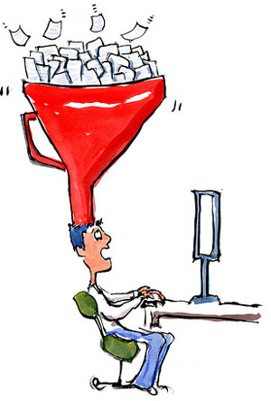
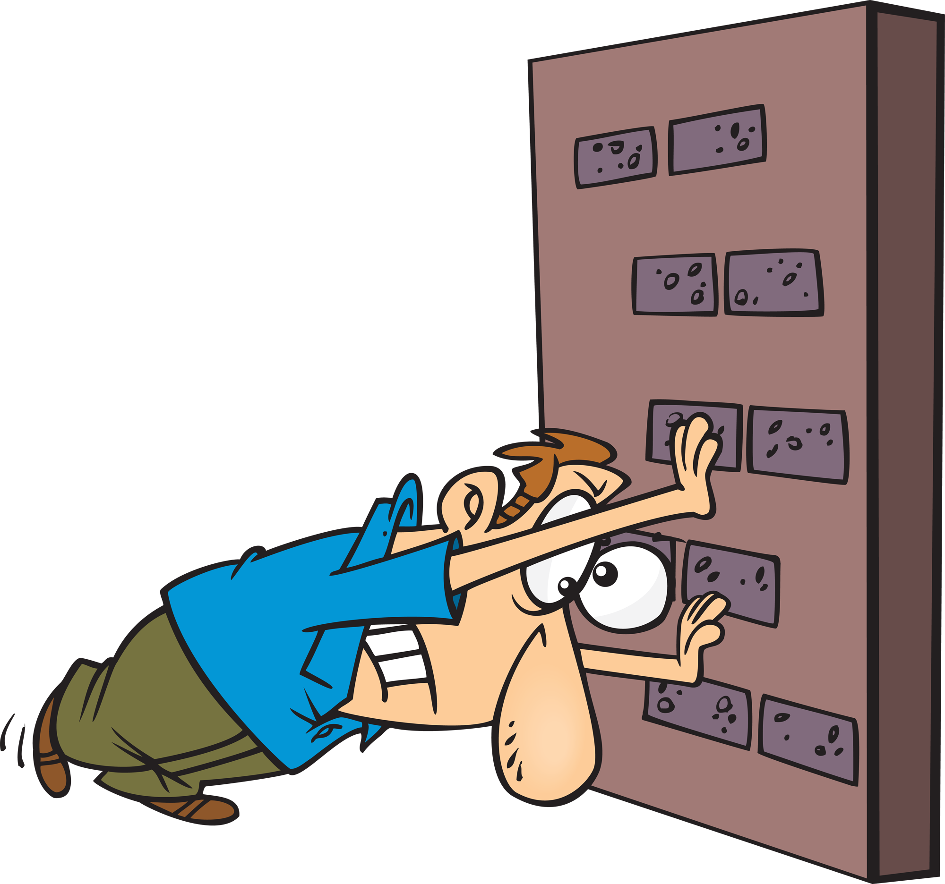
Mismatch: Tutorial’s Difficulty Vs. User’s Skill Level
BEGINNER
ADVANCED
Cognitive Overload
[Pass et al., 2003]
Frustration
[Locke et al., 2002]
Limited Task Success
[Kiani et al., 2019]
Time Consuming
[Grossman et al., 2009]
Notes:
Advanced tutorials assume certain software skills and knowledge of the application’s vocabulary
When beginners try to follow an advanced tutorial it has been studied that they experience cognitive overload.
They become frustrated
They have limited task success.
On the other hand when advanced users follow a beginner tutorial
it becomes time consuming as they usually search for specific content while beginner tutorials provide more detailed instructions. Unfortunately there is very few tutorials that provide any information on the difficulty levels of tutorials

Slide 5
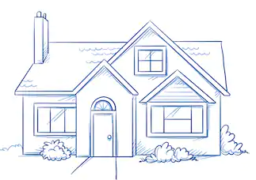
Can we automatically assign a label to this tutorial ?
VS
www.tutorial.com
How to draw a scenery.
Step 1:
BEGINNER
ADVANCED
Step 2:
Notes:
Lets say we have a tutorial here. Now the bigger question is Can we automatically assign a label to this tutorial ? Can we have a system deciding if this tutorial is advanced or beginner.

Slide 6
Our approach …
Extract
Features
ADVANCED
BEGINNER
ADVANCED
BEGINNER
Machine Learning Classifier
Tutorials
Notes:
Now, our approach is doing so using machine learning. We have different advanced and beginner tutorials.
If we could extract some features from the tutorials and send it to a machine learning classifier so that the classifier could learn about different patterns from the features.

Slide 7
Our approach …
UNKNOWN
UNKNOWN
Extract
Features
ADVANCED
BEGINNER
ADVANCED
BEGINNER
Machine Learning Classifier
Tutorials
Notes:
After learning about these patterns if the classifier encounters a new unknown tutorial then it could possibly analyze it and label it as advanced and could also label an unknown tutorial as beginner. Again, if these features are generalizable enough then perhaps we could fit these features to any domain and solve our problem.

Slide 8
Research Questions
What are the features that differentiate advanced tutorials from beginner?
How can we develop an automated system?
Is the system helpful to the users?
Notes:
So, our first research question is actually to find out these differentiable features that differentiate advanced tutorials from beginner.
Our next step is to investigate how could we we make a system by leveraging the machine learning classifier and the features.
And the last step to investigate if this system is helpful to the users in finding tutorials.

Slide 9
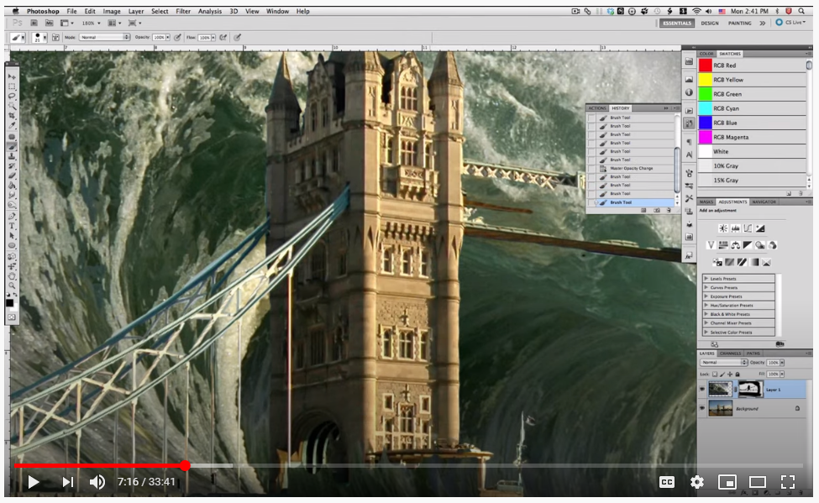
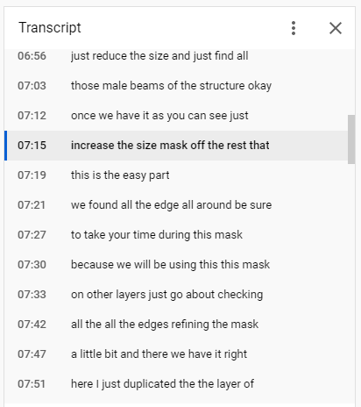
Data Collection
Data Collection
(Text + Video)
750 Pre-Labeled
Advanced & Beginner
Tutorials of Photoshop
Notes:
To investigate differentiable features we needed to find labeled tutorials. Even though a vast majority of tutorials don’t have a difficulty label but there are some tutorial repositories that accumulate labeled tutorials. We collected tutorials from those. Some of them are for example: Adobe, tutsplus etc. We collected 750 pre-labeled photoshop tutorials as our initial point of analysis. We chose photoshop as it is frequently studied in feature rich software research.
Our investigation was only restricted to text. So that means in case of video tutorials we took the transcript.

Slide 10
Investigate Differentiable Features
1. Length
2. Topics
3. Command Ratio
4. Word Repetition
5. Text Complexity
Notes:
After tutorial collection our next step was to summarize the raw text of the tutorials in a form which can be fed into the classifier. So, we investigated a bunch of features. Our objective was to find out some features which could possibly preserve the differentiable patterns among advanced and beginner tutorials. We ultimately defined 5 different features from the texts.
However, I will only talk about 2 of the important features today. Among our features length was pretty straightforward and we defined it as the number of words available in the tutorials. But determining the topics was complicated.

Slide 11
Feature: Topics
Tutorials’ topics have different difficulties [Lafreniere et al., 2013] [Wang et al., 2018]
How could we automatically determine what topics a tutorial covers?
How could we make the topics usable to the classifier?
Notes:
From the previous literature we found out tutorials’ topics have different difficulties.
So the next question is how could we automatically determine what topics a tutorial cover?
How could we make the topics usable to our classifier?

Slide 12
Topics – Our approach LDA
Topic 1:
scene
resize
composite
matte
Tutorials
[Blei et al., 2003]
Topic 2:
color
art
sketch
line
Topic Model
LDA
Topic 3:
animation
timeline
video
playback
 | Topic 1 | Topic 2 | Topic 3
 | 0.7 | 0.2 | 0.1
 | 0.1 | 0.6 | 0.3
Notes:
For this we used a topic modeling technique called LDA. So LDA takes our tutorials as inputs and generate some topics. However, the topics that LDA generates are just a collection of words that tend to occur together. These words may not have any meaning to the user. So, it becomes challenging to interpret those. I will unpack a little more about this during the system design. Now I will give a brief glimpse of how LDA represents tutorials.
LDA represents tutorials as a distribution of the topics and gives a probability score associated with it. Here each row represents a tutorial and the column represents the probability score for the topic. Ultimately this distribution of the topics that our classification model takes as features.

Slide 13
Classification Accuracy
Features
Length
Topics
Command Ratio
Word Repetition
Text Complexity
Error bars represent st. dev.
Classification
Random Forest
10-Fold Cross Validation
750 tutorials
210 tutorials
Notes:
Now that I have shown you what 2 of our features look like. Let’s see how our classifier performs after defining all the 5 features. After defining the features we built a machine learning classifier using Random Forest as our classification algorithm. We evaluated our classifiers performance using 10-fold cross validation approach.
While evaluating we found out the best performance that we could achieve while using all the features together. The best accuracy in classifying advanced vs beginner tutorials for Photoshop Dataset was 85%. We also did similar experimentation with fusion 360 tutorials. We extracted the same features from 210 Fusion 360 tutorials followed the same approach for classification and still got 81% of accuracy.
These results show that it is generally feasible to built a classifier that can take a tutorial and label it either beginner or advanced

Slide 14
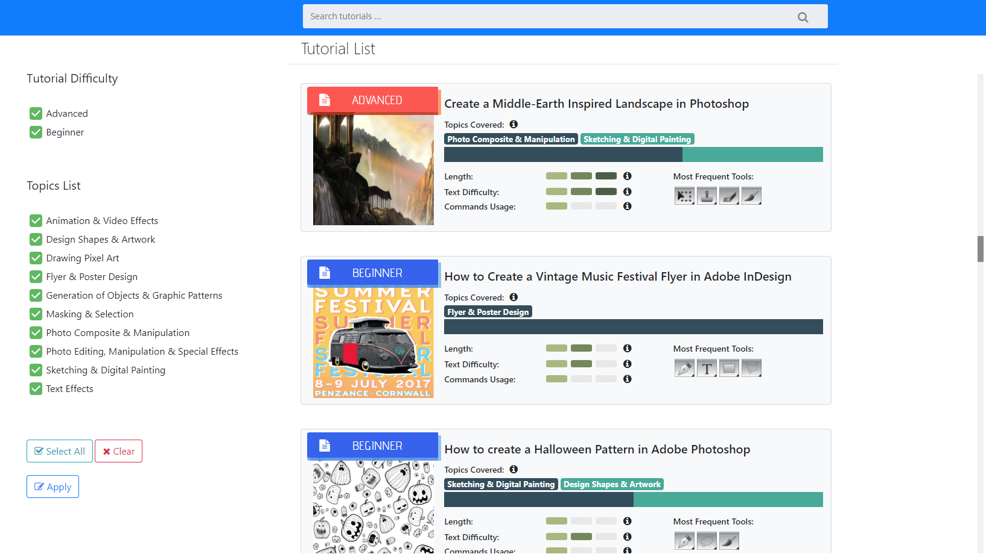
Tutorial Browsing System: TutVis
Notes:
Our next step was to build a system where we could provide users these information while they are looking at tutorials. We present our system TutVis which is a tutorial browsing system with some additional information to help users selecting tutorials. Now every tutorial has this automatically generated difficulty labels.
We also wanted to give users the information on some of the factors that went into the difficulty assessment. That’s what we are seeing on the right.
I am gonna talk about one of the factors today which is topic.

Slide 15
LDA Generated Topics
Notes:
Here is the result of our topic model. As, I presented earlier the topic model LDA represents tutorials as distribution of topics. As we see this information is not gonna be useful to the users. So, what we did here is we looked at bunch of tutorials under topics. Let’s say for example we wanted to know what topic-28 for the first tutorial is about. We qualitatively analyzed some tutorials under this topic to get a common theme. Based on the theme we manually assigned a meaningful name to this topic.

Slide 16
LDA Generated Topics
Notes:
So after the topic labeling procedure the previous distribution looks like this. Now we know the first tutorial is actually talking about sketching and the second one rather be making an animation.

Slide 17
TutVis: Tutorial browsing system
Tutorial Selection Study
Evaluate the utility of TutVis
Value of the interface components in selecting tutorials
Notes:
Now we would like to see if this information is valuable or not to the users. To investigate we designed a tutorial selection study. The purpose is to evaluate the utility of TutVis and also to see the value of the interface components in selecting tutorials.

Slide 18
Baseline
Tutorial Selection Study
Participants
Intermediate - TutDiff
12 participants
(8M, 4F)
Range of expertise (Novice-Expert)
Interface Conditions:
3 Interface conditions
TutVis
Study Design
Within subject
Notes:
For the study we recruited 12 participants having a range of expertise. Among which 8 were male and 4 were female. We gave participants 3 interface conditions.
The baseline condition did not have any of the features and difficulty labels.
The intermediate condition TutDiff only had the difficulty labels of the tutorials.
And finally TutVis had the difficulty labels as well as the features.
Our study design was within subject.

Slide 19
Tutorial Selection Study
URGENT
Task:
Select tutorials under certain scenarios [Dziubak et al., 2016] [Kong et al., 2012]
3 tasks per condition
Suppose you have a deadline and you want to complete a poster design for an advertisement quickly…
Notes:
The task of the participants during the study was to select tutorials under certain scenario. Scenarios are motivated from the findings of the previous research on different reasons that users search for tutorials online. The participants did 3 different scenarios per condition. One of the scenarios for example goes like Suppose you have a deadline and you want to complete a poster design for an advertisement. So it’s giving a sense of urgency. The participants were instructed to spend around 7-10 min in each selection task, so they did not require to complete any tutorial.

Slide 20
Tutorial Selection Study: Results
All participants preferred TutVis
Notes:
Now lets look at the study results. Today, I will present a few highlights, please take a look at our paper for more detailed results.
While asked about the subjective preference all of the participants ranked TutVis as their first prefererence. So it was clear that they needed the difficulty labels and the features.
From the post condition questionnaire participants reported that they were more confident during the tutorial selection while they were using tutVis.
We asked participants to think aloud and tracked paticipants eye gaze and after analyzing these we found out participants mostly used topics and difficulty labels during all the tasks. While during semi-structure interview it was clear that they were using the topics because these were giving them a preview of the tutorial and labels to filter out unwanted tutorials.

Slide 21
Tutorial Selection Study: Results
All participants preferred TutVis
Participants were more confident during tutorial selection while using TutVis (p < 0.05)
TutVis
TutDiff
Baseline
Notes:
From the post condition questionnaire participants reported that they were more confident during the tutorial selection while they were using tutVis. We also found a trend in tutorial selection confidence where Participants were more confident inTutVis than in TutDiff and they were more confident in TutDiff than in baseline.

Slide 22
Tutorial Selection Study: Results
All participants preferred TutVis
Participants were more confident during tutorial selection while using TutVis (p < 0.05)
Topics and difficulty labels were most heavily used components
Notes:
During tutorial selection tasks, we asked participants to think aloud and tracked participant's eye gaze and after analyzing these we found out participants mostly used topics and difficulty labels during all the tasks. While during semi-structure interview it was clear that they were using the topics because these were giving them a preview of the tutorial and labels to filter out unwanted tutorials.

Slide 23
Contributions
Identified differentiable features
Classified tutorials as advanced vs beginner
Designed and developed TutVis
Proof of concept evaluation
Notes:
Our contributions in this work are 4 fold.

Slide 24
Future Direction
Automate topic labeling
Recommender system
Applying to a different domain
Notes:
Now the question is what are some interesting direction for future works?
One could be during the topic labeling procedure we were manually analyzing topics to give them a meaningful name. It would be interesting to see if we could automate this process or if not may be we could use crowdsourcing.
There is a bunch of works looking at techniques to automatically detect users skill level. It would be interesting to see whether we could combined those techniques with our tutorial labeling process so that we can automatically recommend tutorials that are appropriate for users skill levels.
We applied our methodology to 2 of the feature-rich software. Future work should investigate this method in a completely different domain such as DIY home projects or “How to” tutorials for more physical skills.

Slide 25
An Automated Approach to Assessing an Application Tutorial’s Difficulty
Thank You
Presenter
Shahed Anzarus Sabab
sabab05@cs.umanitoba.ca
Shahed Anzarus Sabab¹, Adnan Khan¹, Parmit K. Chilana², Joanna McGrenere³, Andrea Bunt¹
 | ¹Department of Computer Science University of Manitoba | ²Department of Computing Science Simon Fraser University | ³Department of Computer Science University of British Columbia
Notes:
Thank you very much for your attention. I would be very happy to take questions.

