Slide 1
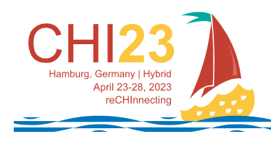
Co-Designing with Early Adolescents: Understanding Perceptions of and Design Considerations for Tech-Based Mediation Strategies that Promote Technology Disengagement
Ananta Chowdhury, Andrea Bunt University of Manitoba, Winnipeg, Manitoba, Canada
Notes:
Hello everyone. I am Ananta Chowdhury, a phd student from the University of Manitoba. I’ll be presenting our paper titled as Co-Designing with Early Adolescents: Understanding Perceptions of and Design Considerations for Tech-Based Mediation Strategies that Promote Technology Disengagement.

Slide 2
Excessive use of technology among children has become a growing concern
Notes:
Nowadays, children’s excessive use of technology has become a growing concern.
While using technology and digital media can offer benefits in terms of education and socialization,

Slide 3
Technology Overuse
Negative effects on social and cognitive development
Can lead to health issues
Can become an addiction
Icons are from flaticon.com
Notes:
excessive screen time can have negative effects on children's social and cognitive development
it can also lead to health issues.
And If not properly monitored and controlled, overuse of technology can become an addiction. So, the question is how to help children disengage from tech overuse?

Slide 4
Example Prior Work on Tech-Based Mediation Strategies
Joint activities with family (Kawas et al, 2021)
Planning device-based playtime (Hiniker et al, 2017)
Using augmented reality (Shin et al, 2020)
Icon is from flaticon.com
Notes:
To tackle this issue, many HCI researchers designed different child-oriented technologies, which include
joint activities with family members,
planning children’s device-based playtime.
and using augmented reality to influence behavioural change.
While there are many research works that aimed to help children limit their tech use, we were interested to see what happens

Slide 5
What if children could design their own solutions?
Notes:
if we could give children the ability to design their own solution? What could we learn about how they conceptualize this problem? and what types of solutions do they see as useful to solve this issue?

Slide 6
Contributions
Involved 21 children (ages 11-14) in co-design
Children’s perceptions regarding tech overuse
How they envision tech-mediated solutions
Icon is from flaticon.com
Notes:
To investigate these questions, we involved 21 children in the co-design of tech-based interventions.
And in our paper, we present Insights into children’s perceptions regarding the issue of tech overuse
And How they envision appropriate tech-mediated solutions to promote healthy tech use
Now let’s look at our study method

Slide 7
Study Method
Online Co-Design Study
21 Participants
Early Adolescents
(11-14 years)
Icons are from flaticon.com
Notes:
We conducted a multi-session co-design study. We ran the study at a point of time when people were still getting used to being back in person, we decided to hold the sessions online.
We focused our investigation on early adolescents. Because according to prior literature, they spend more time with technology than the other age groups. And they develop a sense of autonomy which often leads to parent-child conflicts regarding tech use.

Slide 8
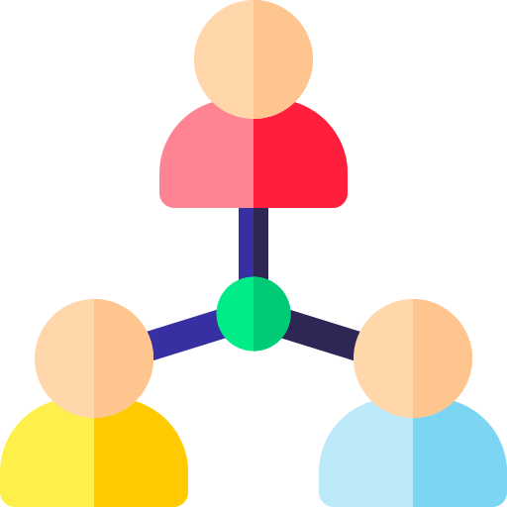
Co-Design Sessions
Group-Based
Session 1
Creating a Story
Session 2 Brainstorming and Mapping
Offline
Activity
Session 3
Generating a Final Solution
Icons are from flaticon.com
Notes:
We conducted the sessions in groups of 3, so we had 7 groups in total. And each group attended 3 online sessions.
In the first session, we asked participants to collaboratively create a story illustrating the problem of tech overuse.
In the 2nd session, we asked the participants to brainstorm ideas to solve this problem and map similar ideas together.
In between sessions 2 and 3 we asked them to sketch out their own solutions individually.
And Finally in the 3rd session, participants shared their solutions, and the groups worked together to sketch a final solution.
I acted as the facilitator in each session, and conducted focus group discussions to better understand participants’ design choices
Now I will briefly discuss findings from each of the sessions

Slide 9
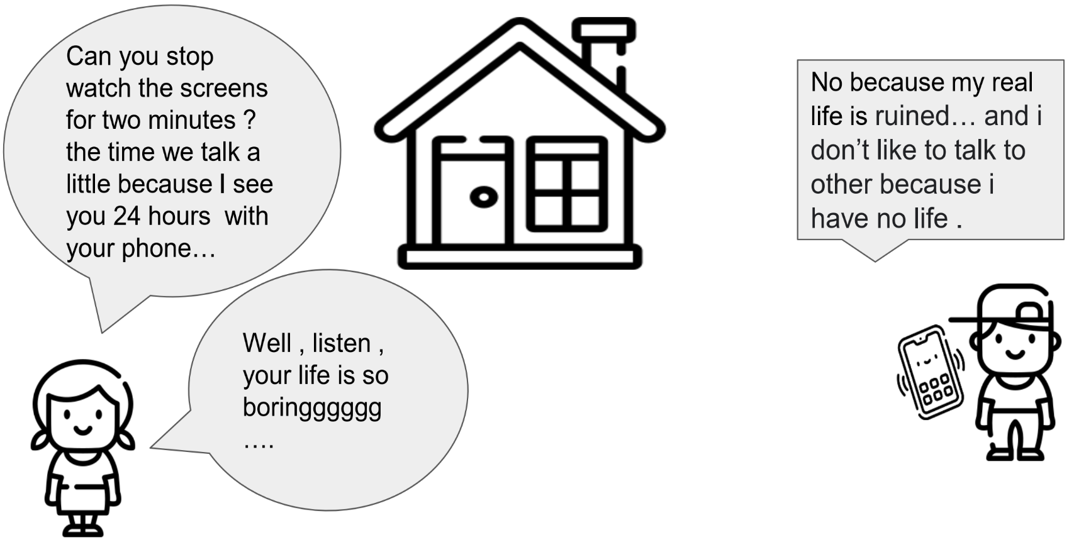
Stories Revealed Conceptualization of Tech Overuse
Demonstrated emotions regarding tech use and parental rules
Notes:
From the stories generated in the 1st session, we learned how participants conceptualized the problem of tech overuse
Through the stories, they tried to demonstrate different emotions related to tech use and parental rules.
Let’s see an example. Here, a friend is asking the main character of the story to stop using technology so that they can have a conversation. But the main character is not interested to engage in any conversation. He says, “my real life is ruined, and I don’t like to talk to others because I have no life.”.
After this story creation session,

Slide 10
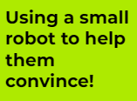
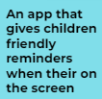
Example Ideas Generated During Brainstorming
Encouraging offline activities
Education
Awareness tools
Icons are from flaticon.com
Notes:
we had a brainstorming session, where the groups generated a lot of different ideas for solving this problem. In fact, we counted a total of 101 ideas across all the groups.
Those ideas included encouraging other offline activities to reduce screen time, like finding a new hobby and engaging in joint activities with friends and family. For example, this is a sticky note from the brainstorming session, where a group generated such an idea “Do some other activities to replace video games, do something they find interesting.
To educate early adolescents about the issue of tech overuse, our Participants talked about using a tech-based companion who would share motivational stories and negative consequences with them. One idea from the participants was to use a small robot to convince children to limit screentime.
They also talked about using different kinds of awareness tools., like an alarm, or a reminder, since early adolescents can often lose the track of time while using devices for entertainment. Here participants talked about designing an app that gives children friendly reminders to disengage.
Based on these ideas and their individual sketches, each group designed

Slide 11
Participant-Generated Solution
Notes:
one final solution to support their tech disengagement. Now let’s look at a couple of these solutions,
Here, participants designed a friendly robot who will educate them about the negative consequences of overusing technology. It will also remind them to disengage and encourage them to do other creative activities.

Slide 12
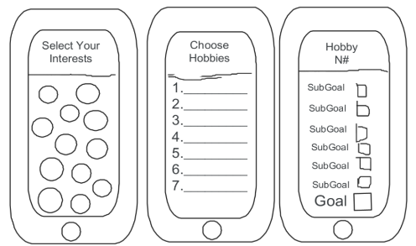
Participant-Generated Solution
Notes:
Here’s a solution from another group that took a very different approach. They sketched an app that will help early adolescents to find a new hobby. There are goals that they will complete jointly with their parents. And if they achieve a goal, they will receive rewards.

Slide 13
Identifying Key Design Factors
Final Design Solutions
Focus Group Discussions
Balancing Children’s Agency & Parental Involvement
Positive Reinforcement to Motivate Participation
Considering Children’s Emotions
Relatability and Novelty
Icons are from flaticon.com
Notes:
these final design solutions and the focus group discussions surrounding them helped us identified some interesting design factors.
In the paper we discuss four factors as being important, which are:
Balancing Children’s Agency & Parental Involvement
Positive Reinforcement to Motivate Participation
Considering Children’s Emotions
Relatability and Novelty
I am going to expand on the first two.

Slide 14
Balancing Children’s Agency & Parental Involvement
P9: I was thinking about planning their own time and tracking their own time. - 13-yr boy
P13: The parent will have to approve the activity so the child can’t just put an activity that they didn’t do to get more points. - 12-yr boy
Icon is from flaticon.com
Notes:
Due to the developing sense of autonomy, Our participants preferred less parental control and more independence. They discussed ways to control their own tech use, as P9 said, I was thinking about planning their own time and tracking their own time.
While participants wanted more autonomy in practicing tech disengagement, interestingly, most of them wanted to give some sort of control to their parents. For example, with any reward-based tech-mediation tool, parents might need to check whether the children actually completed their tasks before rewarding them. As P13 said, “The parent will have to approve the activity so the child can’t just put an activity that they didn’t do to get more points.”

Slide 15
Positive Reinforcement to Motivate Participation
P3: Give them creative tasks! Give reward points and say good things to encourage. 12-yr girl
P18: Maybe we make whatever they have to do, [part of] a game. So, make life into a game. Like do these things and get points. - 13-yr boy
Icon is from flaticon.com
Notes:
One design factor that we found in almost all our participant’s final solutions was the incorporation of positive reinforcement such as different rewards and words and gestures of encouragement. As P3 said, Give them creative tasks! Give reward points and say good things to encourage.
Participants also talked about incorporating gamification. For example, P18 said “Maybe we make whatever they have to do [part of] a game. So, make life into a game. Like do these things and get points”

Slide 16
Summary
Early adolescents’ views on tech disengagement
Key design factors for tech-based interventions
Icon is from flaticon.com
Notes:
To summarize our work, We conducted co-design sessions with early adolescents and
through this sessions we learned about Early adolescents’ views on tech disengagement.
And we Identified key design factors they found useful.
So, now that we have some ideas directly from early adolescents on how they might design tech-based mediation strategies and what they consider to be important
what are some next steps for the future?

Slide 17
Discussion & Future Work
Exploring the design space
Personalizing tech-based interventions
Parents’ reactions towards the solutions
Deployments
Icon is from flaticon.com
Notes:
One interesting next step is to explore this design space further. For example, we talked about how participants wanted a balance between children’ s agency and parental involvement. But what is the right balance? What are the key considerations there?
Then We saw such a range of different sorts of solutions that motivates the question – should we consider individual characteristics of children while designing these tools to allow personalization?
Then, In our study we focused on early adolescents’ perspectives. In the future, it might be interesting to explore how parents respond to these child-generated design factors and ideas
And ultimately, we need to deploy these solutions to investigate how early adolescents and their families adopt them both in the short term and in the long term. One interesting idea is to see whether adoption patterns might change if children know that the solution was designed by their peers

Slide 18
Co-Designing with Early Adolescents: Understanding Perceptions of and Design Considerations for Tech-Based Mediation Strategies that Promote Technology Disengagement
Ananta Chowdhury, Andrea Bunt University of Manitoba, Winnipeg, Manitoba, Canada
Notes:
So that is all from me. Thank you for listening! Now I’ll be happy to answer any questions you might have.

Slide 19
Co-Designing with Early Adolescents: Understanding Perceptions of and Design Considerations for Tech-Based Mediation Strategies that Promote Technology Disengagement
Ananta Chowdhury, Andrea Bunt University of Manitoba, Winnipeg, Manitoba, Canada
Notes:
So that Thank you for watching!

Slide 20
Co-Designing with Early Adolescents: Understanding Perceptions of and Design Considerations for Tech-Based Mediation Strategies that Promote Technology Disengagement
Ananta Chowdhury, Andrea Bunt University of Manitoba, Winnipeg, Manitoba, Canada
Notes:
Hello everyone. I am Ananta Chowdhury, a phd student from the University of Manitoba. I’ll be presenting our paper titled as Co-Designing with Early Adolescents: Understanding Perceptions of and Design Considerations for Tech-Based Mediation Strategies that Promote Technology Disengagement.

Slide 21
Discussion
Participants were actively engaged in designing solutions
Findings indicate which design elements might appeal more to early adolescents
Icon is from flaticon.com
Notes:
Overall, from our findings, we can say that The participants were actively engaged in designing solutions for their tech disengagement. The co-design activities seemed to make the sessions productive.
Now the question is, did they generate solutions that are very different from the existing ones? Not really. For example, incorporating gamification and parental involvement, are also suggested in prior research.
However, our findings give a sense of what kind of design elements might appeal more to the early adolescents and why they find those important
Sum
we involved early adolescents in the co-design of tech-based interventions to limit their tech overuse
We obtained an understanding of their views on tech disengagement
And identified the key design factors we need to consider for creating child-centric tech-based interventions
FW
And investigate how to manage these factors that were considered important. Is this child-specific? Family-specific?
Looking into different personality types, tech usage levels, and family dynamics might provide more insights in this regard.
early adolescents can design tech mediation tools. But what about the early adolescents who might use these tools? how might they respond to these tools if they knew that these were actually designed by someone of their age, instead of an adult designer?
From our data, we’ve seen that the groups came up with very different solutions. This indicates a need for personalizing tech-based interventions, since one solution might not work for all early adolescents, in a Future work we should explore how we can personalize these tools to cater to different personality types, tech usage levels, and family dynamics.
And finally, Longitudinal studies are also needed to investigate how different early adolescents apply these tech-based mediation strategies in their daily lives to promote a healthy tech use.

Slide 22
Our Approach
Gain direct insights from children
Target age group: Early Adolescents
Co-design tech-based interventions
Icons are from flaticon.com
Notes:
We augment this design space by gaining direct insights from children
The target age range for our investigation is early adolescence
And our approach involves early adolescents in the co-design of tech-based interventions to support their tech disengagement.

Slide 23
Discussion
Participants used the main character of their story as a persona
It was unclear whether they were speaking from their own experiences or making assumptions about the character
They might have sometimes been hesitant to fully express their opinions to avoid appearing as a “tech addict”
Icon is from flaticon.com
Notes:
In the co-design sessions, we observed that participants used the main character of their story as a persona while thinking about design solutions.
When analyzing the data, It was sometimes unclear whether they were speaking from their own experiences or making assumptions about the character
Furthermore, there is a possibility that participants sometimes were hesitant to fully express their opinions to avoid appearing as a “tech addict”.

Slide 24
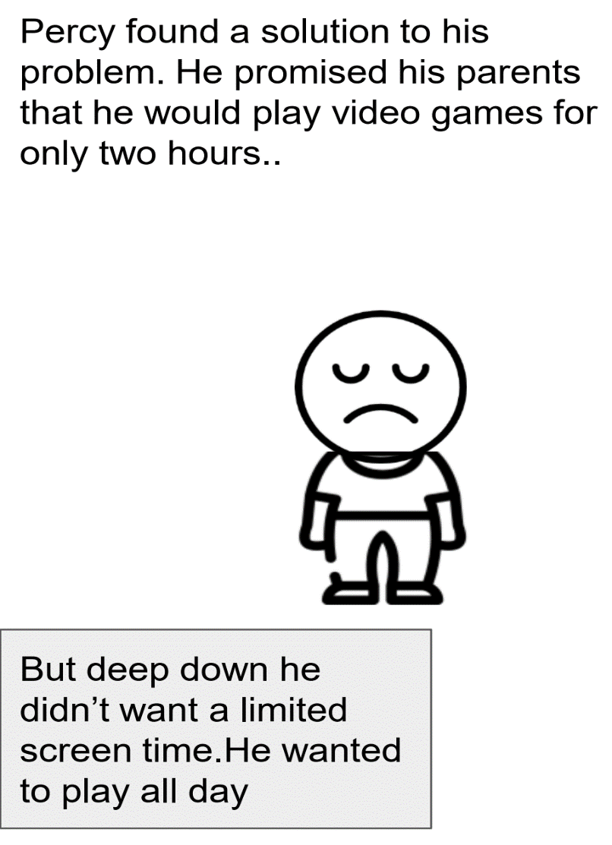
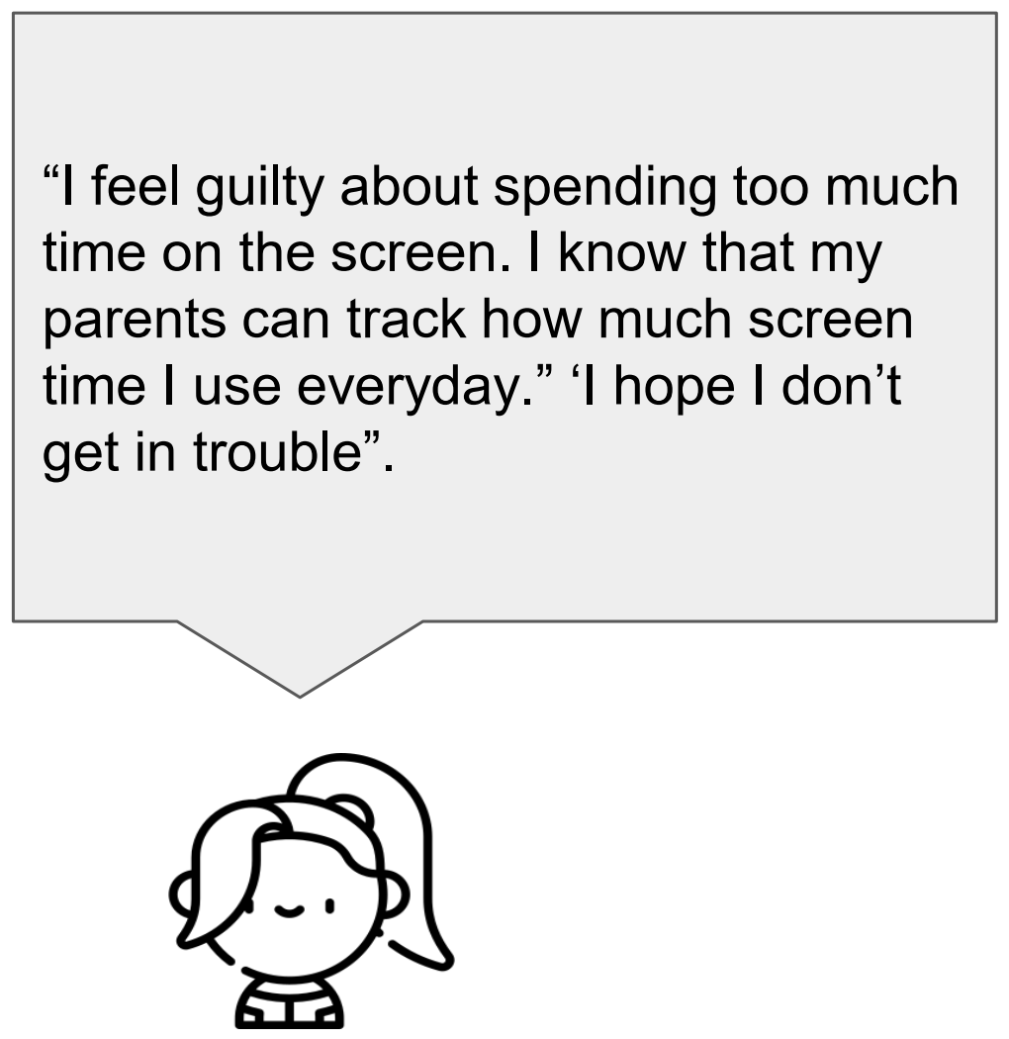
Findings: Engagement in Co-Design Activities
Story creation & focus group interviews helped understand how participants conceptualized the problem of tech overuse
Icons are from flaticon.com
Notes:
Story creation & focus group interviews helped us understand how participants conceptualized the problem of tech overuse
While creating the story, Participants discussed different examples of technology addiction and its consequences. For example, in this story, the main character is suffering from depression and avoiding socializing with others.
Participants also tried to demonstrate different emotions related to tech use and parental rules through their stories. For example, here the main character is feeling guilty about not following their parents’ rules
In this story, even after agreeing to follow the rules, the main character kept feeling the urge to break the rules and enjoy unlimited play time. So, even after realizing the negative consequences of tech overuse, participants felt that children wita severe addiction might have difficulties restricting their tech use.
We used the focus group interviews to find
The discussion that occurred as they were generating it
These solutions and the interviews around them helped us

Slide 25
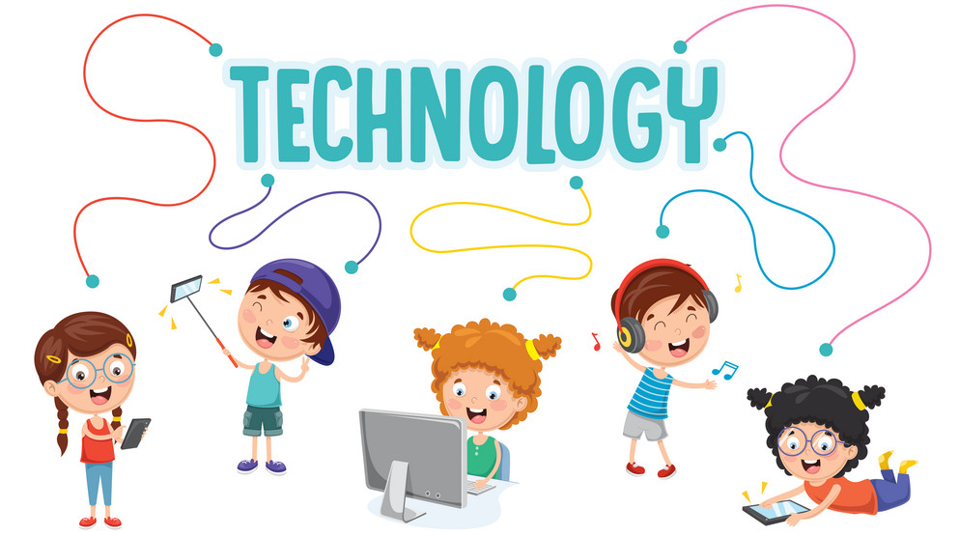
Children’s excessive use of technology has become a growing concern
Notes:
We know that, With the availability of technology in our surroundings, nowadays, children are spending more and more time with different gadgets like smartphones, tablets, computers, gaming consoles etc. And with the easy access to the internet, these devices enable them to explore unlimited sources of entertainment. Though digital media can offer many benefits to children in terms of education or socialization, too much exposure to these devices can have many negative effects.

Slide 26
Motivation
Children’s overuse of technology can have many negative effects
Parents apply various mediation strategies
Restrictive mediation, Active mediation, Co-using the media, Supervision and Monitoring
www.theodysseyonline.com/technology-affected-generation
Icon is from flaticon.com
Notes:
According to prior research, excessive screen time can have a negative impact on children’s social and cognitive development, can cause sleep disturbances, and can also create health issues [34]. If not monitored and controlled properly, the overuse of digital devices can turn into an addiction.
Therefore, children’s increasing use of technology has become an alarming issue for the parents, and naturally, they attempt to control their children’s media usage by applying various mediation strategies.
These strategies include

Slide 27
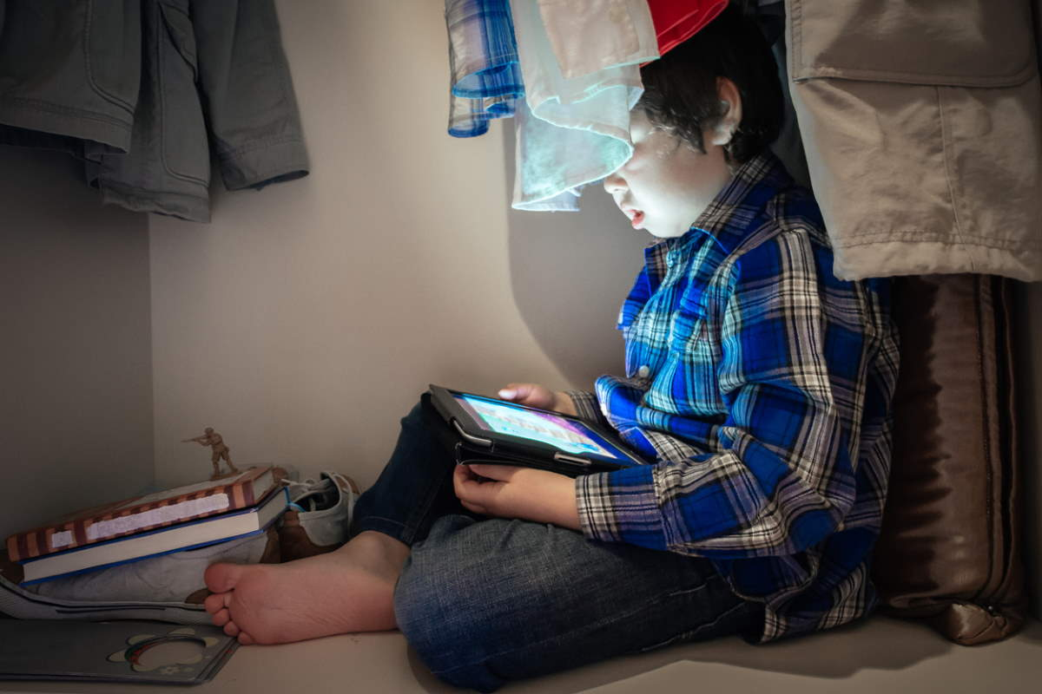
Motivation
Despite applying various measures, parents often fail to control their children’s tech usage
Research has explored children’s attitudes towards parental mediation
Children often escape from the rules
www.pennmedicine.org/the-cycle-of-addiction
Icon is from flaticon.com
Notes:
However, Despite applying various measures, parents often fail to control their children’s tech usage.
Studies were conducted to understand children’s attitudes towards these parental mediations.
And these studies report that children often find their ways to escape from the rules, which include hiding the devices, continue to play beyond the specified time, ignoring the surroundings to focus on the device, etc. [1,30].

Slide 28
Attitudes towards Tech-based Mediation
Tech-mediated transitions are preferred by some parents
Others find it ineffective in limiting children’s tech use
Children feel these tools overlook their needs and expectations
play.google.com/store/apps/
Icon is from flaticon.com
Notes:
According to research, some parents find that tech-mediated transition is more effective than a parent-mediated transition to disengage children from technology.
On the other hand, many parents report that these interventions are not useful, since children can easily navigate around these tools.
Moreover, a prior research reported that most of these tools are focused on the parents and children feel that these tools overlook their needs and expectations. It can often lead to conflict between the children and their parents about children’s media use.

Slide 29
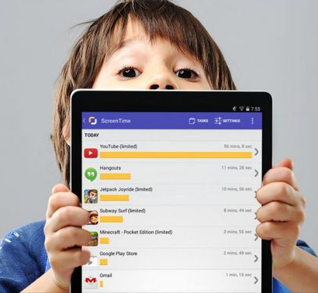
Prior Work to Help Children Follow the Rules
Joint activities with family
Planning their device-based playtime
Using augmented reality
However, no prior work has involved children in the design process of these interventions
www.geekersmagazine.com/tools-limiting-kids-screen-time/
Understand children’s perceptions about self-disengagement from technology
Icon is from flaticon.com
Notes:
Since the restrictive interventions are not always effective, To help children follow the rules and disengage from technology comfortably, many HCI researchers focused on developing different child-oriented technologies.
For example, they attempted to limit children’s tech usage by involving them in joint activities with their family [24,25], helping them plan their device-based playtime [20], using augmented reality [16] to influence behavioral change, etc.
However, to our knowledge, no prior work has involved children in the design process of these interventions. We know that to design appropriate child-oriented technology, it is important to understand children’s needs and perceptions and according to prior work co-designing with children is a great way to achieve that.
Therefore, in this research, we want to include children as design partners, and through this process, I believe, we will be able to gain interesting insights into children’s perceptions about self-disengagement from technology

Slide 30
Technology Overuse
Can negatively impact
Can lead to
Social Development
Cognitive Development
Health Issues
Addiction
Notes:
excessive screen time can have negative effects on children's social and cognitive development and can lead to health issues. If not properly monitored and controlled, overuse of technology can become an addictio

