Slide 1
Data-Centric Explanations: Explaining Training Data of Machine Learning Systems to Promote Transparency
Ariful Islam Anik, Andrea Bunt {aianik, bunt}@cs.umanitoba.ca
ACM CHI Conference on Human Factors in Computing Systems – May 2021
Notes:
=

Slide 2
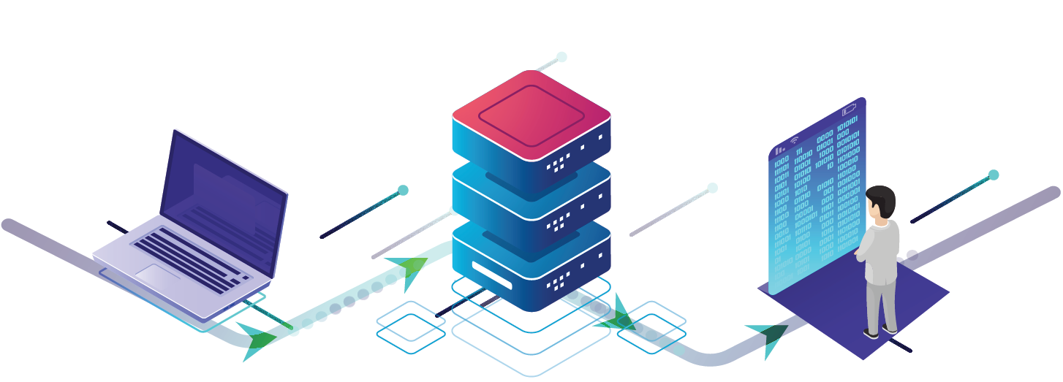
not accurate
not representative
machine learning systems
training data
data-driven systems

Slide 3
training data
presenting training dataset information
study the impact on perceptions of ML systems

Slide 4
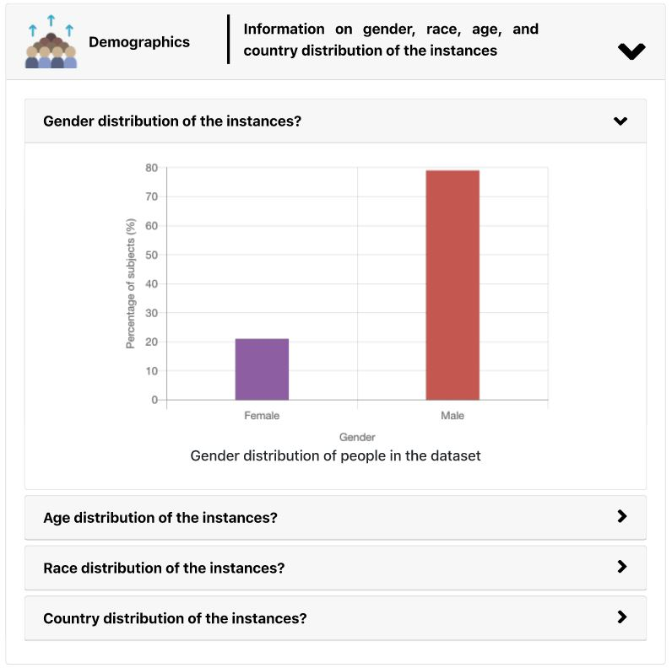
data-centric explanations: communicating training dataset information
4
4

Slide 5
study
impact on end-users’ trust and fairness perceptions
9 experts
8 intermediate
10 beginners
data-centric explanations from example systems
27 participants
data collection
5

Slide 6
findings
positive impact on trust and fairness perceptions
“I actually trust [the systems] more now that I have seen [the explanations].”

Slide 7
findings
positive impact on trust and fairness perceptions
“ […] I can see that more than 90% are male, so I can conclude that the results could be more reliable to men than women.”
demographics help to identify biases in the data

Slide 8
are machine learning experts underestimating the capabilities of end-users?
“I think if a user does not have any machine learning background or CS background, they will find it hard at first.”

Slide 9
contributions
data-centric explanations

Slide 10
Data-Centric Explanations: Explaining Training Data of Machine Learning Systems to Promote Transparency
Ariful Islam Anik, Andrea Bunt {aianik, bunt}@cs.umanitoba.ca
ACM CHI Conference on Human Factors in Computing Systems – May 2021

