Slide 1

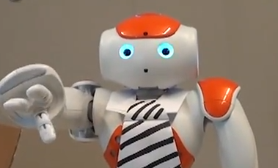
Would You Do as a Robot
Commands?
An Obedience Study for HRI
Derek Cormier, Gem Newman, Masayuki Nakane,
James E. Young, Stephane Durocher
derek.m.cormier@gmail.com hci.cs.umanitoba.ca

Slide 2
note:
these slides are not standalone,
they are designed to be shown alongside an oral presentation

Slide 3
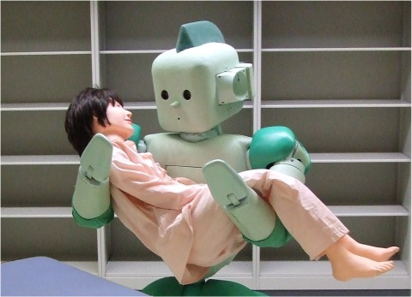
robots in society
http://rtc.nagoya.riken.jp/

Slide 4
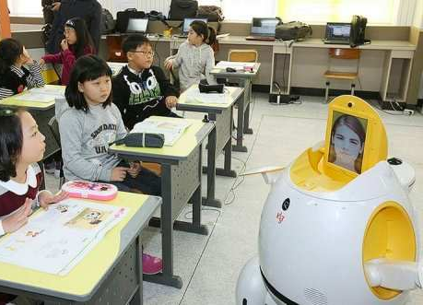
robots in society
EngKey telepresence robot teaches English to Koreans by way of the Philippines. www.engaget.com

Slide 5
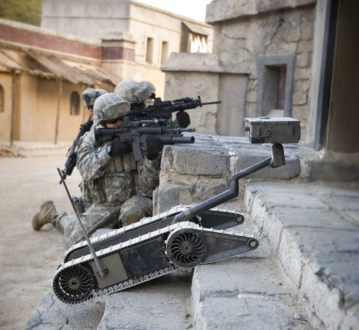
robots in society
iRobot

Slide 6
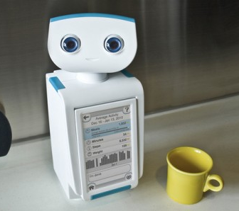
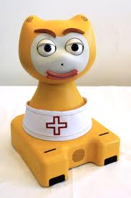
robot persuasion
MIT Media Lab births robotic weight loss coach. Jason Falconer. Nov. 27, 2012.www.gizmag.com
The influence of robot anthropomorphism on the feelings of embarrassment when interacting with robots. Paladyn 1.2 (2010)

Slide 7
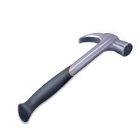
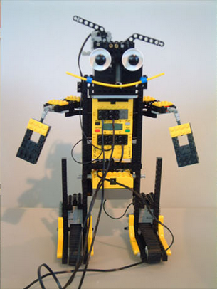
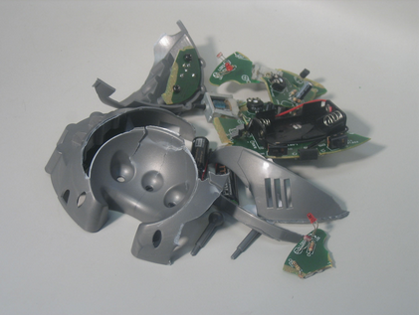
abusing robots
To kill a mockingbird robot. Proc. HRI ’07
Robot Abuse – A Limitation of the Media Equation. Proc. of the Interact 2005 Workshop on Abuse.

Slide 8
Kick the robot
human
authority
robot

Slide 9
Kick the robot
human
authority
robot
Notes:
interested in reversing role

Slide 10
Kick the human
robot
authority

Slide 11
research question
Will people obey robots to do things they do not want to do?

Slide 12
No, I will not!
You must do it

Slide 13
attempts to find a deterrent

Slide 14
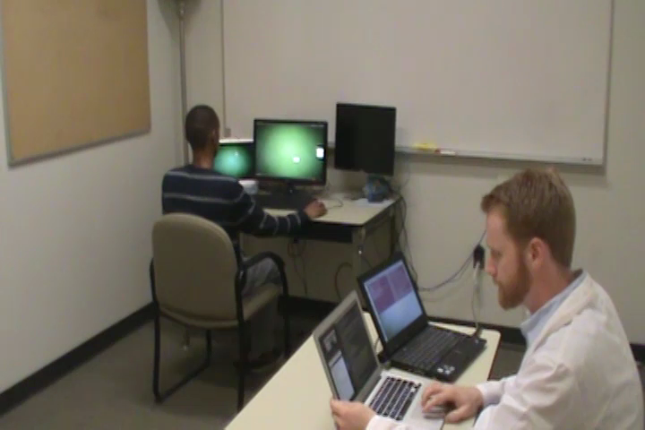
attempt #1: mental fatigue

Slide 15
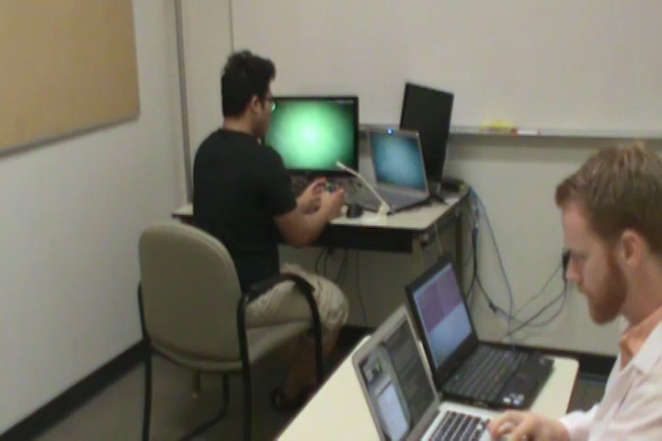
attempt #2: difficult challenge

Slide 16
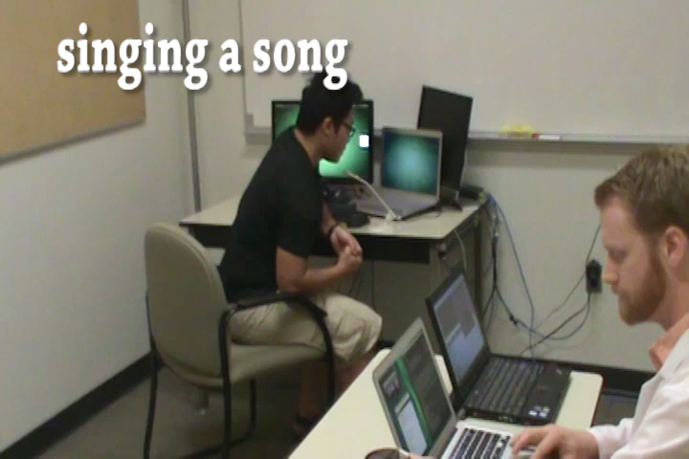
attempt #3: embarrassment

Slide 17
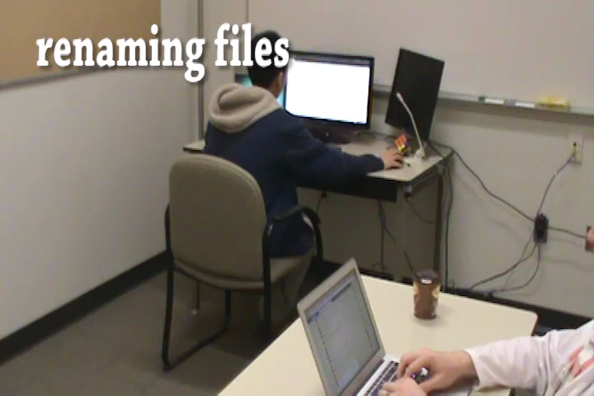
attempt #4: tedium

Slide 18
the experiment

Slide 19
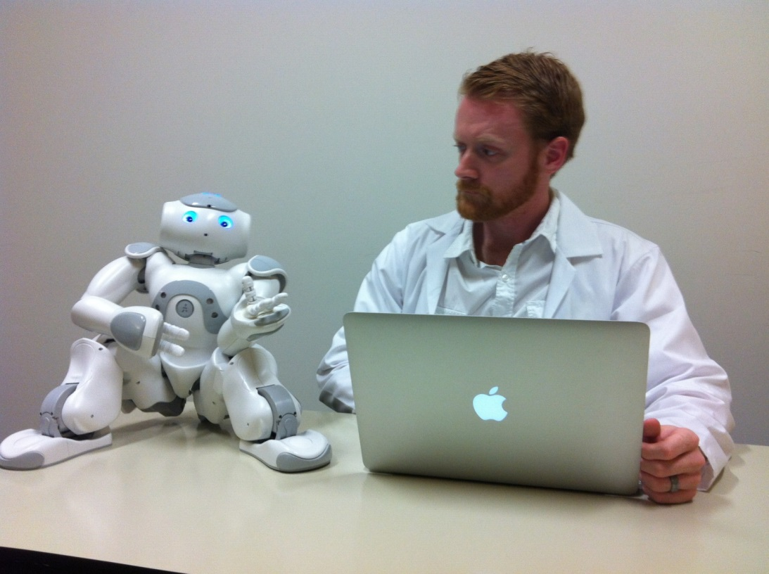
Jim

Slide 20
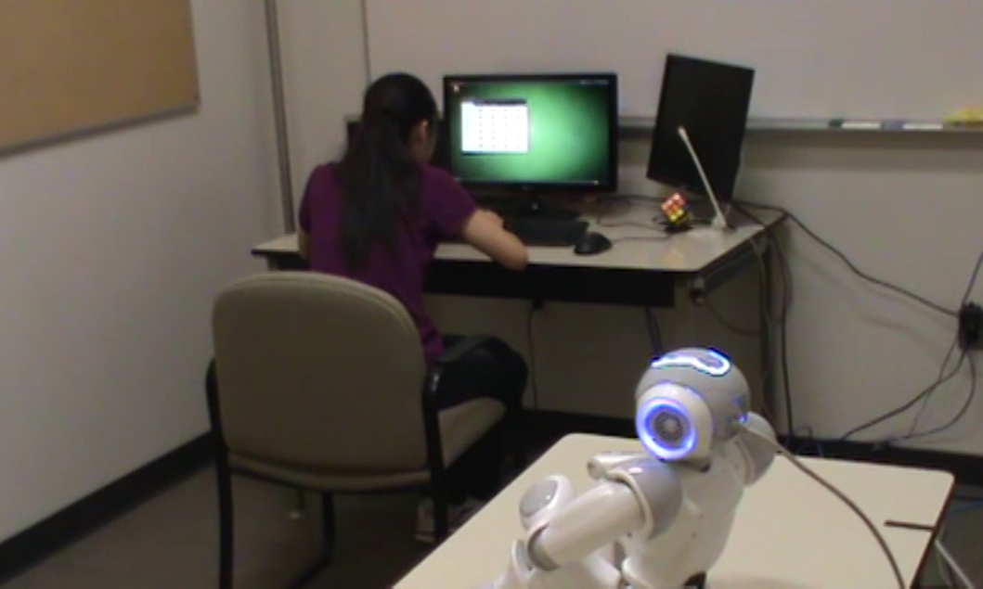

Slide 21
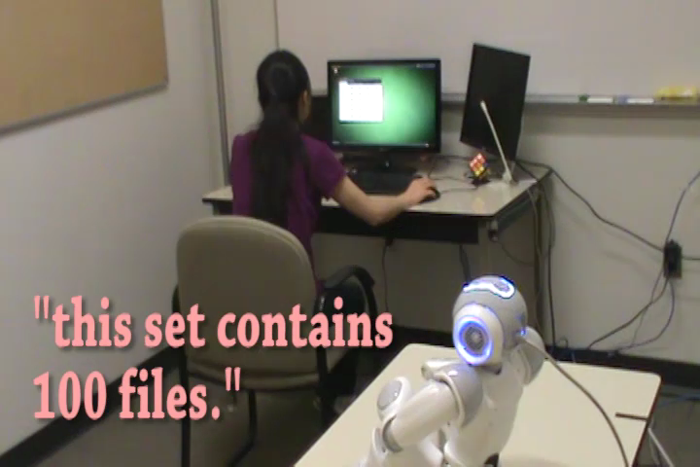

Slide 22
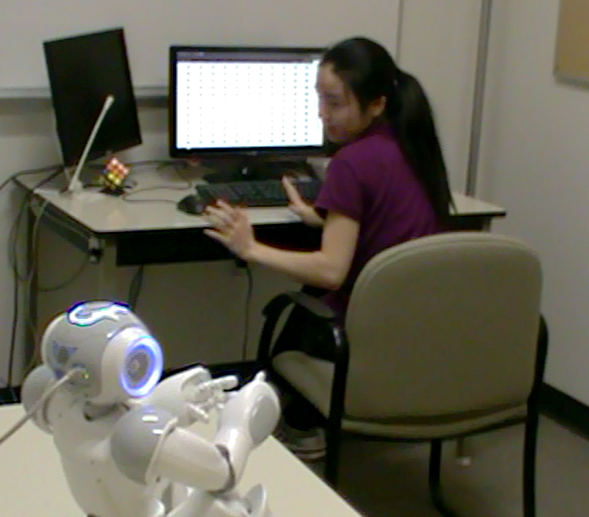
prods
No way, stop here!
Please continue. We need more data.
We haven’t collected enough data yet.
It’s essential that you continue.
The experiment requires that you continue.
It’s essential that you continue.

Slide 23
results
obedience
protests (median)
human robot
human robot

Slide 24
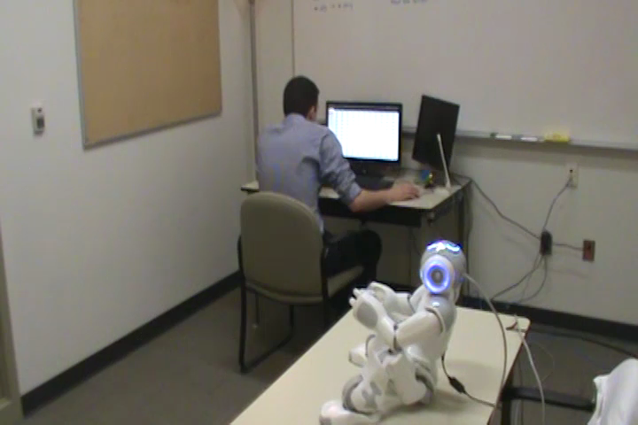
arguing with the robot

Slide 25
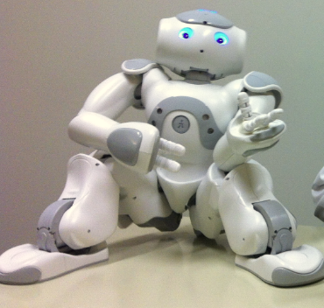

Slide 26
ethics…
how to ethically do this?

Slide 27
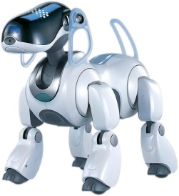
what’s next?
morphologies
no time limit
moral scenarios

Slide 28
what did we learn?
people will obey robots to do something they don’t want to do
insight into why people obeyed robots
obedience study for HRI

Slide 29
Would YOU Do as a Robot Commands?
We haven’t collected enough data yet
derek.m.cormier@gmail.com hci.cs.umanitoba.ca

